Slide 1
SKA Korea Industry Working Group
SKA Korea Industry Discussion Group
Bong Won Sohn (KASI)

Slide 2
Looking for possible industry partners in Korea
learnt from KVN project, EU Framework programs and from industry activities of other countries
Possible Korean industry contributions:
Antenna production
Power generation & management (SmartGrid)
Multi-layer PCB production
Cloud computing
need more exploration
SKA Korea IWG kick-off meeting in May

Slide 3
IWG kick-off meeting
On 30th May 2011
Introductions
SKA introduction (J. S. Kim, KASI)
SKA Industry participation (B. W. Sohn, KASI)
Industry talks
Small-scale re-generable energy management system
J. H. Kim (KEPCO KDN)
HighGain Antenna
S. P. Kim (HighGain)
eMediaTrack SKA cloud computing
R. Newman, Oxford U./eMediaTrack
PCB manufacturers in Korea
J. W. Yeom (KASI)
Discussion - Next steps

Slide 4
Jung T.H.
Specifications
First VLBI facility in Korea
First dedicated mm-VLBI network
First simultaneous multi-frequency receiving system @ 22/43/86/129GHz
Three 21m antennas
Fast slewing speed : 3 deg/sec (AZ/EL)
High surface accuracy ~ panel < 65 micron ~ total < 150 micron
High pointing accuracy ~ 4 arcsecond in RMS
High aperture efficiency ~ 52% @100GHz

Slide 5
Antenna Pointing accuracy (arcsec)
Jung T.H.
Pointing Accuracy & Aperture Efficiencies
Pointing Accuracy
Aperture Efficiency
Lee et al.(2011)

Slide 6
Antenna Pointing accuracy (arcsec)
Jung T.H.
Pointing Accuracy & Aperture Efficiencies
Aperture Efficiency
Lee et al.(2011)

Slide 7
Antenna construction
High Gain Antenna
High Gain Antenna Co., Ltd
Antenna & Communication System Specialized
High Gain Telecom
Repeater & RF module Specialized
Kuk dong Telecom
Radar Specialized
Total Solution on
RF, Wireless Communications

Slide 8
Cloud computing
SKA memo 134 (Newman and Tseng)
Oxford U., eMediaTrack

Slide 9
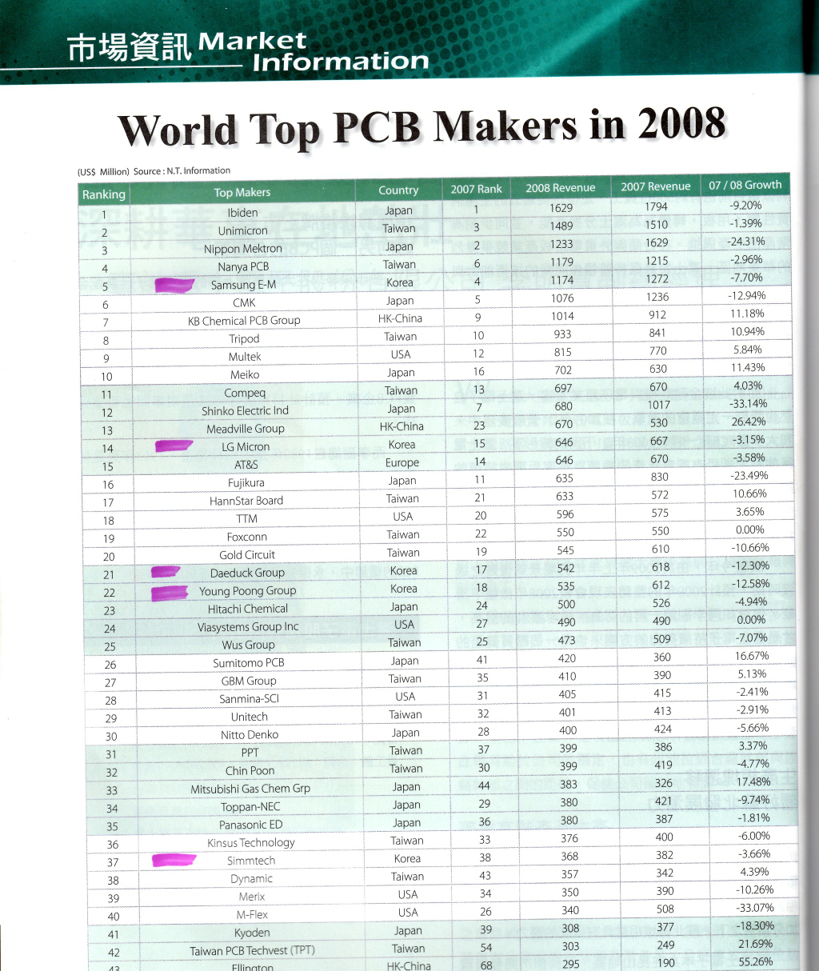
J. Yeom
Printed Circuit Board manufacturers’ ranking
33 out of 40 top manufacturers are from EA region
Including
Samsung E-M (HDI사업부)
LG Micron (이노텍)
Daeduk Group (대덕그룹)
- 대덕전자
- 대덕GDS
- 이수페타시스
Young Poong Group (영풍그룹)
Simtech (심텍)
<NT Information (Japan), 2008>

Slide 10
Looking for possible industry partners
learnt from KVN project, EU Framework programs and from industry activities of other countries
Antenna production (High Gain)
Power generation & management (Next talk)
Multi-layer PCB manufacturers
Cloud computing (eMediaTrack)
more exploration and discussion

Slide 11
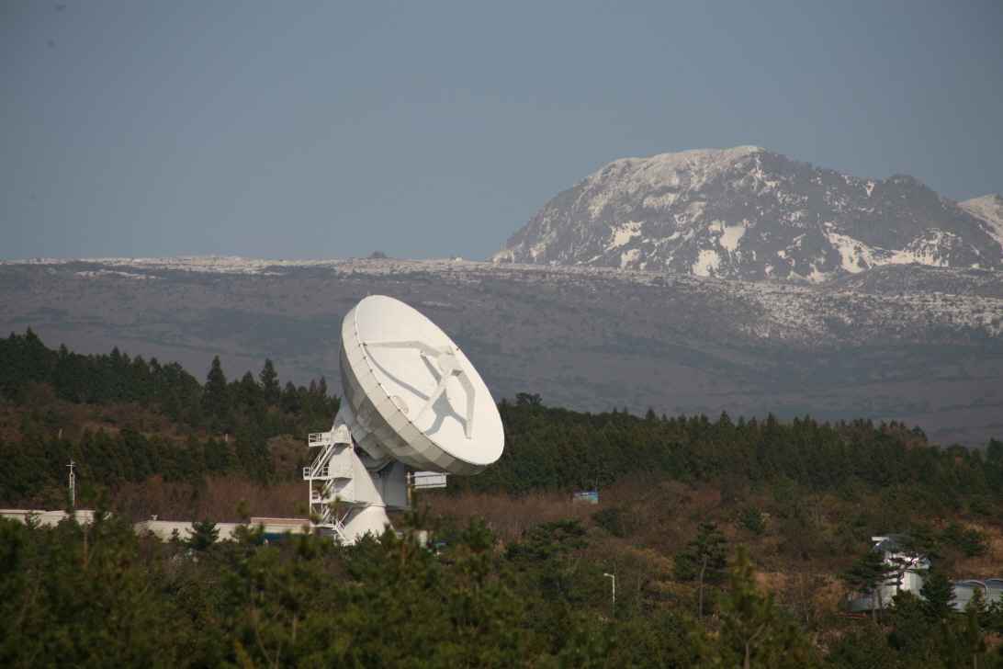
new 7 wonders of nature
KVN Tamna, Jeju Island
Thank you!

Slide 12
Backup slides

Slide 13
High Gain Antenna (since 1970)
Recent activities
r
February | 1999 | The Citation received from the Korea Industrial Technology Association for Excellent Technical Management
August | 2000 | Granted license for Installations of IT Facilities and Qualified as a Military Service Exemption Industry for the Employees.
May | 2004~2008 | Supplied three 21m (diameters) Radio Telescope Antennas to Korea Science & Astronomy Institute for the Korean space & radio observation network
January | 2007 | Obtained TL 900 Certificate from TÜV - Rheinland, Germany and KMA-QA, KOREA.
November | 2007 | Awarded the prize of State of Art Radio Broadcasting Technology from the Ministry of Information and Communications (No. 334)
JUNE | 2009 | Obtained ISO 14001 Certificate from TÜV - Rheinland, Germany

Slide 14
❑ 대기업(삼성, LG, 대덕전자)
자사 PCB 생산에 특화
소품종, 대량 생산에 초점
중위권(대덕 GDS, 이수페타시스, 영풍, 심텍)
휴대폰, LCD 등 연성(Flexible) PCB 생산에 특화
저 유전율(Permittivity) 등 물성 PCB 제작에 취약
Uniboard 양산 조건
고 사양 High-Speed PCB (High Tg, 저 유전율, Loss tangent, u-via)
2,000-3,000개의 비교적 소량 생산
다품종, 소량 생산에 초점

Slide 15
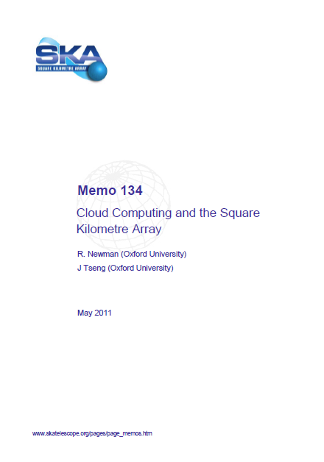

Slide 16
