Slide 1

Science with The Square Kilometre Array
Joseph Lazio
Project Scientist, SKA Program Development Office
&
Jet Propulsion Laboratory, California Institute of Technology
© 2011 California Institute of Technology. Government sponsorship acknowledged.

Slide 2
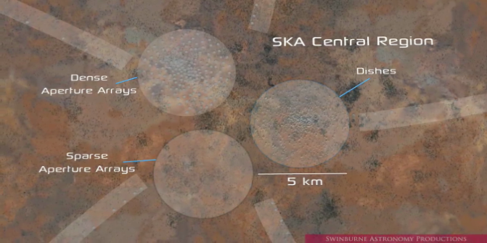
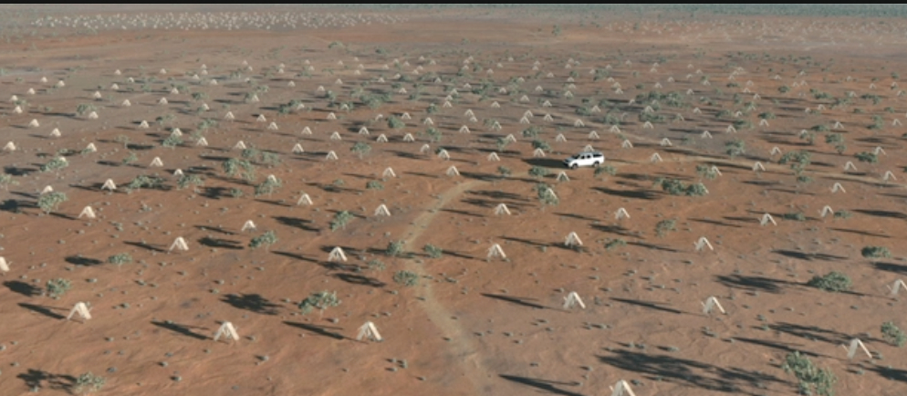
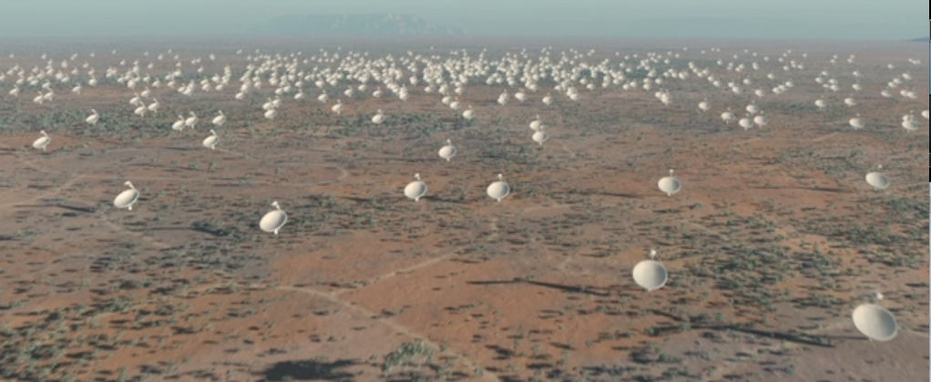
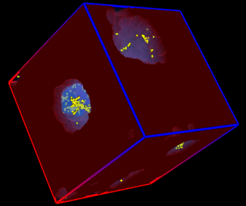
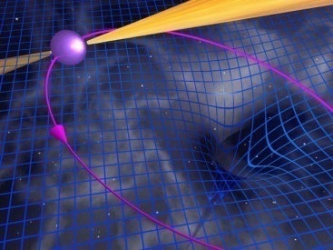
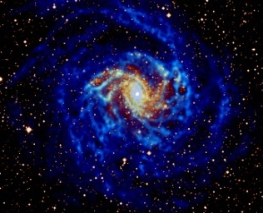
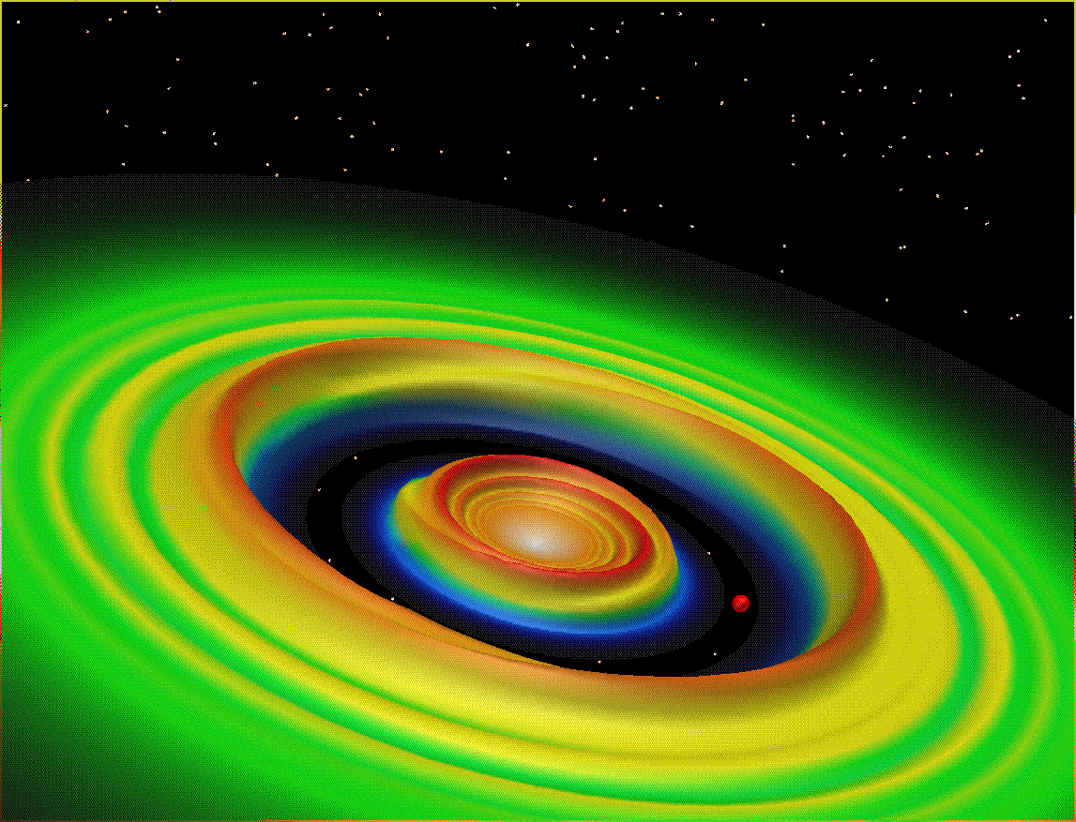
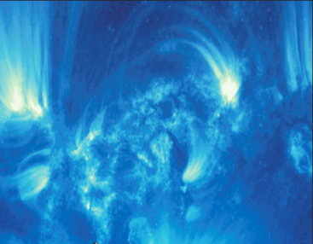
Square Kilometre Array
The Global Radio Wavelength Observatory
Originally: “Hydrogen telescope”
  Detect H I 21-cm emission from Milky Way-like galaxy at z ~ 1
SKA science much broader
  Multi-wavelength, multi-messenger
On-going technical development
  Cyber-infrastructure and “big data”
International involvement

Slide 3
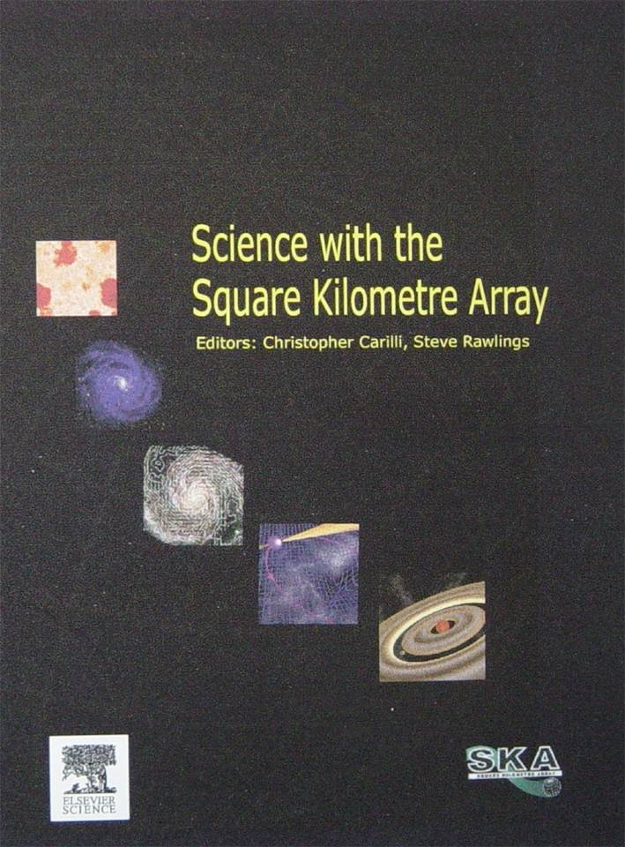
SKA Key Science
International working group
Strong-field Tests of Gravity with Pulsars and Black Holes
Galaxy Evolution, Cosmology, & Dark Energy
Emerging from the Dark Ages and the Epoch of Reionization
The Cradle of Life & Astrobiology
The Origin and Evolution of Cosmic Magnetism
With design philosophy of Exploration of the Unknown
Science with the Square Kilometre Array (2004, eds. Carilli & Rawlings, New Astron. Rev., 48)

Slide 4

21st Century Astrophysics
20th Century: We discovered our place in the Universe.
21st Century: We understand the Universe we inhabit.
Cosmology & Fundamental Physics
Gravity
  Can we observe strong gravity in action?
  What is dark matter and dark energy? (dark energy and BAOs with H I galaxies)
Magnetism
Strong force
  Nuclear equation of state
Galaxies Across Cosmic Time, The Galactic Neighborhood, Stellar and Planetary Formation
Galaxies and the Universe
  How did the Universe emerge from its Dark Ages?
  How did the structure of the cosmic web evolve?
  Where are most of the metals throughout cosmic time?
  How were galaxies assembled?
Stars, Planets, and Life
  How do planetary systems form and evolve?
  What is the life-cycle of the interstellar medium and stars? (biomolecules)
  Is there evidence for life on exoplanets? (SETI)
Notes:
These questions are taken straight from the European Astronet report. The point to make is that the SKA Science Case is well aligned with major national and regional strategic planning.

Slide 5
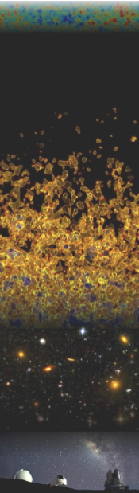
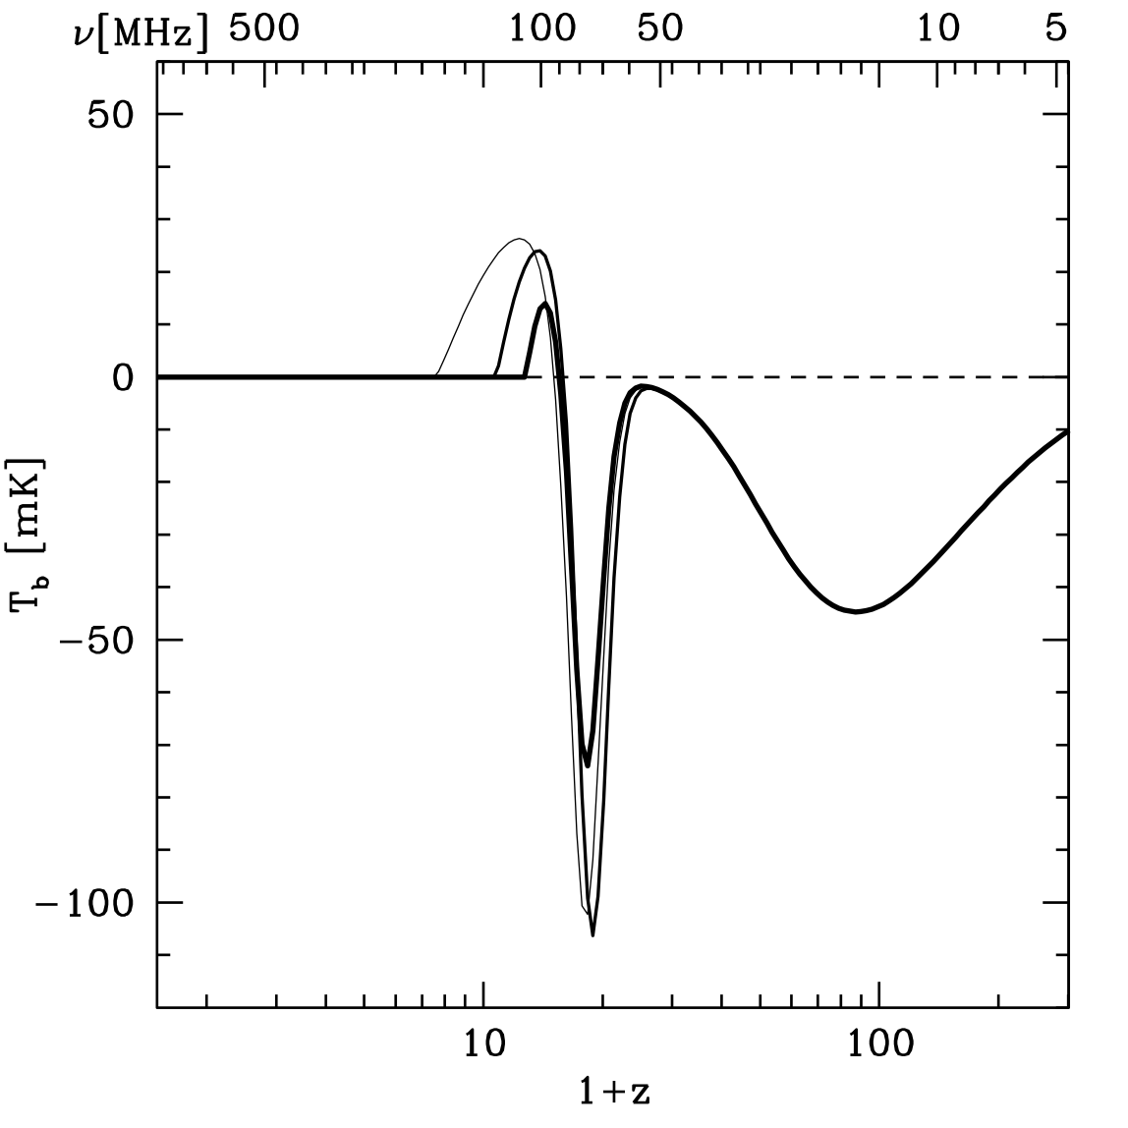
Evolution of the Universe
H I brightness temperature signal (w.r.t. CMB)
X-ray heating, EoR
First Stars
Dark Ages
SKA
space?
(Pritchard & Loeb 2008)
Notes:
Basic overview of the possible H I signals from the Dark Ages through the EoR.

Slide 6
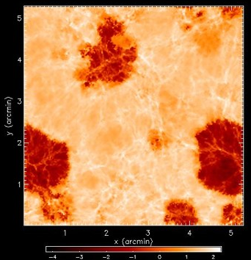
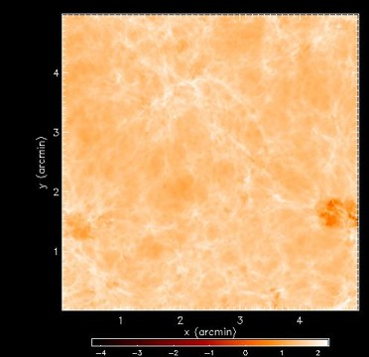
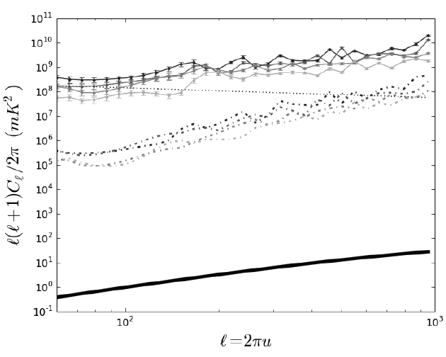
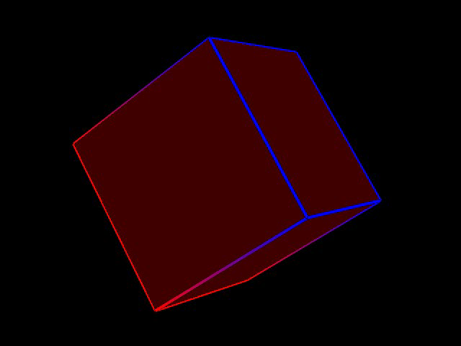
Evolution of the Universe
Epoch of Reionization
z = 9.8
z = 12.1
EDGES
(Bowman et al. 2008)
PAPER
SKA objective: Image the IGM transition in the H I (21-cm) line
data
Galactic synchrotron
EoR signal
noise
Furlanetto et al.; Gnedin
Parsons et al. 2009; arXiv:0904.2334
Notes:
Left panel illustrates what is being done now on SKA science; right panel illustrations long term goal.

Slide 7

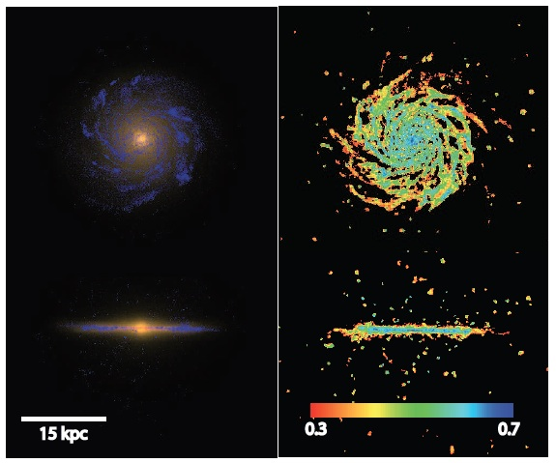
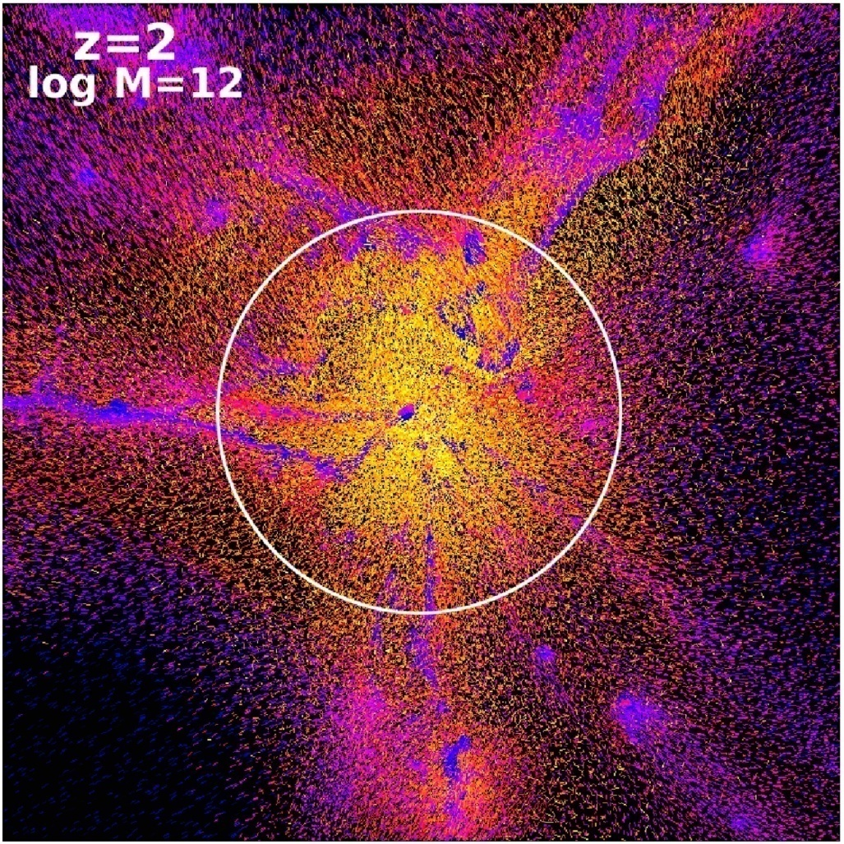
Galaxy Assembly
Stars and Gas
Gas content and dynamics becoming critical part of simulations.
Astronomy is an observational science.
Need observations of gas content —over cosmic time—to understand galaxy formation!
observation vs. simulation
Eris simulation (Guedes et al.)
NGC 6946 (T. Oosterloo)
Keres et al.

Slide 8
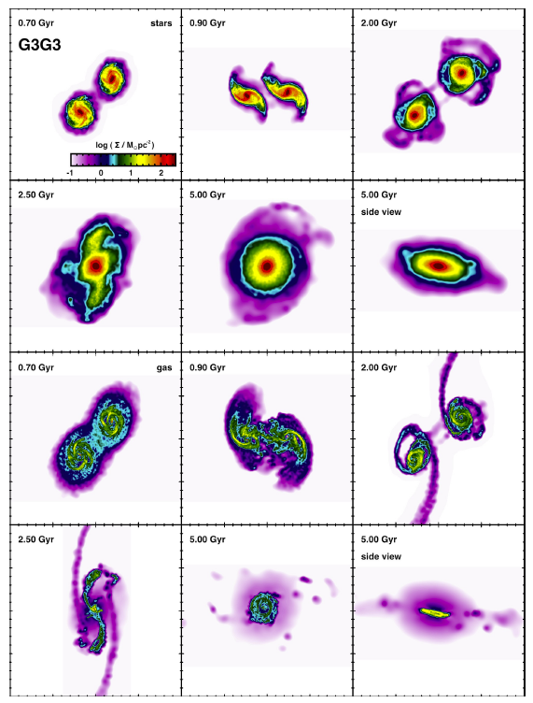
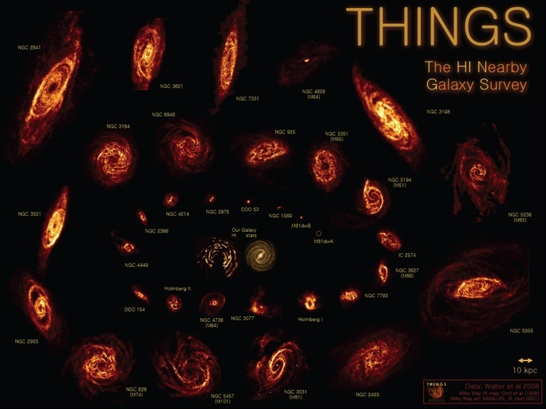
Galaxy Assembly
The Role of Mergers
stars
0.7 Gyr
0.9 Gyr
2.0 Gyr
2.5 Gyr
5.0 Gyr
gas
0.7 Gyr
0.9 Gyr
2.0 Gyr
Mergers are recognized as important aspect of galaxy evolution and formation
Gas can be sensitive tracer of interactions, long after original event took place
  E.g., Holwerda et al. with THINGS
2.5 Gyr
5.0 Gyr
(Moster et al. arXiv:1104.0246)

Slide 9
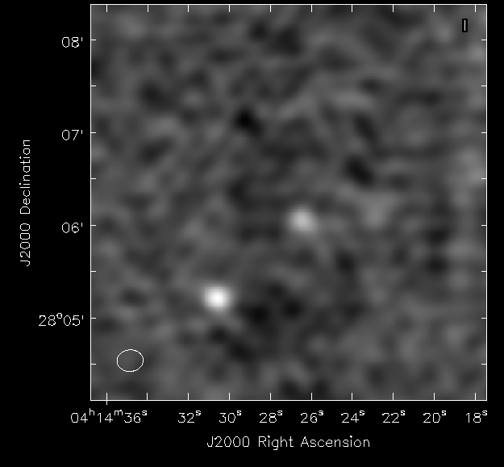
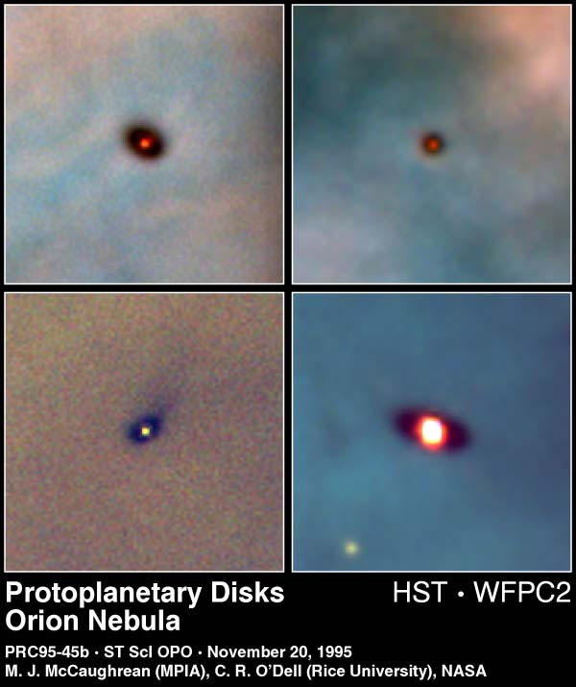
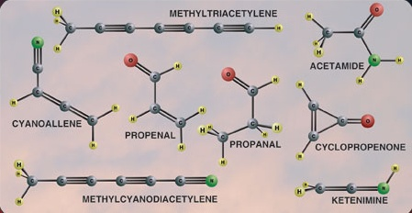
Astrobiology at Long Wavelengths
λ > 1 cm
Not affected by dust
Complex molecules have transitions at longer wavelengths
“Waterhole” (1.4–1.7 GHz)
Magnetically-generated emissions from extrasolar planets
EVLA 6 cm observations of protoplanetary disks; PEBBLES on e-MERLIN coming soon
Complex organic molecules detected at radio wavelengths

Slide 10
21st Century Astrophysics
20th Century: We discovered our place in the Universe.
21st Century: We understand the Universe we inhabit.
Cosmology & Fundamental Physics
Gravity
  Can we observe strong gravity in action?
  What is dark matter and dark energy? (dark energy and BAOs with H I galaxies)
Magnetism
Strong force
  Nuclear equation of state
Galaxies Across Cosmic Time, The Galactic Neighborhood, Stellar and Planetary Formation
Galaxies and the Universe
  How did the Universe emerge from its Dark Ages?
  How did the structure of the cosmic web evolve?
  Where are most of the metals throughout cosmic time?
  How were galaxies assembled?
Stars, Planets, and Life
  How do planetary systems form and evolve?
  What is the life-cycle of the interstellar medium and stars? (biomolecules)
  Is there evidence for life on exoplanets? (SETI)
Notes:
These questions are taken straight from the European Astronet report. The point to make is that the SKA Science Case is well aligned with major national and regional strategic planning.

Slide 11
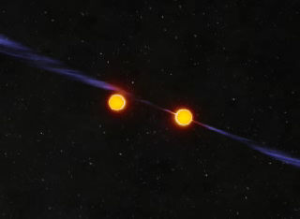
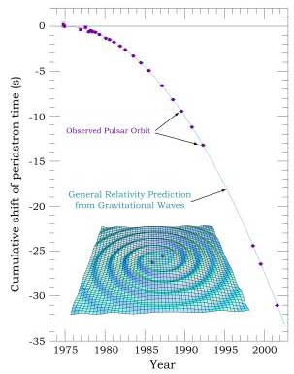
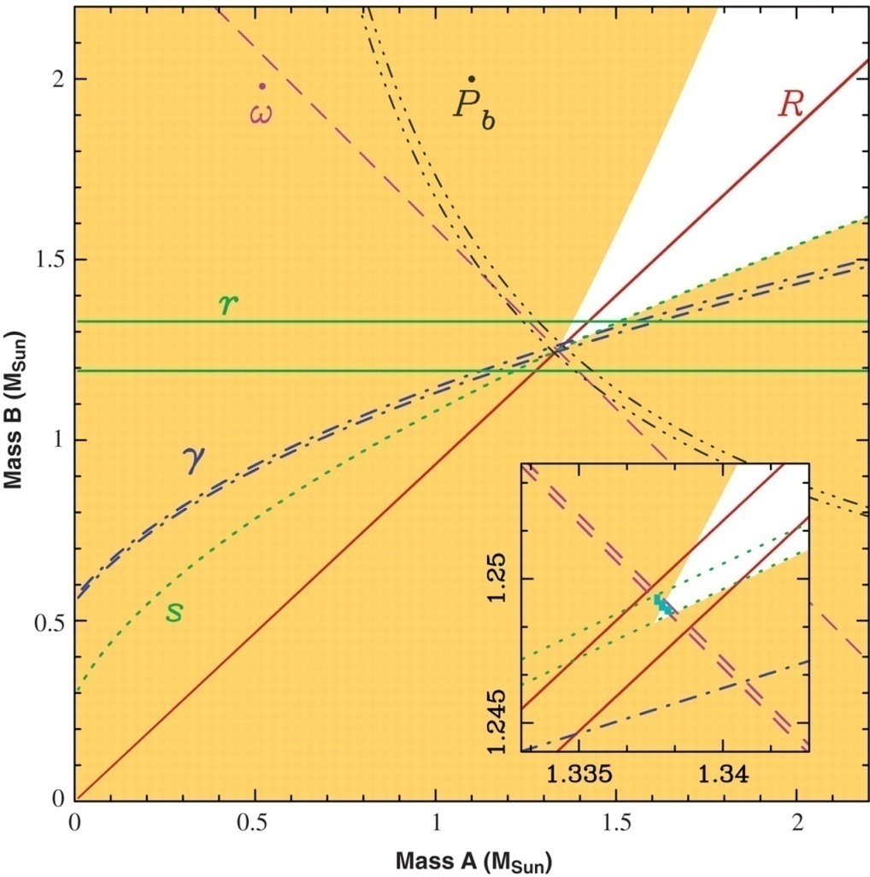
Did Einstein Have the Last Word on Gravity?
G_{μν} + Λg_{μν} = 8πGT_{μν}/c⁴
PSR J0737−3039
Relativistic binaries probe
  Equivalence principle
  Strong-field tests of gravity
Neutron star-neutron star and neutron star-white dwarf binaries known
Black hole-neutron star binaries?
Kramer et al.

Slide 12
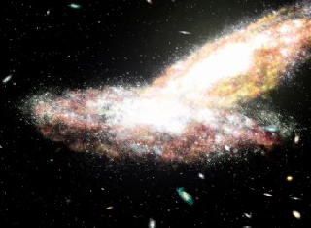
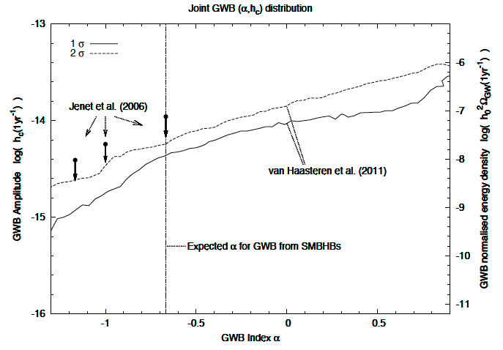
SKA: Gravitational Wave Detector
Test masses on lever arm
Pulsar Timing Array = freely-falling millisecond pulsars
LIGO = suspended mirrors
LISA = freely-falling masses in spacecraft
Pulsar timing arrays starting to provide results from ensemble of pulsars
EPTA (van Haastern et al., above)
PPTA (Yardley et al.)
NANOGrav (Demorest et al.)

Slide 13
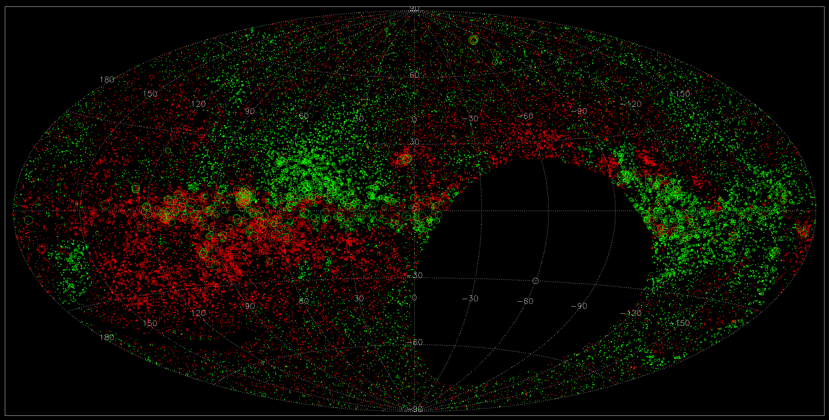
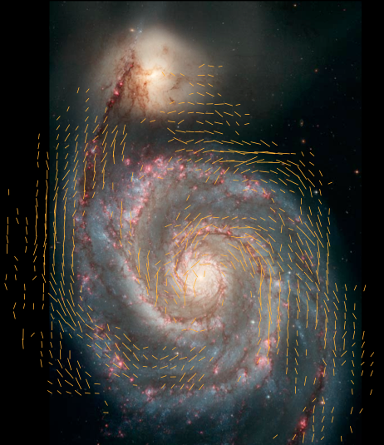
Origin & Evolution of Cosmic Magnetic
Magnetic fields are fundamental, but poorly constrained
  Affects galaxy, cluster evolution?
  Affects propagation of cosmic rays in ISM and IGM
All-sky rotation measure surveys provide B fields along lines of sight
Continuum in I, Q, and U!
Notes:
13
Add some motivation for looking for cosmic web at start of slide

Slide 14
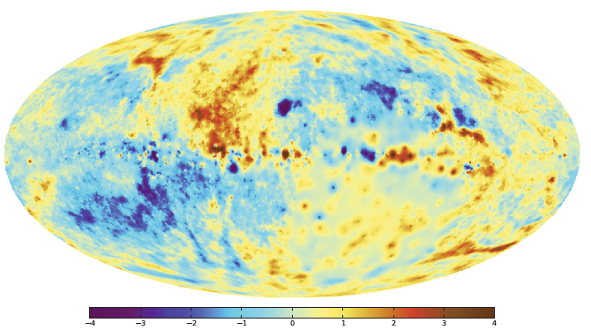
Origin & Evolution of Cosmic Magnetic
Magnetic fields are fundamental, but poorly constrained
  Affects galaxy, cluster evolution?
  Affects propagation of cosmic rays in ISM and IGM
All-sky rotation measure surveys provide B fields along lines of sight
(Oppermann et al. 2011)
Notes:
14
Add some motivation for looking for cosmic web at start of slide

Slide 15
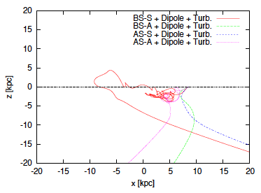
Magnetic Fields and Cosmic Rays
Are ultra-high energy cosmic rays (UHECRs) produced in nearby AGN?
Galactic magnetic field influences cosmic ray propagation
Different models of Galactic field imply different arrival directions
  Axi-symmetric vs. bi-symmetric?
  Field directions above and below the Galactic plane
  Effect of turbulence?
  …?
Takami, arXiv:1104.0278

Slide 16
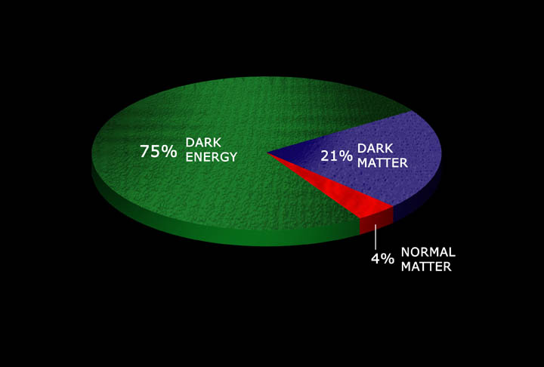
Cosmology and Gravity
G_{μν} + Λg_{μν} = 8πGT_{μν}/c⁴
Origin and Fate of the Universe
Era of “precision cosmology”
  … or precision ignorance
Need to sample a substantial volume of the Universe
Volume ~ D² ΔD Ω
  D – distance; Ω – solid angle
  Surveying to larger D is difficult ➔ need larger telescopes
    “square kilometre” of SKA
  Surveying larger sky areas Ω “just” requires more observing time
Composition of the Universe

Slide 17
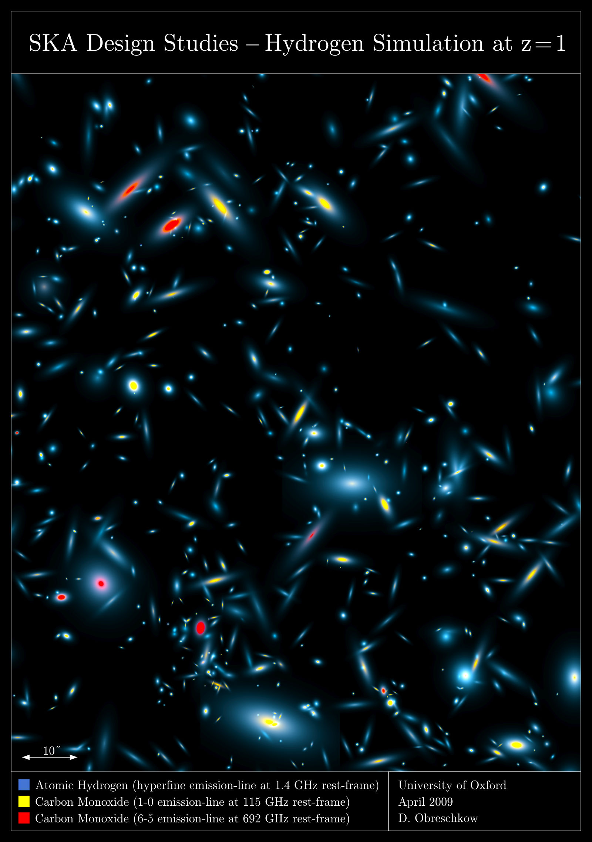
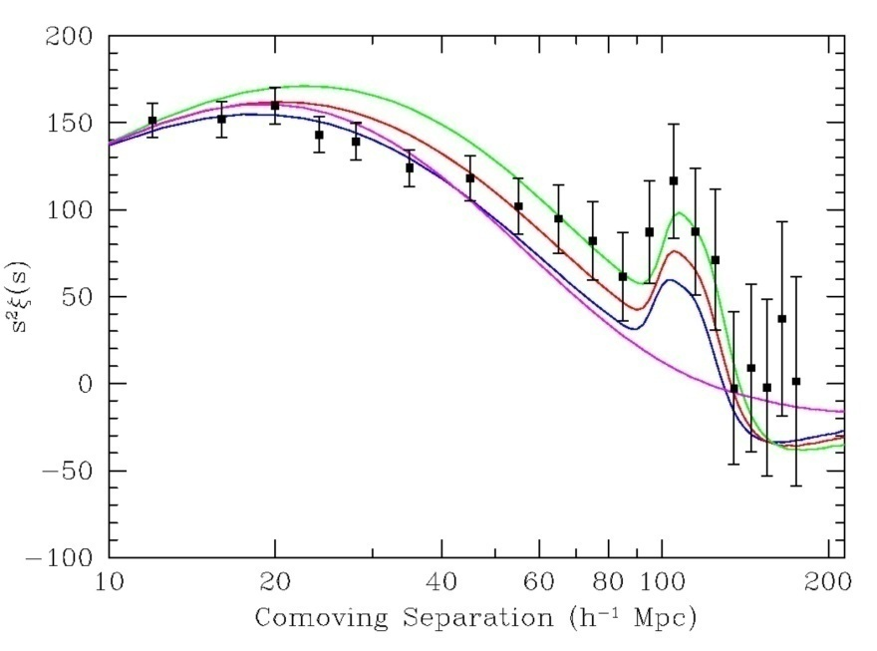
Cosmology and Sky Surveys
Image the sky, locating galaxies
  Analysis of locations compared with cosmological models to constrain parameters
Two broad classes of surveys
  Continuum: e.g., NVSS, FIRST, ASKAP/EMU, WSRT/APERTIF/WODAN
  Spectroscopic: SDSS, Arecibo ALFALFA, ASKAP/WALLABY, SKA H i survey
    Spectroscopic surveys locate in 3-D space! very powerful
Ultimate goal: spectroscopic survey of 1 billion galaxies
SDSS
SKADS Simulated Sky

Slide 18
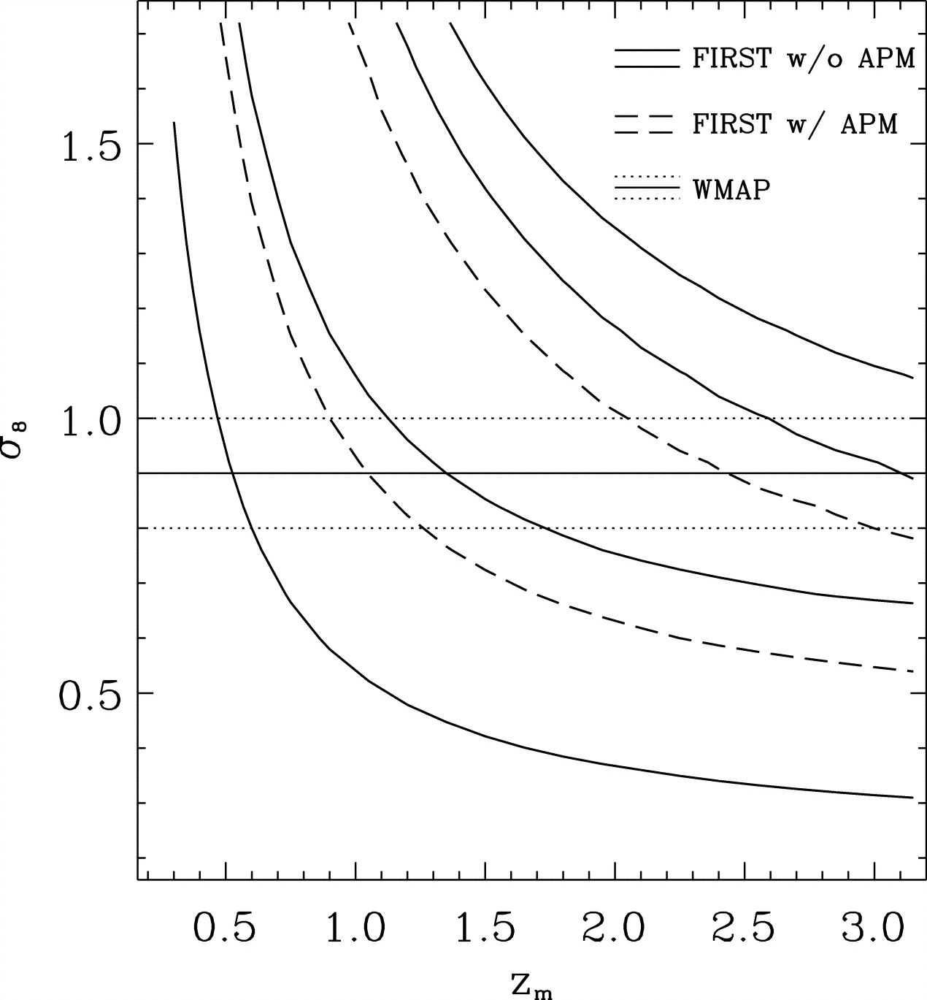
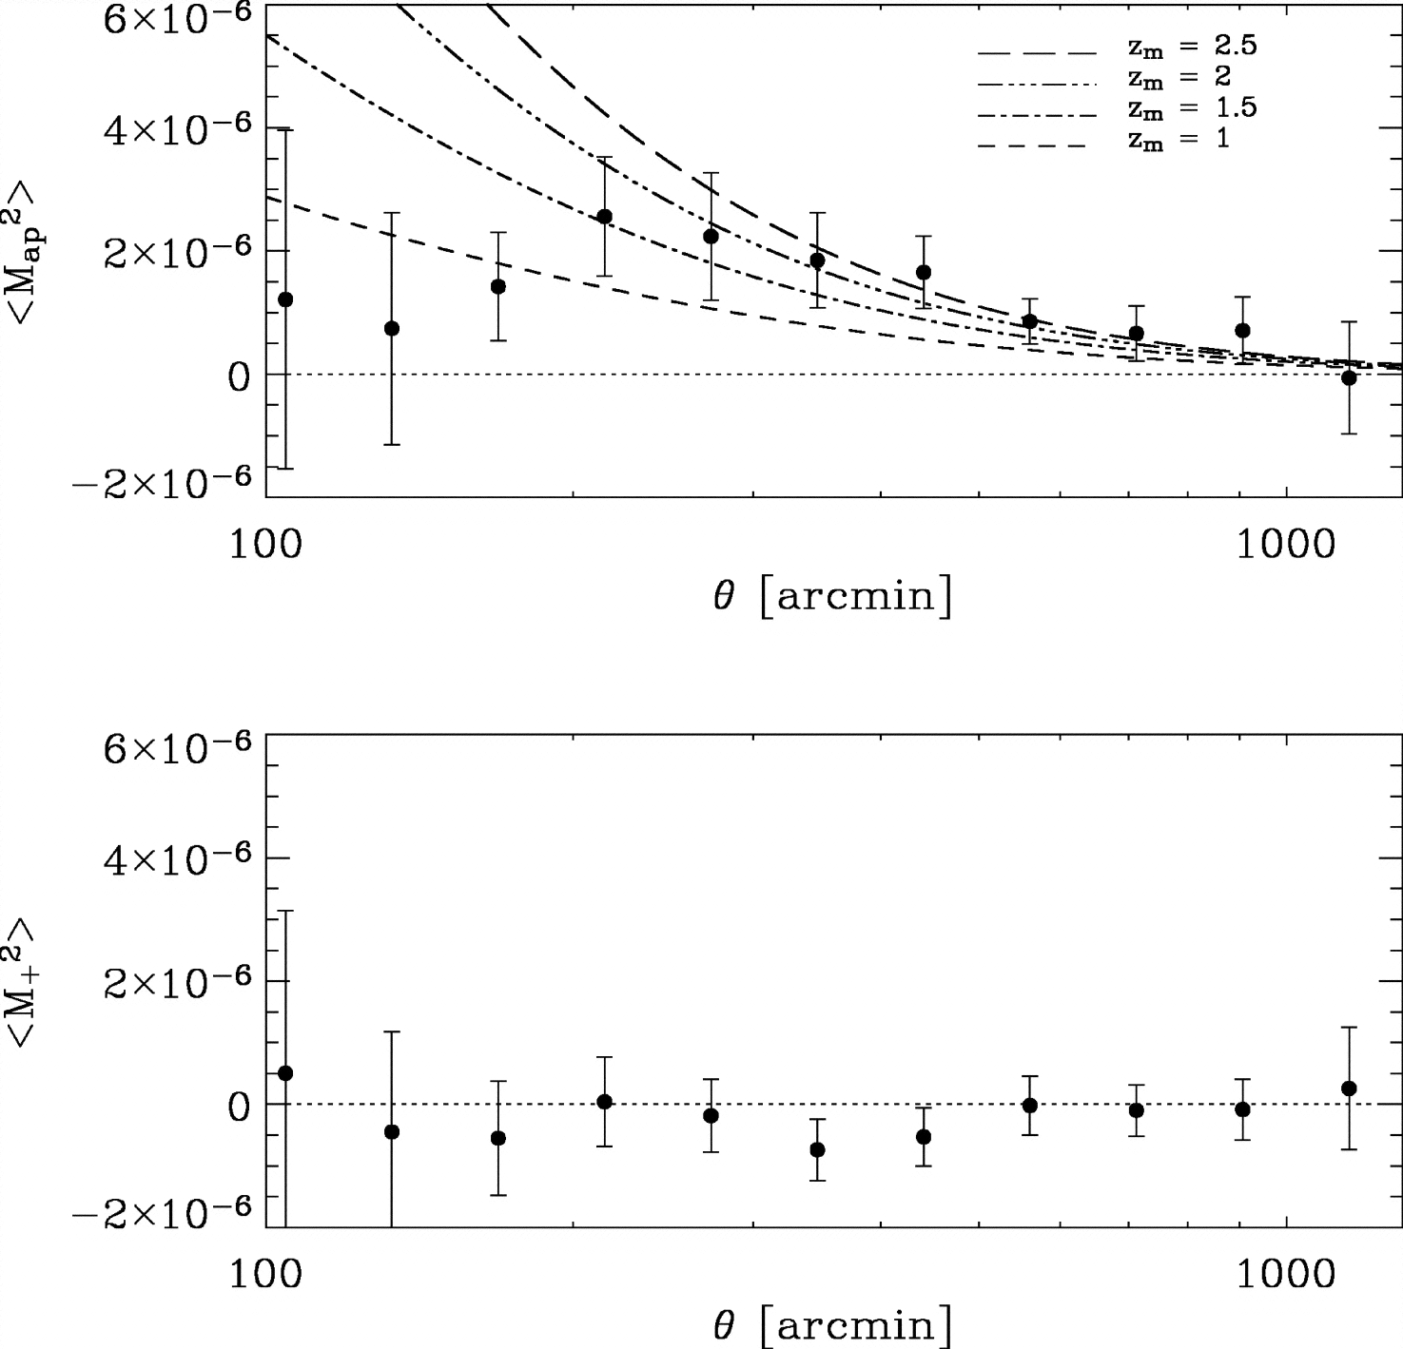
Cosmology and Gravity
Detection of weak lensing (E modes) from FIRST (Chang et al.)
σ₈
z_{m}
Radio observations should have fewer (different) systematics

Slide 19
21st Century Astrophysics
Fundamental Forces and Particles
Gravity
Magnetism
Strong force
“The Universe is patiently waiting for our wits to grow sharper.”
Photon frequency /wavelength / energy
Time
Polarization
Sensitivity
Field of View
Angular Resolution
Origins
Galaxies and the Universe
Stars, Planets, and Life

Slide 20
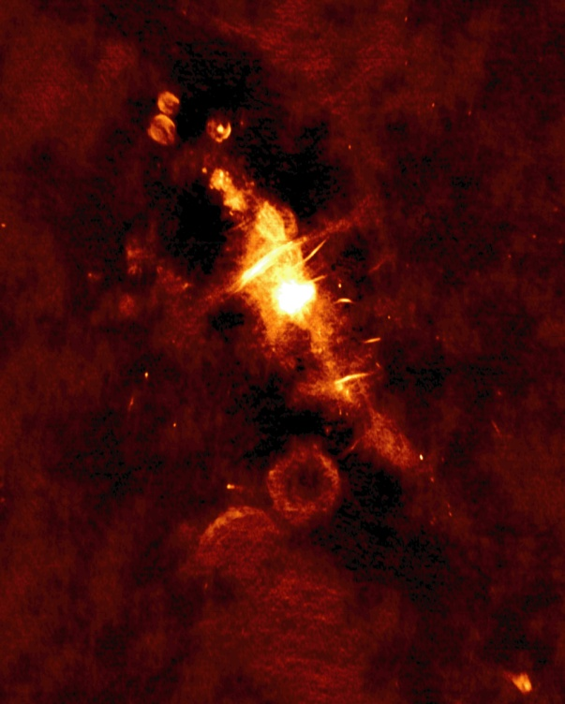
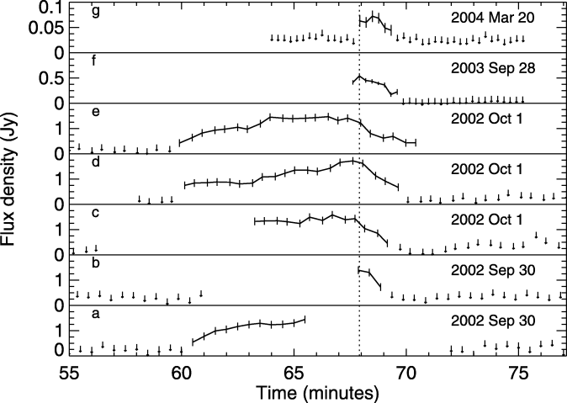

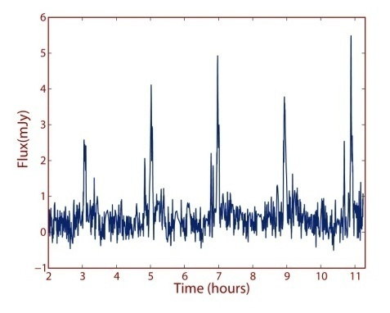
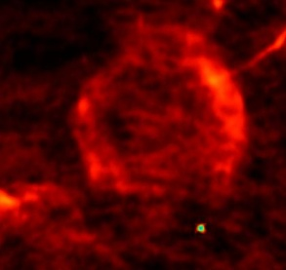
The Dynamic Radio Sky
Neutron stars
  Magnetars
  Giant pulses
  Short GRBs?
Microquasars
Tidal Disruption Events
GRBs (γ-ray loud; γ-ray quiet?)
  Afterglows
  Prompt emission?
Sub-stellar objects
  Brown dwarfs
  Extrasolar planets?
Scintillation
GW counterparts
UHECRs
ETI
Exploding black holes
???
Amplitude
Frequency
Time
Rotating Radio Transients (RRATS)
Pulsating Brown Dwarfs

Slide 21
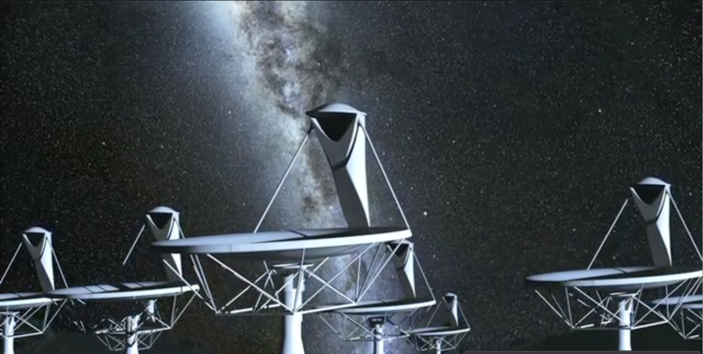
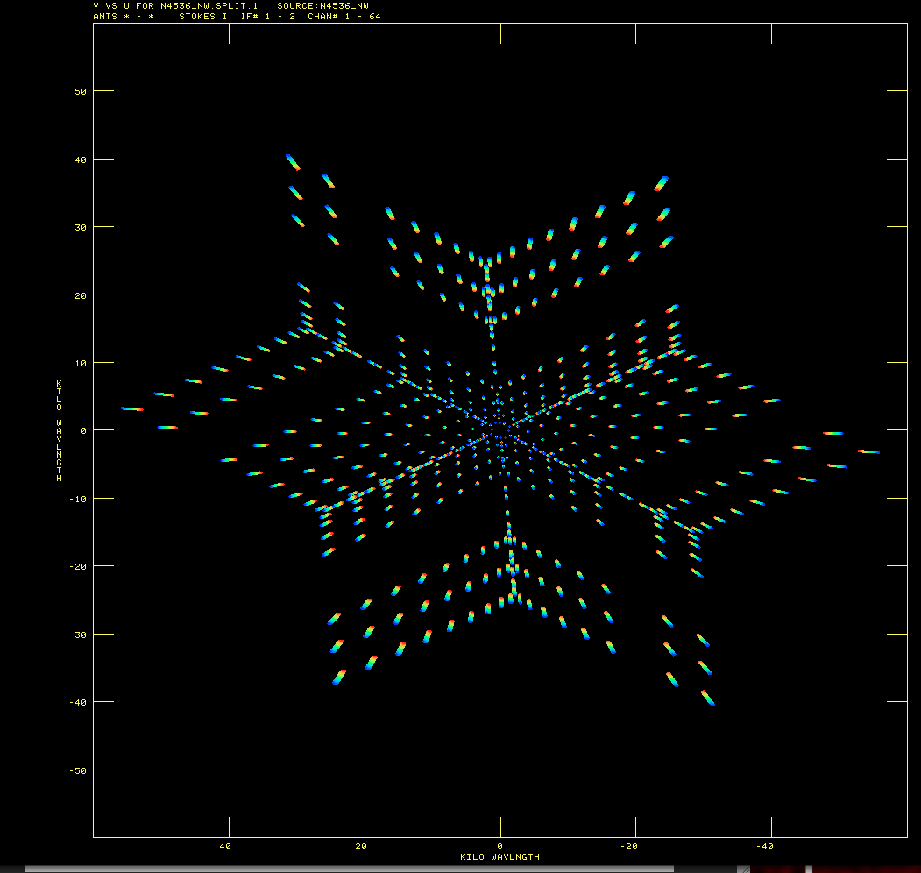
Imaging with Arrays
Fourier transform (u-v) plane
Image plane
Fourier Transform
⬅➔
N_{data} ~ N_{antenna}² N_{frequency}N_{time}

Slide 22
Imaging Surveys
Requirements
Many antennas in order to provide sensitivity and image quality
  large N_{antenna}
Spectral resolution because of wide-field effects, line emission from galaxies, or both
  large N_{frequency}
Long integrations in order to obtain adequate signal-to-noise ratio
  large N_{time}, e.g., 1 hr at 1 s sampling?
N_{data} ~ N_{antenna}² N_{frequency}N_{beams}N_{time}
ASKAP | SKA Phase 1 | SKA Phase 2
N_{antenna} = 30 | N_{anntena} ~ 250 | N_{antenna} ~ 1000
N_{beams} = 30 | N_{beams} = 1 | N_{beams} = 1?
N_{frequency} ~ 16k | N_{frequency} ~ 16k? | N_{frequency} ~ 16k?

Slide 23
Imaging Surveys II
ASKAP | SKA Phase 1 | SKA Phase 2
N_{antenna} = 30 | N_{anntena} ~ 250 | N_{antenna} ~ 1000
N_{beams} = 30 | N_{beams} = 1 | N_{beams} = 1?
N_{frequency} ~ 16k | N_{frequency} ~ 16k? | N_{frequency} ~ 16k?
N_{time} ~4k
N_{data} ~ 1.8 × 10¹² | N_{data} ~ 4 × 10¹² | N_{data} ~ 65 × 10¹²
N_{OPS} ~ 18 × 10¹⁵ | N_{OPS} ~ 40 × 10¹⁵ | N_{OPS} ~ 650 × 10¹⁵
Imaging is more than “just” an FFT.
  Gridding, deconvolution, wide-field corrections, self-calibration, …
Community estimates are 10⁴ to 10⁵ ops per visibility datum(!).
Leads to significant power challenges
  Related to moving data on/off chips
  Careful design can yield significant savings, e.g., D’Addario (SKA Memo 130)

Slide 24
Fundamental Physics with Radio Pulsars
Arrival times of pulses from radio pulsars can be measured with phenomenal accuracy
Better than 100 ns precision in best cases
Enables high precision tests of fundamental physics
  Theories of gravity, gravitational waves, nuclear equation of state
  1993 Nobel Prize in Physics
Problem: Not all pulsars are equal!
Good “timers” < 10% of total population
Need to find many more!
All-sky survey
Ultra-relativistic binaries
&
gravitational wave studies

Slide 25
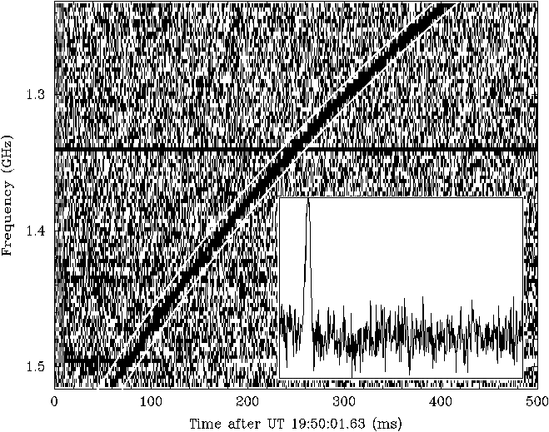
Pulsar Surveys I
Requirements
Large bandwidths because pulsars are faint
Long integration times because pulsars are faint
Rapid time sampling in order to resolve pulse profile
Narrow frequency channelization in order to mitigate interstellar scattering
For a “pixel” on the sky, accumulate data for a time Δt over a bandwidth Δν
  Suppose Δt = 20 min., Δν = 800 MHz
Time sampling δt with frequency channelization δν
  For GBT GUPPI, δt = 81.92 μs, δν = 24 kHz
60 GB data sets per pixel …

Slide 26
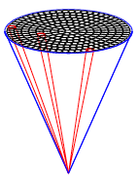
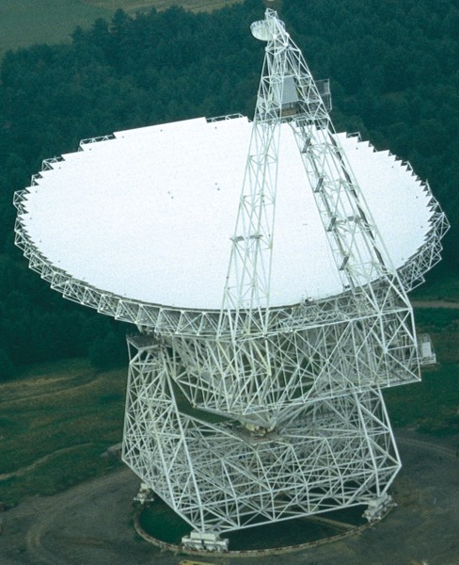
Pulsar Surveys II
For GBT
For SKA
At 800 MHz, “pixel” ~ 16' = 0.3°
About 350 kpixels in the sky
20 PB data set
At 800 MHz, “pixel” = 1.2'
About 76 Mpixels in the sky
4.6 EB data set
Notes:
4 EB storage = 2M hard drives
$100 /drive
MTBF = 1000 hr
Be careful about redundancy or where the failures might occur
36,000 drives is about the maximum that is currently done in industry

Slide 27


Data Intensive Astronomy
(“There is nothing new under the Sun.”)
Data Volumes
Computational Limitations
Harvard computers
Production of stellar plates and spectra (“data rate”) was increasing enormously
Examined and classified telescope output
SKA all-sky survey
Ιππαρχος (Hipparcus)
ca. 135 BCE
Stellar catalog with 850 entries
SKA pulsar survey

Slide 28
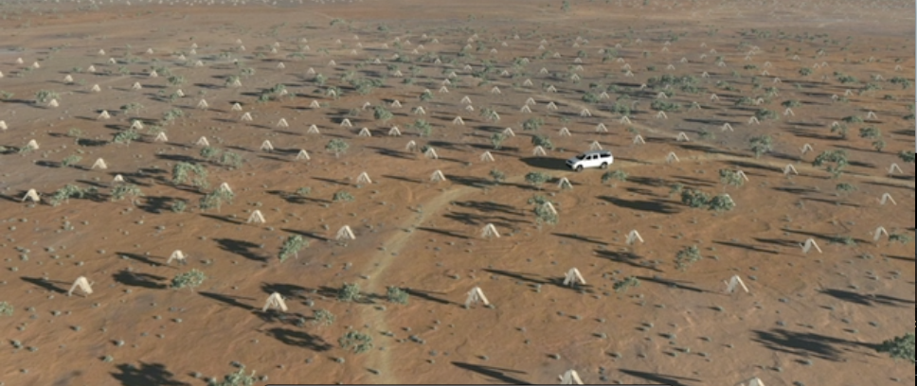
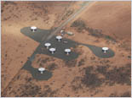
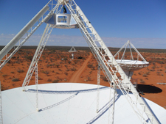
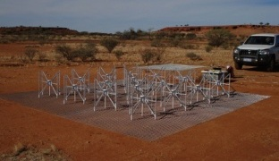

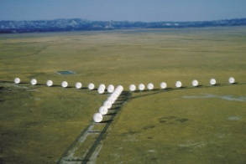











SKA Pathfinding
SKA is ultimate goal, though long-term program
Precursors and many pathfinders in existence or under construction
Learn lessons from the Precursors and pathfinders across the full range of experience
  Hardware, (firmware), software, data processing, operational modes, …

Slide 29
Square Kilometre Array
The Global Radio Wavelength Observatory
Originally: “Hydrogen telescope”
  Detect H I 21-cm emission from Milky Way-like galaxy at z ~ 1
SKA science much broader
  Multi-wavelength, multi-messenger
On-going technical development
International involvement

