Slide 1
Exploring
the
μJy and nJy Sky
with the
EVLA and the SKA
Ken Kellermann
NRAO
East Asia SKA Workshop
December 3, 2011
Notes:
One of the key problems in extragalactic astronomy has been to understand the nature of extragalactic radio sources, how the different populations evolve with cosmic time, and the connection between different phenomena such as SMBHs and star formation

Slide 2
Understanding Radio Source Populations
Traditional Radio Source Surveys
Understanding using multi-wavelength studies
Classification
Luminosity functions
Evolution
New Discoveries
Targeted Observations
Notes:
Radio source survey
Aid of multi wavelength data – leads to classification, LF, Evolution
Targeted obs: galaxies, quasars, stars, GRB
VLA targeted observations
SKA will be very much better

Slide 3
Radio Astronomy Discoveries
Discovery | Sensitivity | δθ | δν | δτ
Radio Galaxies |  | X
Quasars |  | X
Pulsars |  |  |  | X
Cosmic Masers |  |  | X | X
Gravitational Lensing |  | X
Extra Solar Planets | X |  |  | X
Solar Radio Bursts |  |  |  | X
Cosmic Evolution | X | X
Radio Recombination Lines | X |  | X
Jupiter Bursts |  |  |  | X
HI | X
Molecules | X |  | X
Surveys
Target observations
Notes:
Interesting to look at how some of the major radio astronomy discoveries came about.

Slide 4
Outline
EVLA Targeted Observation of SDSS QSOs
Radio Loud: SMBH
Radio Quiet: Star formation from host galaxy
VLA and EVLA Surveys of the CDFS & ECDFS
Implications of measured high radio sky brightness
Implications for the design of SKA
Sensitivity
Resolution
Dynamic Range
Confusion
Notes:
Star formation from host galaxy

Slide 5
Radio Loud and Radio Quiet Quasars?
Quasars (Schmidt 1963) from strong radio emission
Radio Quiet QSOs (Sandage 1965)
Bimodal radio distribution
Condon, 1981
Kellermann et al. 1989
Ivezić et al. 2002
Jiang et al. 2007
Single population with steep Luminosity Function
Lacy et al. 2001
Hewett et al. 2001
Cirasuolo et al. 2003
White et al. 2007
Rafter et al. 2009
Mahony et al. 2010

Slide 6
Why are only some QSOs radio loud?
Starburst and accretion onto a SMBH
BH mass or spin
Different hosts (E and Disk galaxies)
Intermittent activity: ~10% duty cycle
Free-free absorption
Synchrotron self absorption
Doppler boosting of relativistic jets
Notes:
A variety of processes have been discussed to explain the radio emission from QSO
Star formation --- SN activity

Slide 7
Limitations of Previous Surveys
Inhomogeneity of the optical QSO Sample
Inadequate sensitivity
Redshift – luminosity degeneracy in flux density limited samples
Evolution over observed redshift range

Slide 8
New Opportunity (SDSS +EVLA)
197 QSOs from SDSS observed with EVLA
0.2 < z < 0.3
14 < i < 19; M < -23
All detected 2MASS (1.25μ. 1.65μ, 2μ)
125 detected ROSAT
69 previously detected at 1.4 GHz (FIRST, NVSS)
Each QSO observed from 3 min to 35 min with EVLA
ν = 6 GHz
BW = 2 GHz
σ ~ 6 μJy rms in 35 min
S > 20μJy

Slide 9
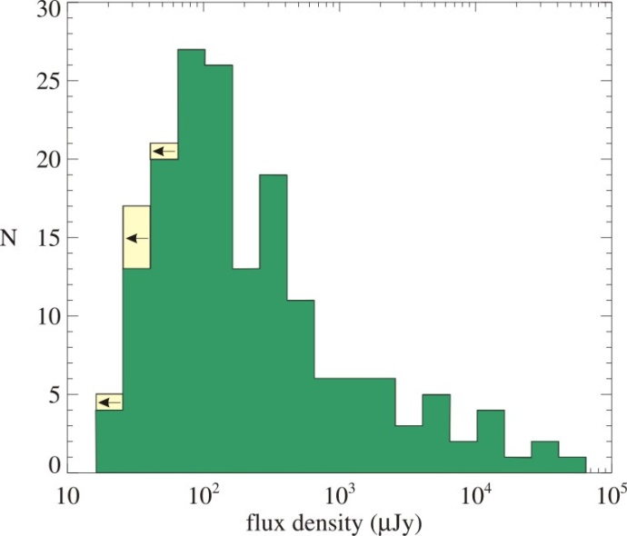
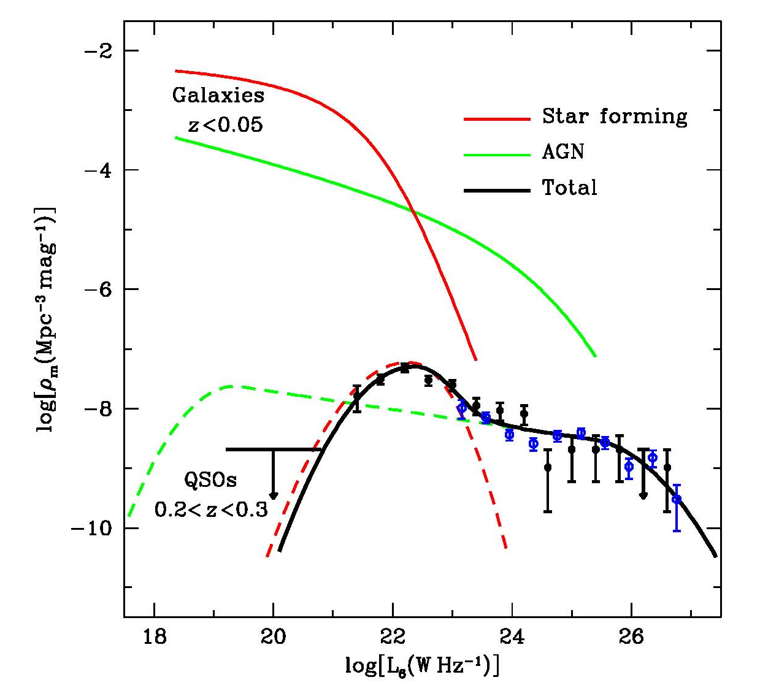
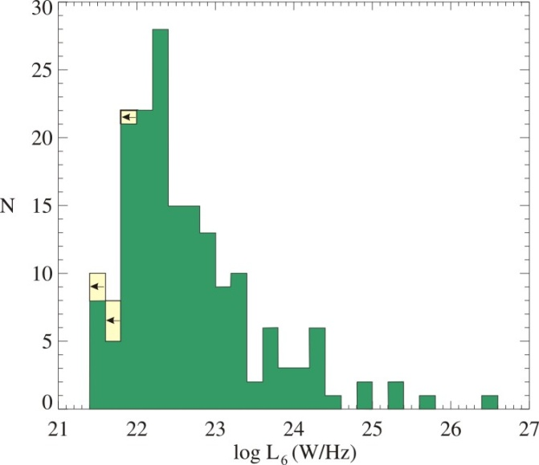
QSO Radio Luminosity function
Kimball et al. 2011
Local Luminosity Functions
Condon 2002
Kimball et al. 2011
Kimball et al. 2011
EVLA 6 GHz
NVSS 0.2<z<0.45
NVSS extrapolated
Star forming host galaxies
Notes:
Detected all but 6 sources
10^22.5 W/Hz separates SF galaxies from RL AGN
Right panel – Luminosity functions
Upper panel – local LF from Condon 2002
Lower panel
EVLA LF -black
Too few strong sources to get high end of LF
Blue NVSS- 6 GHz – mostly QSOs (agrees with 6 GHz obs)
Green dashed – extrapolation well below observed LF where LF has a peak
Peak not observed on LLF of AGN
Upper limit if 6 non detections in range 10^19-20
Must fall off ~10^19 otherwise would be > SDSS QSOs
RQ QSO – radio emission due to SF in host, not to SMBH

Slide 10
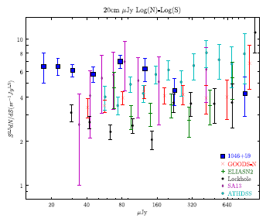
Radio Surveys:
The microjansky radio source count
Deep Radio surveys
VLA, ATNF, WSRT, & GMRT
Serious discrepancy among different surveys
Statistical
Incompleteness
primary beam, bandwidth,
Statistical weight corrections
Time smearing corrections
Resolution corrections
nanoJy number density & size?
SKA design: resolution vs. confusion
Owen & Morrison, 2008, AJ 136, 1889
Notes:
Let me turn now to radio surveys

Slide 11
Sky background implications
Current
survey
limits
ARCADE 2
Condon, 1989; Wilman 2008
ARCADE Balloon observations at 3, 8, 10, 30, 90 GHz (Fixen et al. 2011)
Notes:
Large discrepancy between observed background temperature and that expected from source counts

Slide 12
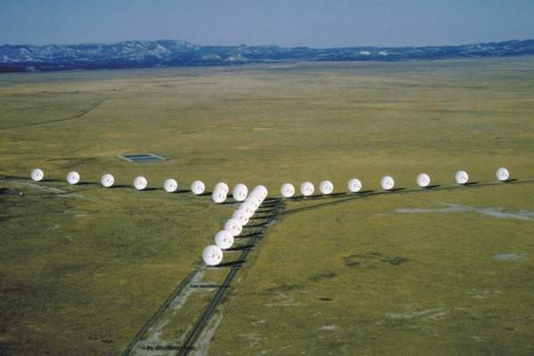
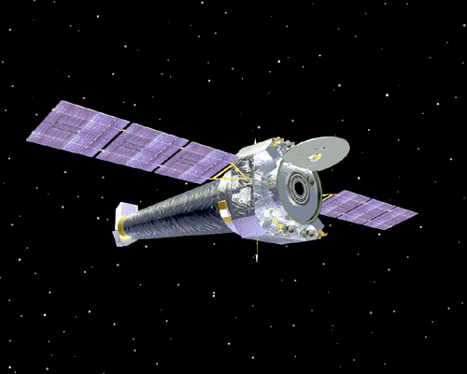
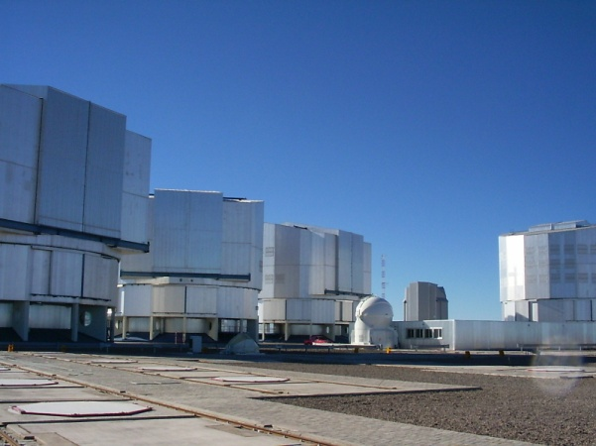
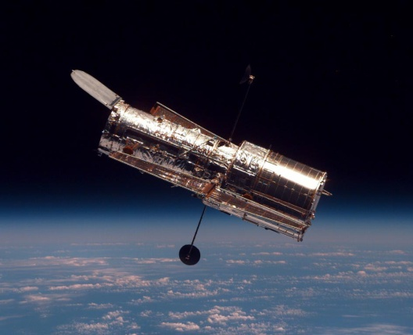
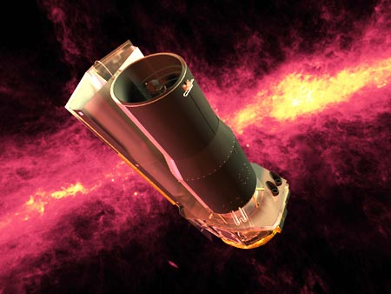
Chandra Deep Field South
Chandra
VLA
HST
VLT
Spitzer
Notes:
Many deep fields observed with VLA reaching down to about 10 microJy rms
One of the best studied is the CDFS and the Extended CDFS

Slide 13
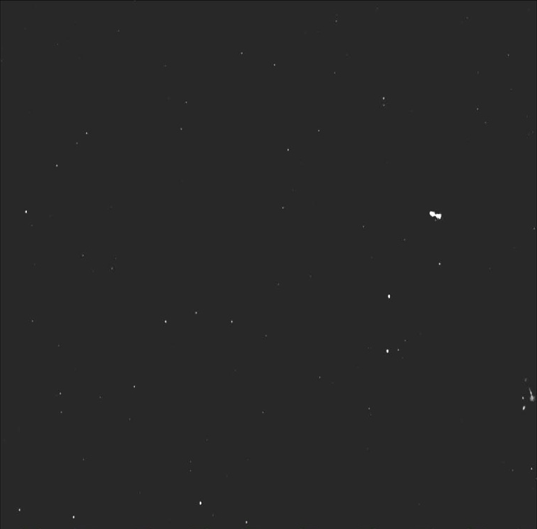
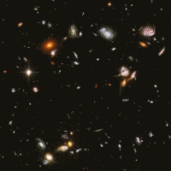
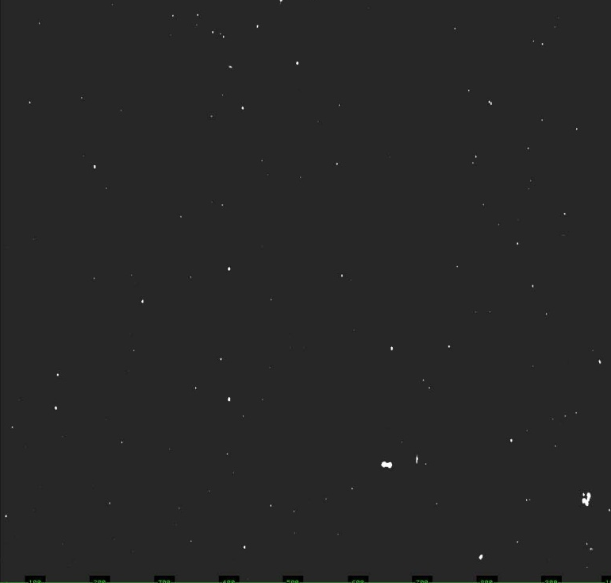
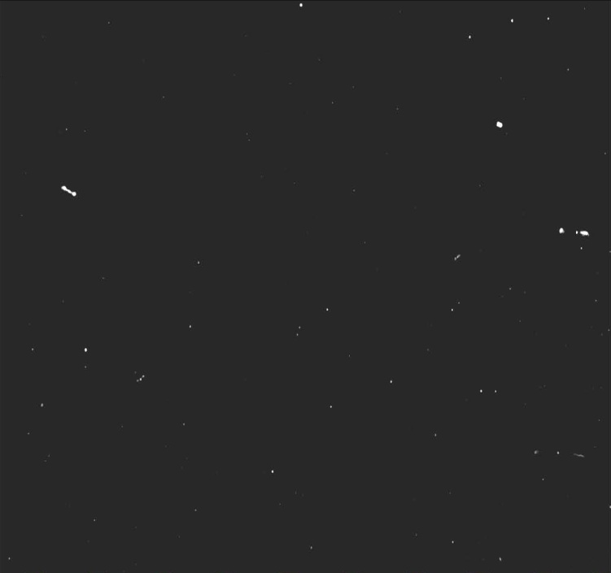
ECDFS
240 hours. 1.4 GHz
σ~ 8 μJy
879 sources > 40 μJy
Miller et al. 2012
CDF S 4 Megasec
Chandra
250 ks per field
Hubble UDF
976 ks exposure
10,000 galaxies
mag 29
5 GHz
σ ~ 7 μJy
GOODS ACS
B, V, I, z < 28
Spitzer – IRAC/MIPS
ESO VLT
2.2m/WFI
32 arcmin
Notes:
One of the best studied multi-wavelength fields is the CDFS and the ECDFS

Slide 14
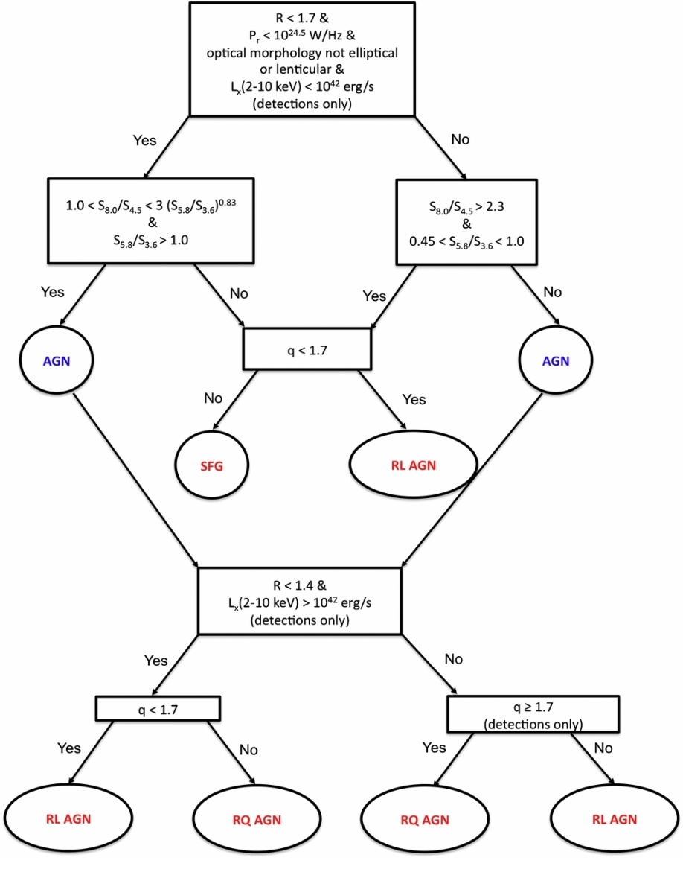
AGN/SF Classification
Nearly all sources in CDFS have optical counterpart
193 sources in complete sample
178 redshifts
143 spectroscopic
35 photometric
Classification as SF or AGN (SMBH)

Slide 15
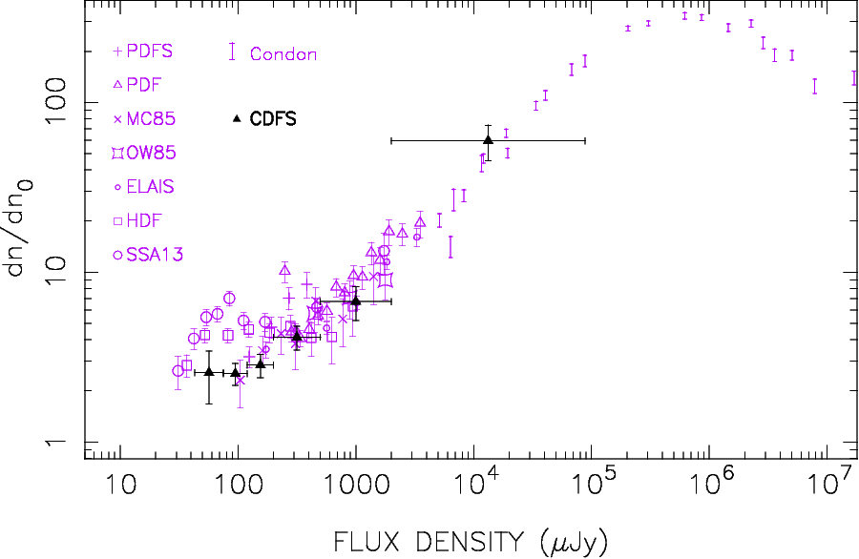
Star forming galaxies
Radio-FIR: q ~ 1.7
R = log(S_{r}/S_{V}) < 1.7
L_{r}< 10^{24.5} W/Hz
Not E galaxy
L_{x} not > 10⁴² ergs/sec
Kellermann et al 2008
ApJ S 179, 71
Powerful radio sources
RL AGN
R > 1.4
L_{x} > 10⁴² ergs/sec
NIR (IRAC) colors
FIR: q < 1.7
RQ AGN
R < 1.4
L_{x} > 10⁴² ergs/sec
NIR (IRAC) colors
FIR: q ≥1.7
L_{x} > 10⁴² W/Hz
R < 1.4
Padovani et al. 2011, ApJ, 740, 20
Notes:
Powerful sources
Star forming population < milliJy
Population of RQ AGN missed by previous surveys with brighter optical limits
Characterized by Hard x-ray emission and radio morphology

Slide 16
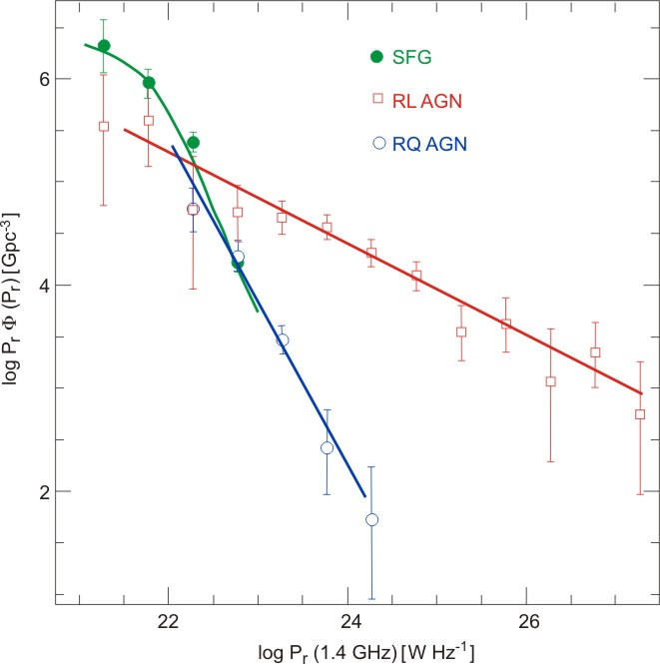
CDFS Luminosity Fuction
Adopted from
Padovani et al. 2011, ApJ 740, 20

Slide 17
Summary
EVLA Observations of SDSS and the CDFS: a new population
RQ QSOs due to star formation from host galaxy
SKA & large optical telescopes will probe the SMBH – star formation link to much greater depths
Will need adequate resolution to distinguish SMBH and SF
Next steps
VLA Survey of ECDFS
Radio: Miller et al. 2012; 879 sources, S ≥ 8 μJy
Bonzini et al. 2012: 635 (197) optical (IR) IDs
Vattakunnel et al. 2012: X-ray: 4 Megasec E-CDFS
EVLA survey: 1 μJy rms – ARCADE population?
MeerKAT, ASKAP deep low resolution survey?
SKA will reach below 100 nJy
Must understand the submicroJy population and effects of confusion and resolution before finalizing the SKA design.
Notes:
EVLA Observations of SDSS and the CDFS sho a new population RQ QSOs due to star formation not to SMBHs
High resolution observations – SF coexist with SMBHs
WSRT -- APERTIF
SKA, in conjunction with the new generation of large optical telescopes will probe the SMBH – star formation link to much greater depths and trace their evolution over nearly the full range of cosmic time.

