Slide 1
East-Asian Workshop on SKA (one perspective)
Budget for Microphones
Current Status
What is the Main Problem?
How good are the Budget Estimates?
Is Schedule Realistic (wrt Budget)?
When to freeze design relative to fund raising?
How to divide work among partners?
(how to engage “East Asia”)

Slide 2
CURRENT STATUS
SKA Point of View:
Organized (Board, Leadership, Science Definition, Project Management, Designs/Reviews, Funding/Pledges, Pathfinders, High Community Profile, One-Voice)
Started (LOFAR, ASKAP, MeerKAT, FAST,….)
Defined (Collecting Area, Frequency Coverage, Dish/AAs, Telescope Design, WBSPF/PAF, EVLA correlator, Software)
Fund Raising (“Company”, Partners/Investors)
East Asian Point of View:
Globally: None of the Above!
Localized Activities: China (FAST), Japan, Korea, Taiwan
Engaged/Committed: Manpower, Technical Developments

Slide 3
What is the Biggest Problem?
SKA Point of View:
Richard says “Software, Power”
Translation: “Data Handling, Budget”
East Asian Point of View:
How (not should) do we “Engage the Project”?
Need to define “Engaged”?
How do we “Raise the Resources”?
(people, skills, budget: non-theoretical variety)

Slide 4
Budget/Schedule: Instrument Design
Science Driven? Parameter Space Driven? Cost Driven?
Focal Plane Arrays vs Collecting Area?
When will design be frozen? How to augment or change (fluid/flexible design)?
How/Can instrument change with time?
What will operating costs be?
What will be Developments/Upgrades?
East Asian Point of View:
How to be Engaged in this Process?
Where to contribute? Focus? Direction?

Slide 5
How Will the Science be Done?
Science: Wide-Ranging, all “sounds good”, “not easy”!
Mode: Surveys vs PI Science?
Details: How to let students work? Proposal Cycle and proposal time available.
Focus: What Science is Unique to SKA, SKA₂?
(Articulate and Justify Burning Questions?)
How to Trade: Science vs Cost?
East Asian Point of View:
Mode of Science will Determine Users Community/Funding Level / Regional Linkage

Slide 6
How to Retain/Absorb Partners?
SKA Point of View:
How to involve all Pathfinders?
How to get “East Asia” (not-China) to participate?
East Asian Point of View:
When and How to Engage SKA?
(Before or After Ante?)
How to Share/Lead Science Objectives?
How to be “Equal Partner(s)”?
How to demonstrate “Regional Benefits”?
How to Divide Work Among Partners?

Slide 7
Next Step: Raising SKA Budget
Magnitude: Mega Science (need 2 significant digits)
Current Model: Pathfinder, SKA₁ (luck? )
Model of Fund Raising: NASA, ALMA, ELT (ESO)
Timeline: Fields are developed in “Cycles”
Can it ever be Faster? (maybe)
New Partners: (looks like we have some)
Top: External Pressures (enormously important)
Bottom: Courtship, Early Engagement, Contract
Keeping in Mind: “Selling” vs “Buying”
“Outside” vs “Inside” of Project

Slide 8
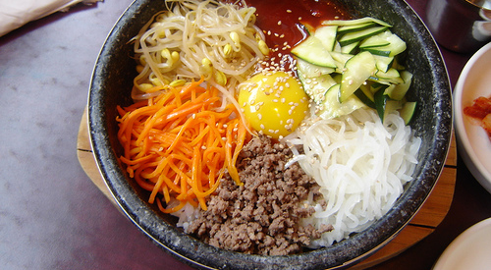
for Great Bibimbap !
Got to have a bunch of different stuff,
Got to mix well, Got to have spicy sauce !

