Slide 1
MeerKAT the SA SKA precursor, its science – (and other developing collaborations)
Prof. Roy Booth (Director - Science)

Slide 2
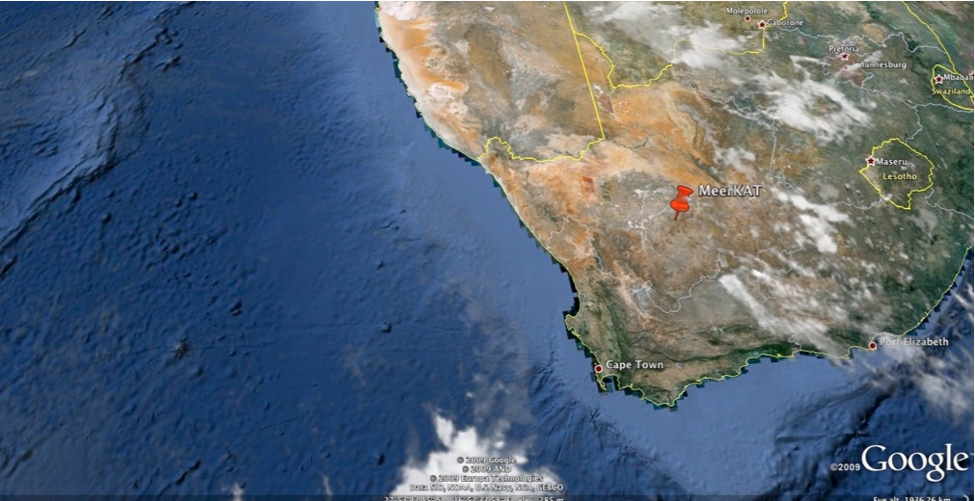
MeerKAT-
South Africa’s SKA Precursor and its KEY science

Slide 3
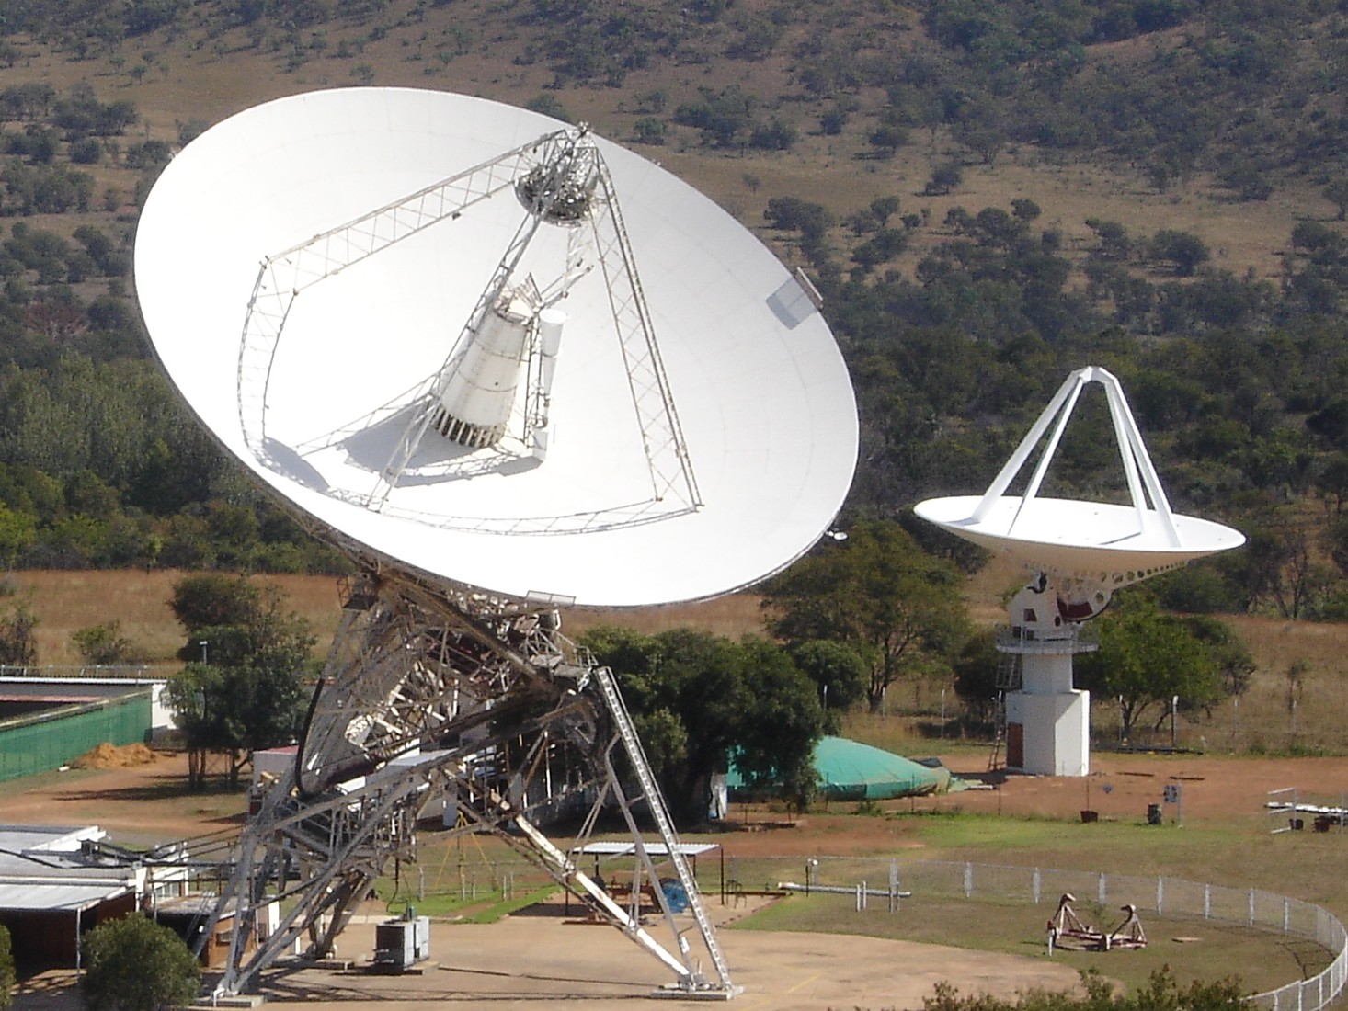
26m cassegrain, antenna on a polar mount operating between 1.6 and 22 GHz (13 mm)
XDM

Slide 4
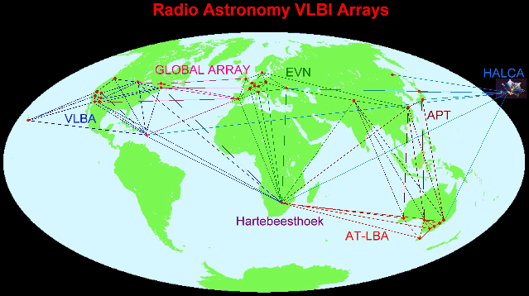
HartRAO: VLBI with EVN and LBA
A fibre communications link between HartRAO and and the European Geant network, and hence the rest of the world means that HartRAO regularly participates in e-VLBI, especially with Europe.

Slide 5
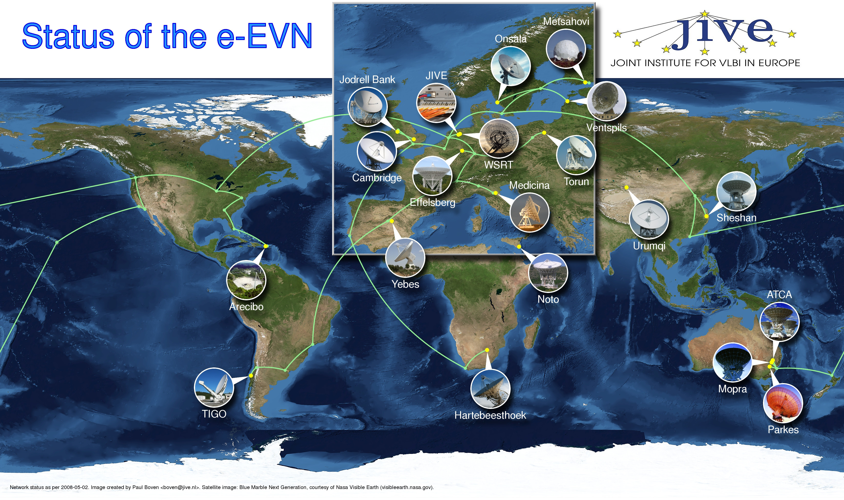

Slide 6
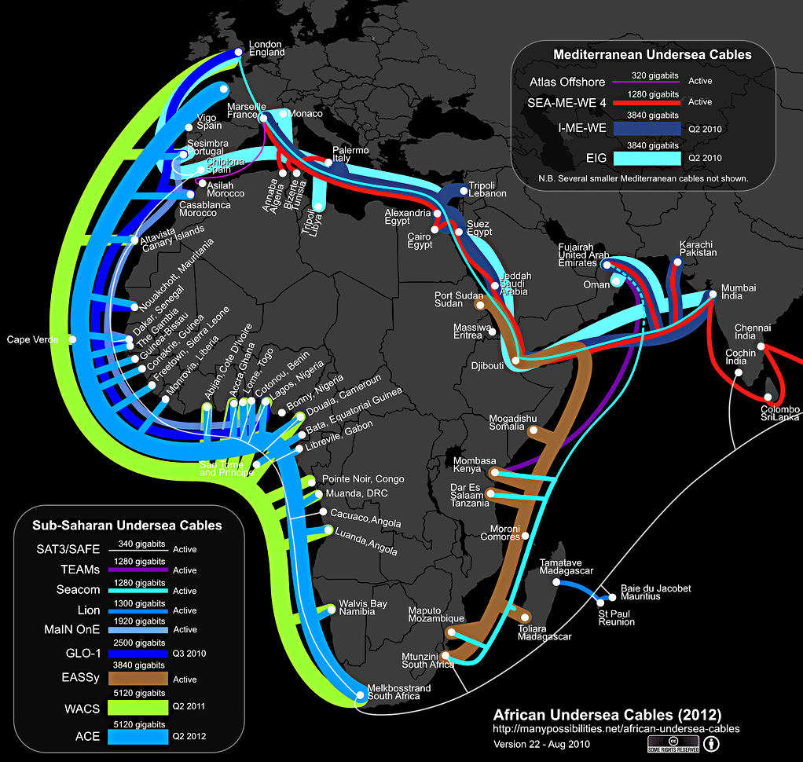
Fibre Connections to Africa

Slide 7
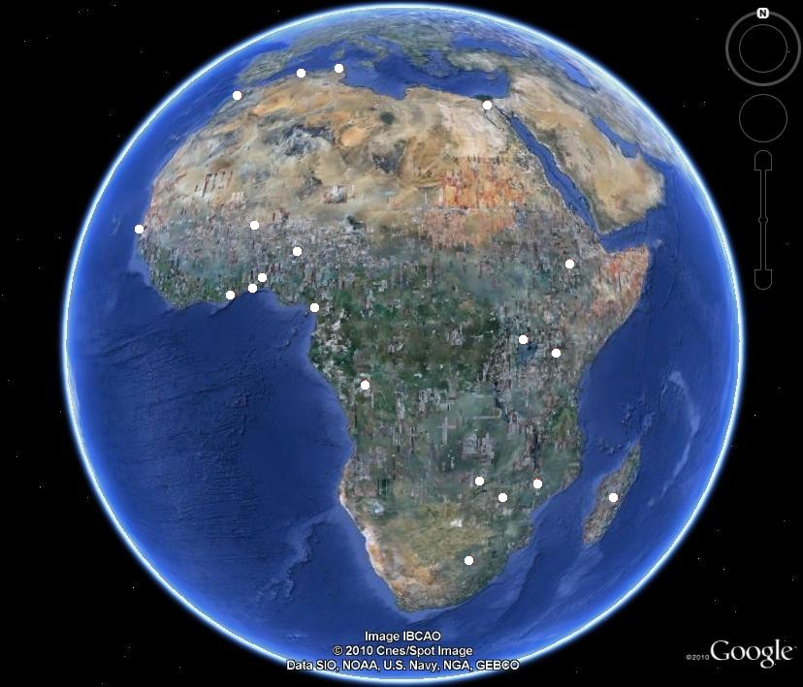
……make us realise that there are many redundant Communications anennas out there…

Slide 8
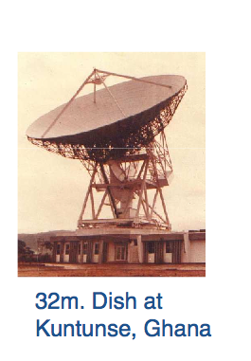
In Ghana, Kenya, Madagascar, Zambia and Nigeria ..
The first 3 32m antennas to become available are at HartRAO, in RSA and at Kuntunse in Ghana.
We are getting enormous help and cooperation from the Ghana group, despite there being no previous inolvement in Radio Astronomy

Slide 9
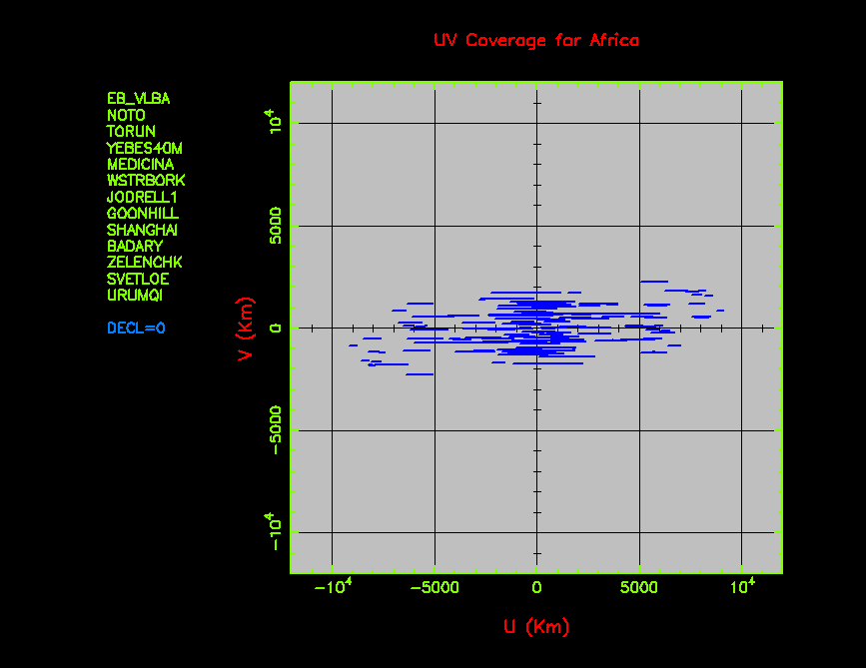
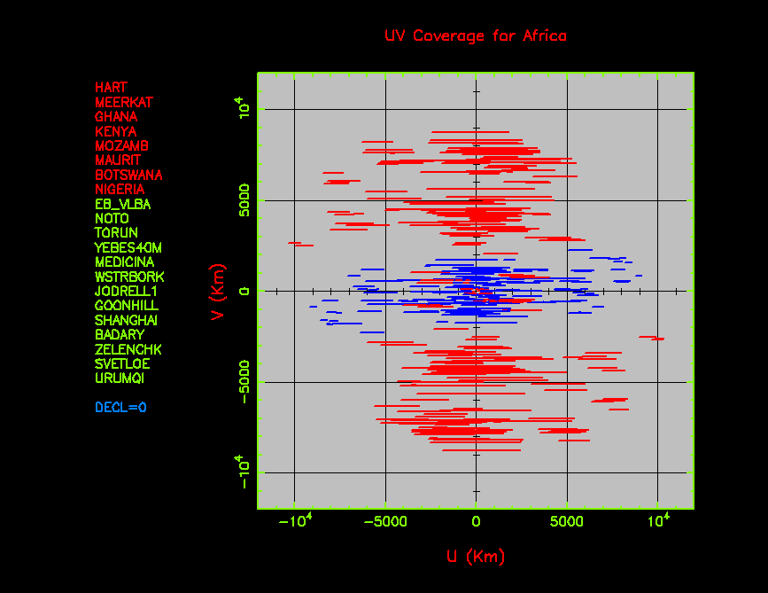
New potential for European Cooperatiion an
EVN - AVN
VLBI imaging potential of VLBI array is related to the baseline coverage or filling of the UV plane – distance vectors between antennas as they track a source
Here we show (left) the imaging potential of the EVN alone for a source on the celestial equator (dec.= 0) and right with an African Array.

Slide 10
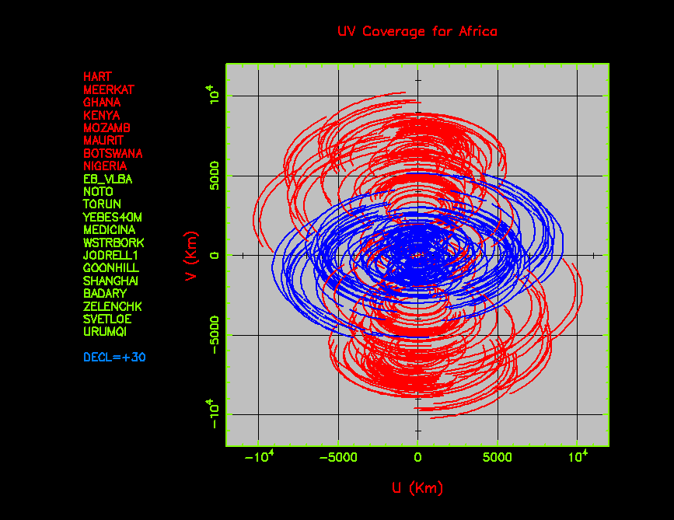
EVN + Africa for a source of declination
+30 degrees;
Great mapping potential

Slide 11
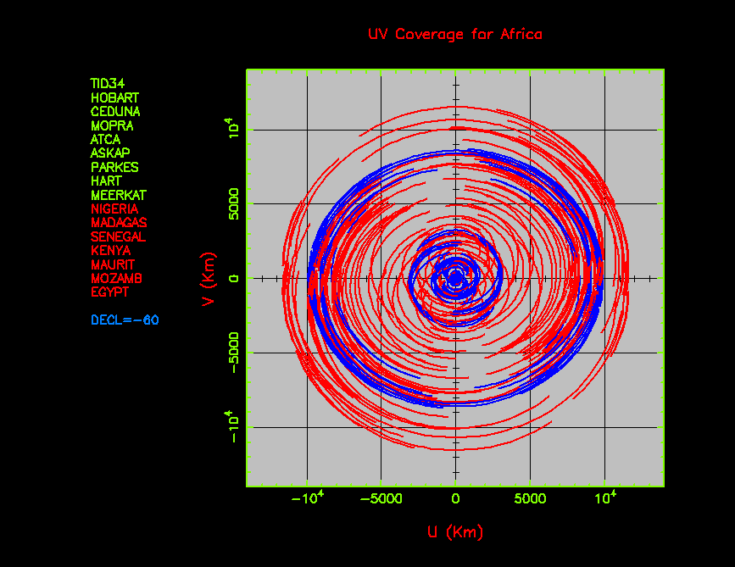

Slide 12
Another ongoing collaboration:
C-BASS – Cosmic foreground all sky survey
A collaboration between Jodrell Bank and Univ of Oxford (UK)
Caltech (USA) and
South Africa.
The cosmic foreground emission must be measured and subtracted before a good measurement of the background
can be obtained
nb also Paper - EoR

Slide 13
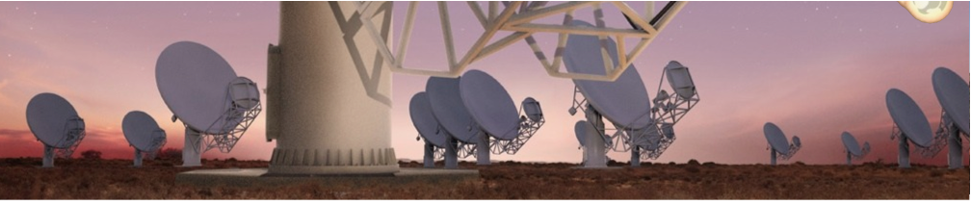
Coming shortly (2016)
MeerKAT the South African SKA precursor, will consist of 64 x 13.5m Gregorian offset antennas

Slide 14
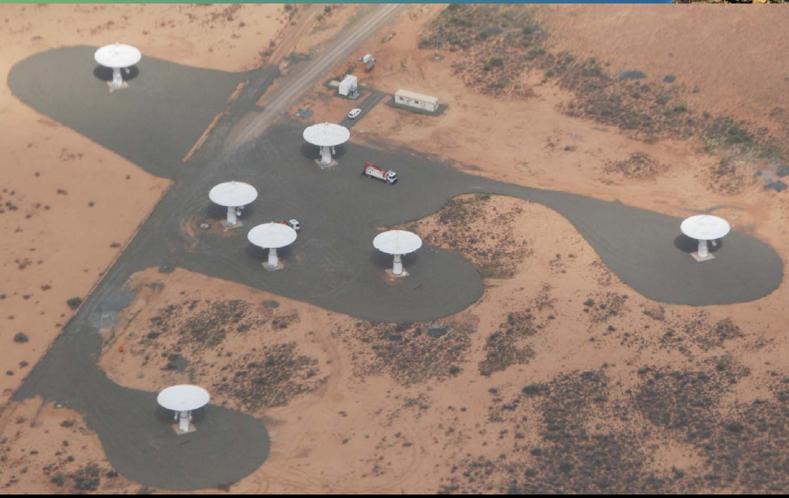
KAT-7
Under commissioning
and already in demand!

Slide 15
Science-verification of KAT-7
Commissioning, software and systems engineering teams coming together with PI teams to start science verification
Systematic/thematic approach with small teams led by commissioning scientists
Broadening out to PI teams
Real observations within 6 -12 months…..????

Slide 16
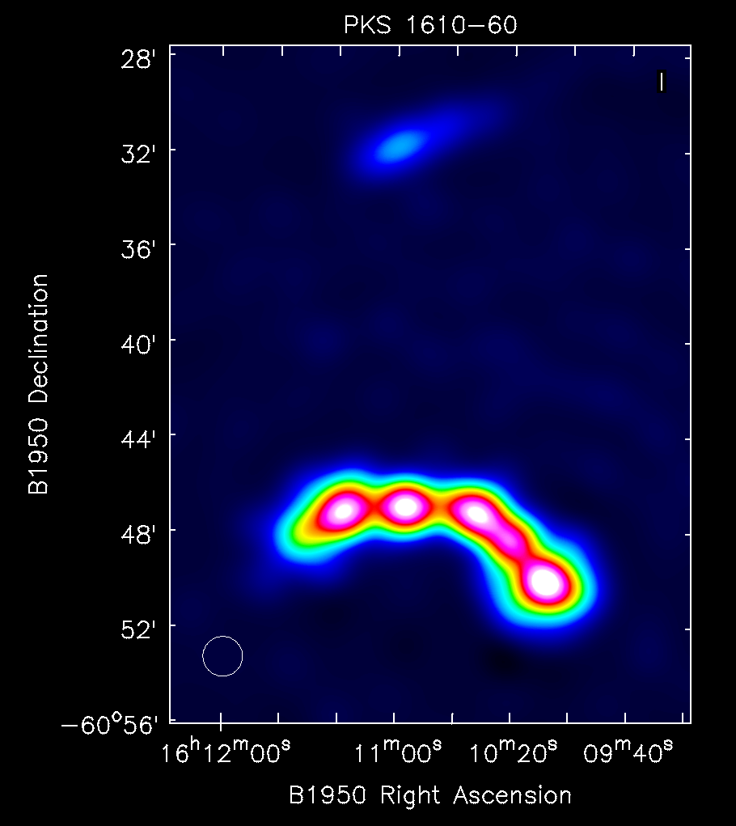
KAT-7 image of Pks 1610 - 60

Slide 17
KAT-7 monitoring of the L-band radio flux after the Gamma –ray flare in
The BL Lac object PKS 1510-089
Flare detected by SKA student, Faith Hungwe and monitored by Simon Ratcliffe and the commissioing team

Slide 18
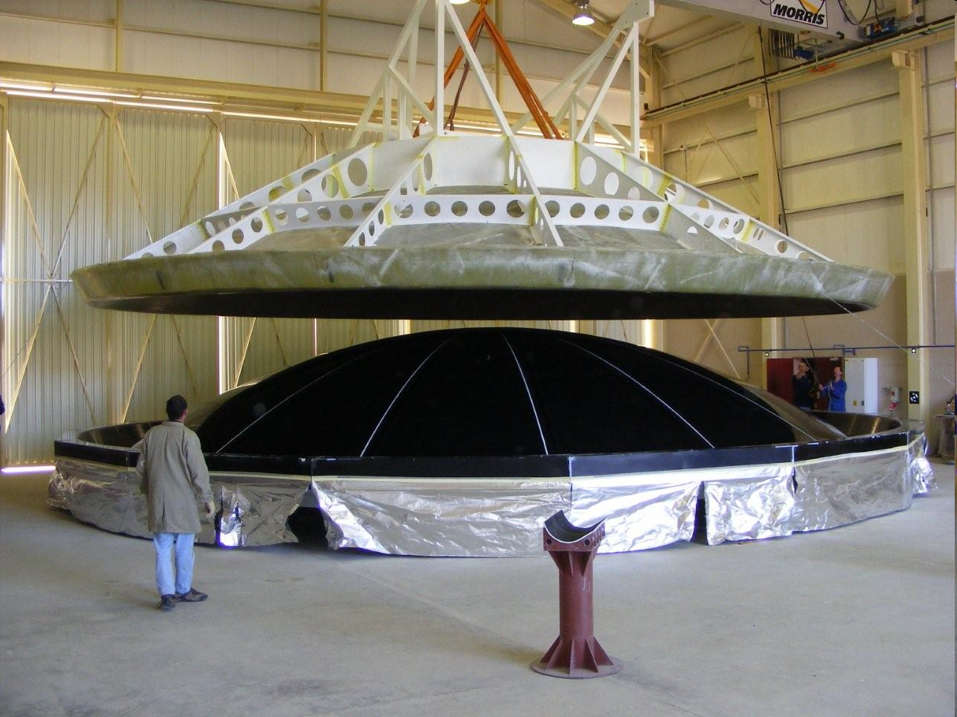
SA Innovation in antenna design/construction.
The first KAT-7 12m composite antenna being lifted off its mould in Kleerfontein

Slide 22
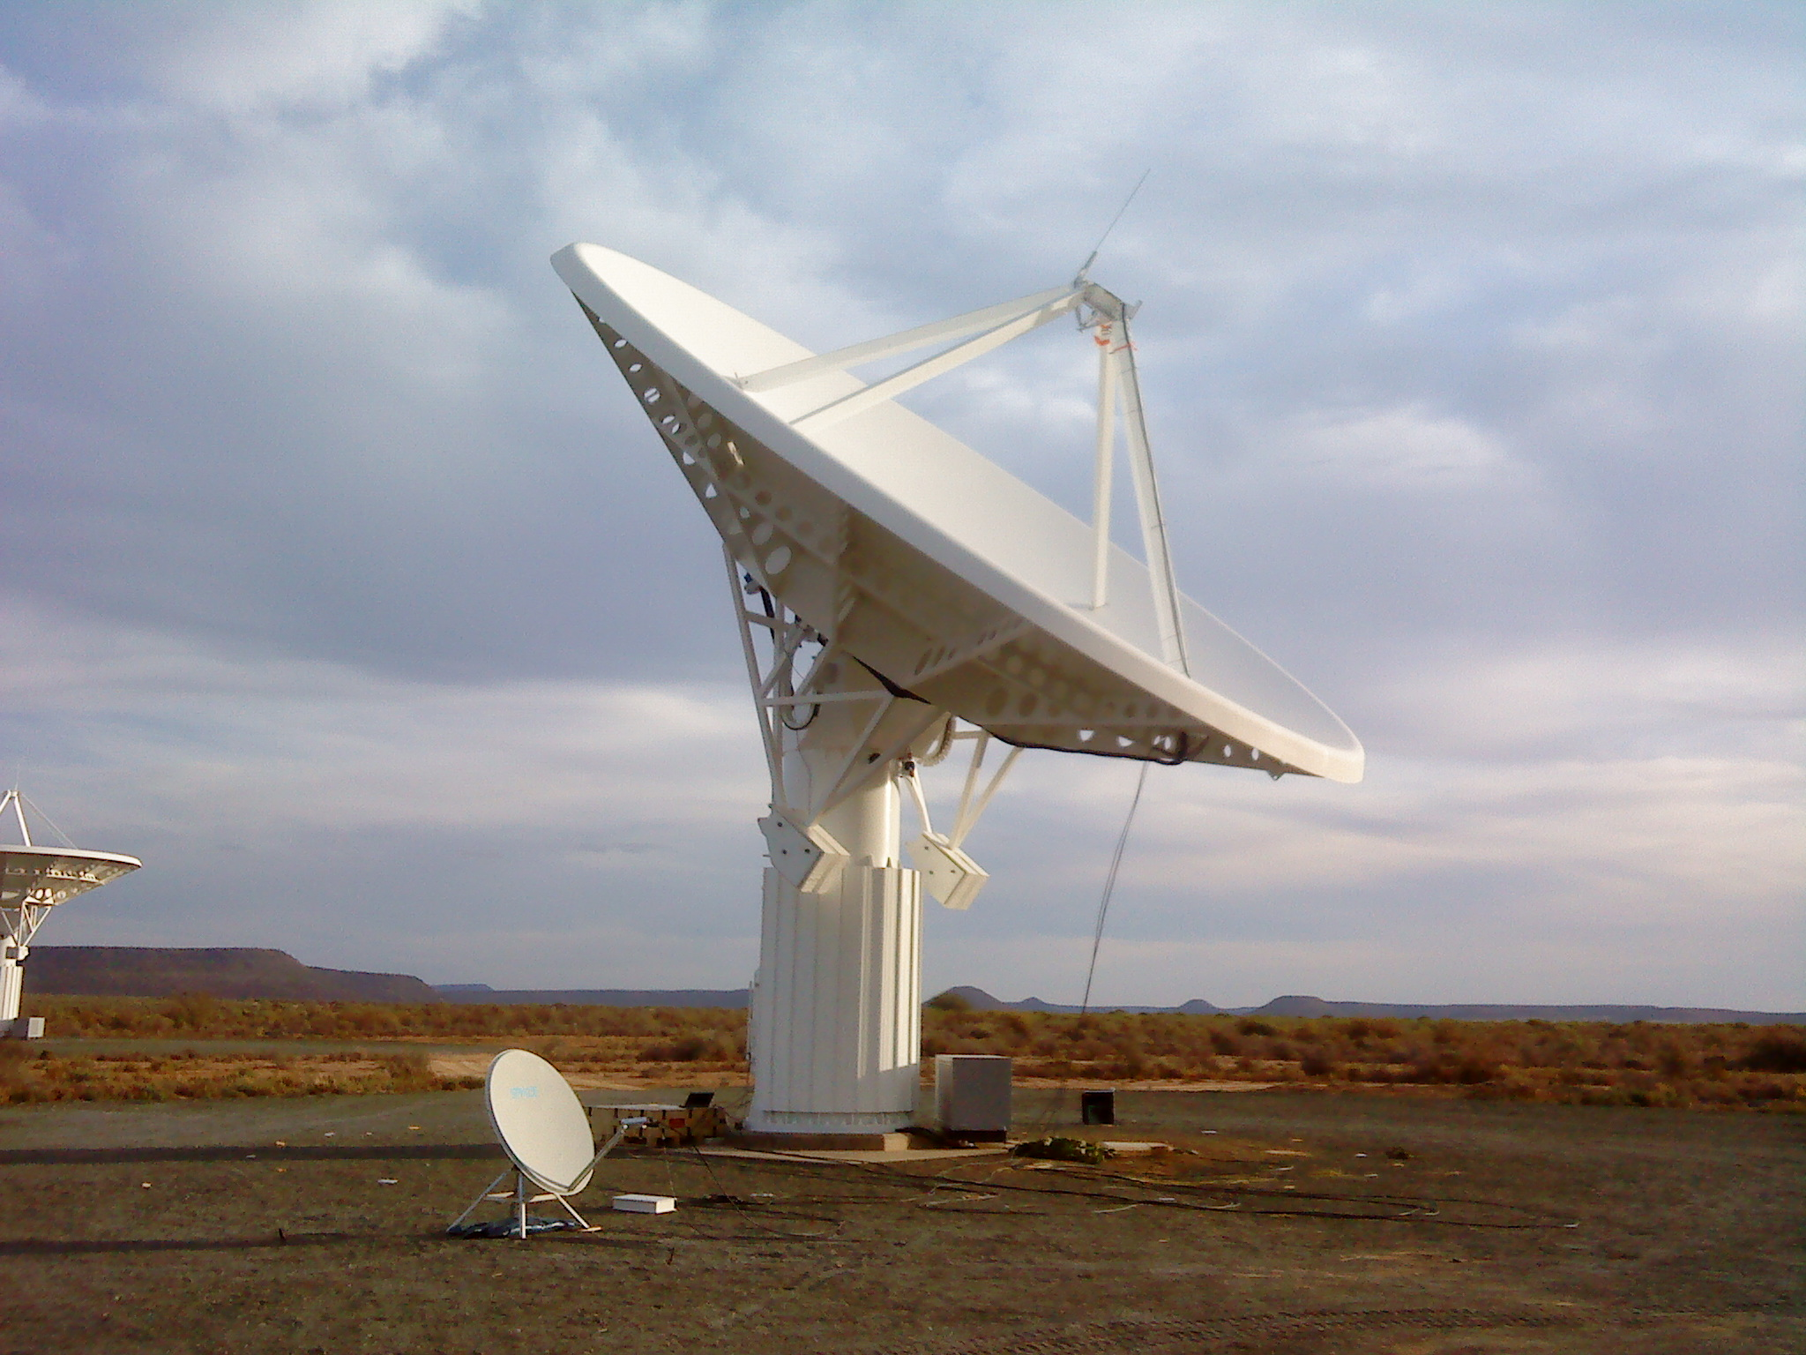
But the KAT-7 Antenna has limitations
Single cryogenic octave-band receiver
Single-reflector symmetric centre-fed antenna
Analogue signal transport and remote digitization

Slide 23
And given our goal for MeerKAT:
The most sensitive cm telescope in the southern hemisphere (world)
580 MHz – 15 GHz (in 3 bands –
0.9 – 1.7 GHz, 0.58 – 0.9 and 10- 15 GHz )
High sensitivity >250m²/k
High dynamic range imaging
High (u-v plane) filling factor < 1 km
10% dishes at longer baselines out to 20 km for positional precision

Slide 24
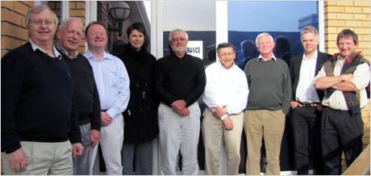
MeerKAT Concept Design Review

Slide 25
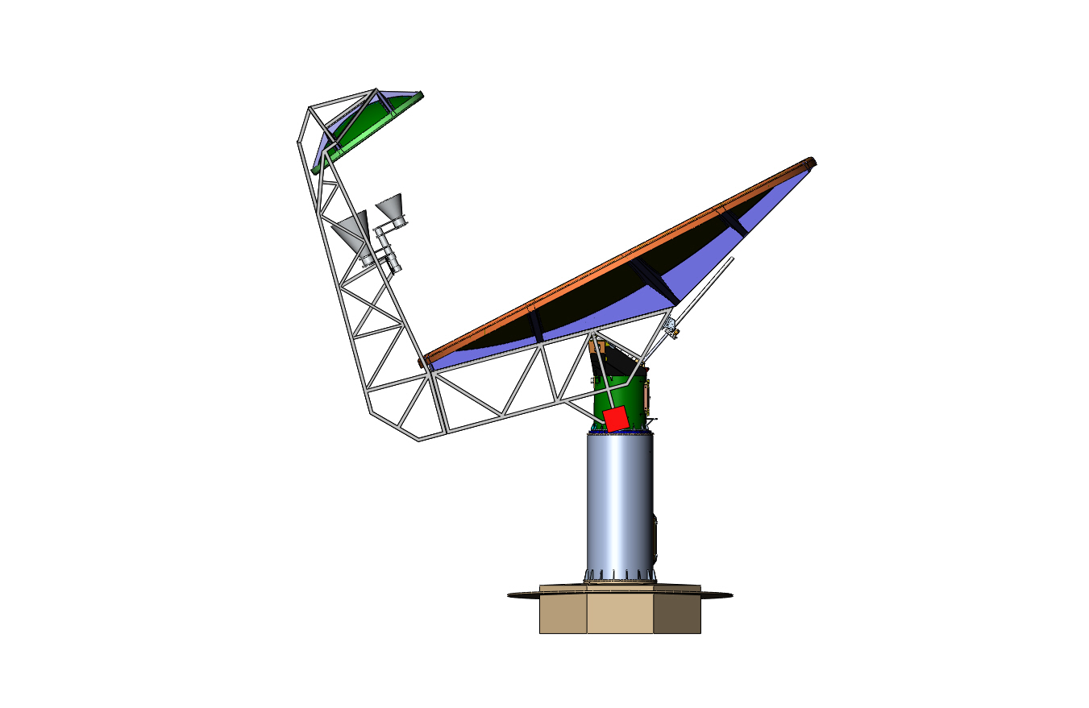
We chose to change the antenna configuration
- Also to comply with the SKA Baseline Design
Gregorian offset dual-reflector antennas
-NO Aperture blockage
-- Cleaner beam, lower sidelobes
  Allows multiple receivers
  Superior RFI rejection
  Superior sensitivity and signal fidelity
Cryogenically cooled octave-band receivers
  Superior sensitivity and signal fidelity
Direct digitization
  Superior signal fidelity
Multiple cryogenically-cooled octave-band receivers
Dual offset reflectors
Direct digitization at the receiver

Slide 26
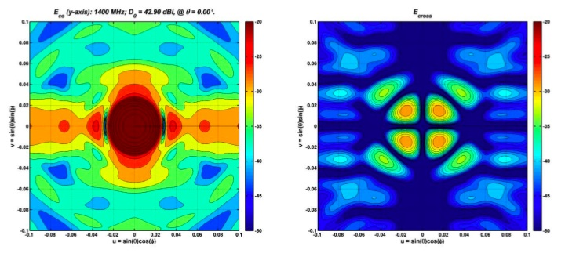
CF vs GO inner beam pattern: lower far out side lobes, better polarisation response

Slide 27
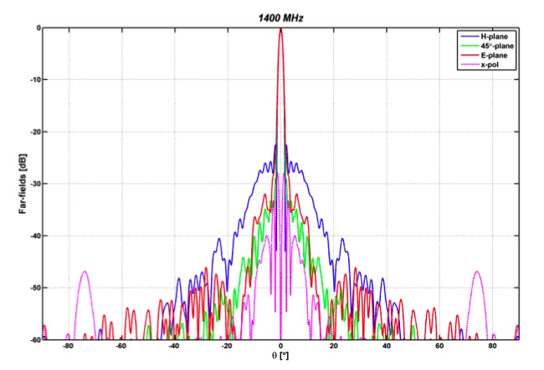
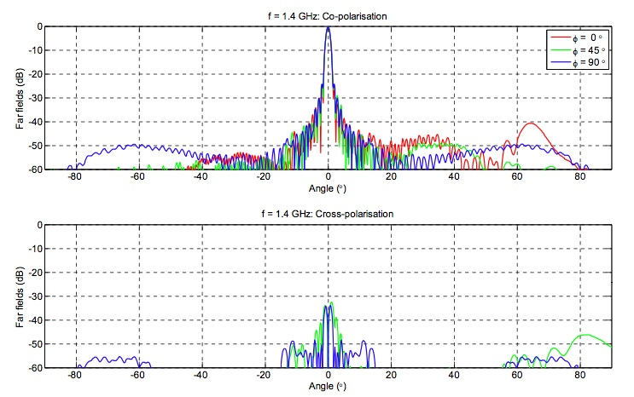
CF vs GO far sidelobes

Slide 28
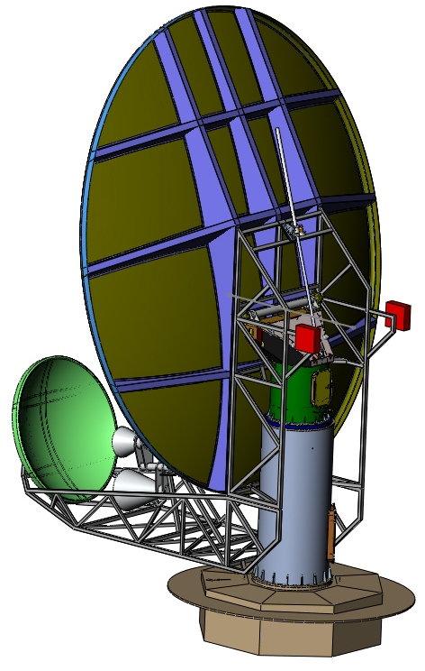
MeerKAT
Offset Gregorian Antenna
13.5 x 16m rms 0.63 – 0.7 mm
Focus mechanism 15 GHz
85% availability:
8% wind; 2% rain
Wind stow 68.4 km/s

Slide 29
Digitization and synchronization
Based on CASPER, but may be modified ROACH
(MeerKAT Engineers played a major role in these digital developments, begun in Berkley but taken over by KAT)
No heterodyne
4 Gb/s, non interlaced.
RFI and heat management
Round-trip phase monitor/control?
X-band digitization?

Slide 30
MeerKAT Array Configuration
Distribution of collecting area:
  70% within a dense core with < 1km diameter with baselines down to 20 m
    Extended low surface brightness emission
    Radio transients
  20% randomly scattered out to 10 km
    High dynamic range imaging
    Short exposure imaging
  10 % in designed array out to 20 km
    Rotation and bandwidth synthesis imaging
    Source localization

Slide 31
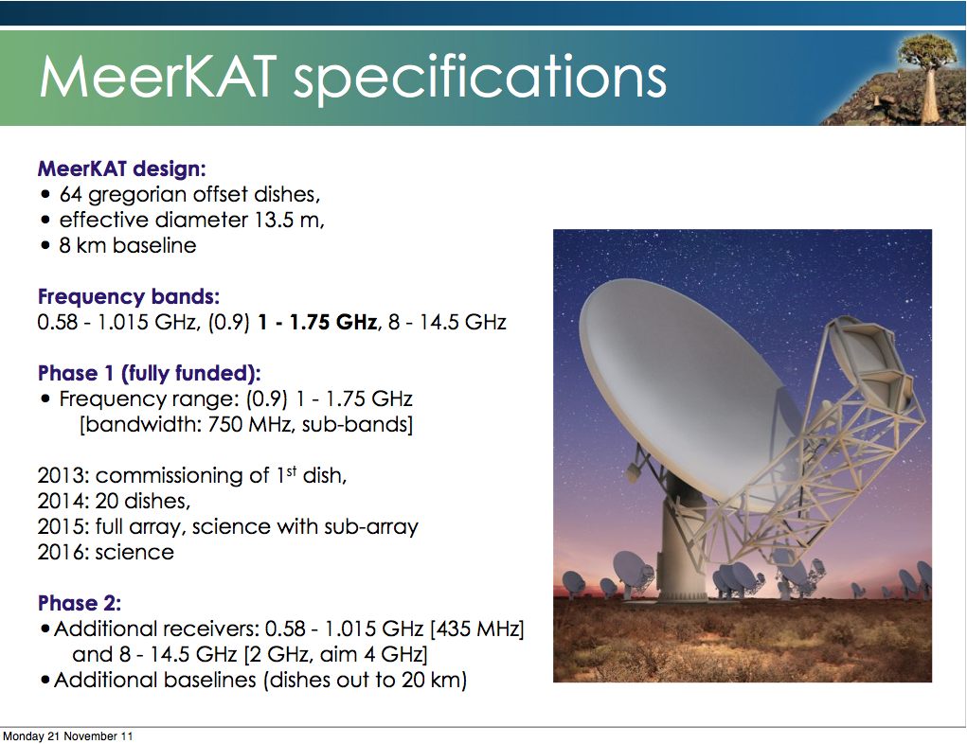

Slide 32
MeerKAT Science
Call for Proposals for MeerKAT survey science : Mid 2010
>20 proposals: asking for more than 10 years of observing time
700 authors –about 500 unique
60 RSA astronomers
A scientific advisory committee helped us assess the proposals and we have allocated circa 5 years of time

Slide 33
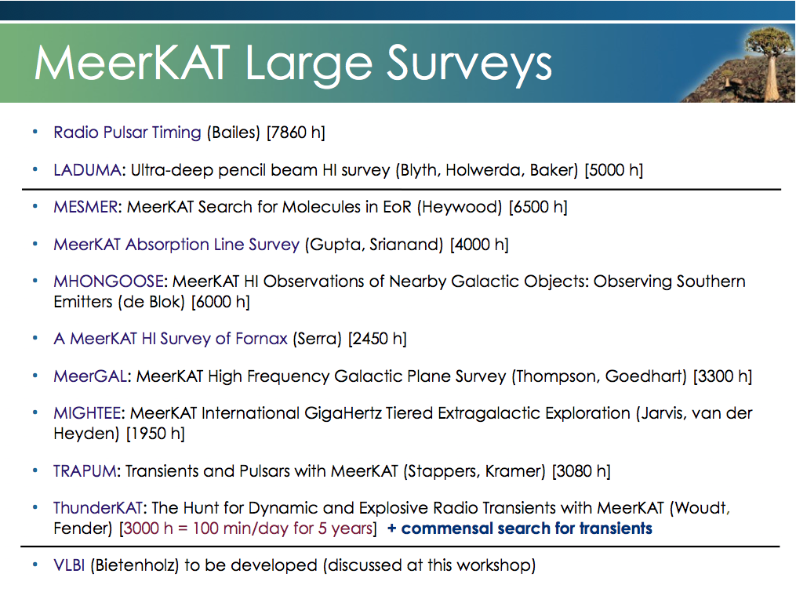

Slide 34
MeerKAT Science- Summary
1. Deep, sensitive studies of the early Universe and the first galaxies after the EoR.
Studies of primordial hydrogen, both atomic and molecular
2. The earliest radio galaxies – even new types – Galaxy evolution
3. High frequency studies of the Galaxy and the Magellanic Clouds, our nearest neighbour - Galactic structure and dynamics; new interstellar molecules - formation of life
4. Transient sources and Pulsars, especially in the Centre of our Galaxy – Einstein’s Gravitational Radiation

Slide 35
The MeerKAT Large Survey Proposals
- Science goals
1. Deep, sensitive studies of the early Universe and galaxies out to the Epoch of Re-ionization.
Studies of primordial hydrogen, both atomic (z = 1.4) and molecular, via CO, to z about 7
2. The earliest radio galaxies – even new types – Galaxy evolution
3. High frequency studies of the Galaxy and the Magellanic Clouds - Galactic structure and dynamics (using e.g CH3OH masers; new interstellar molecules - formation of life
4. Transient sources and Pulsars, especially in the Centre of our Galaxy – Einstein’s Gravitational Radiation

Slide 36
1. HI (OH) Galaxy Surveys
Galaxies form from gas that cools and condenses in dark matter halos. In the local Universe (z < 0.5) HI is the easily detectable manifestation of this process (Kauffmann)
Distant Universe (LADUMA) HI to z=1.4 (580 MHz) – ECDF South (Blythe, (RSA), Baker (USA) and Holweda (ESA))
Deep survey (5000 hrs) single pointing. Evolution of HI mass density to z=1.2
Direct detection HI -> z = 0.6: stacking to z= 1.2. HI mass v. stellar mass
Baryonic Tully-Fisher relation
ECDF South is of order 0.3 sq deg: z= 1.2 FoV = 4.5 deg. Need multi band photometry, high FoV optical data with eg SALT
Simulations (SKA Simulate Skies – Oxford)

Slide 37
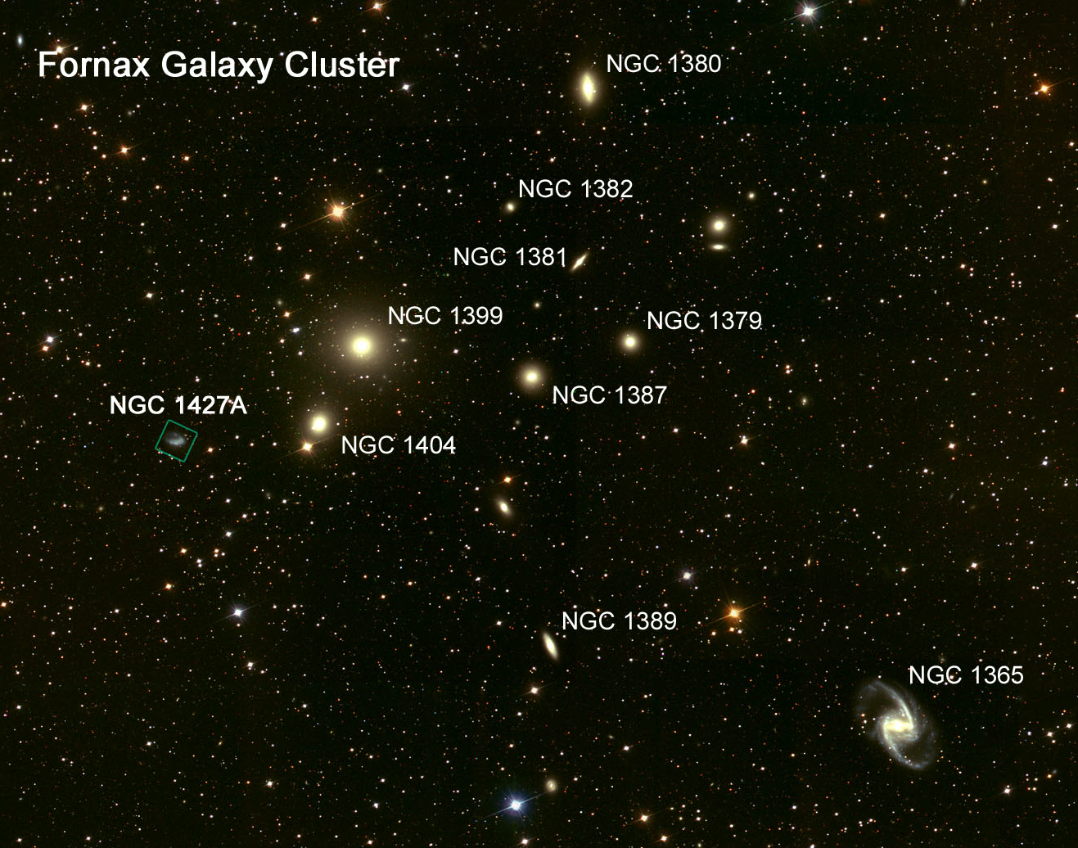
Further HI proposals
Galaxy Clustering (FORNAX cluster) PI P. Serra - ASTRON)
Galaxy formation and evolution in clusters - Effects of galaxy-galaxy interaction, tidal stripping, etc…. (
HST heritage image

Slide 38
More HI studies
Nearby galaxies of different types (MHONGOOSE)
(E. de Blok – Netherlands/UCT)
Deeper version of ‘Things’ Survey with the VLA
Studying relatively local galaxies; comparison with eg Spitzer data
Connection between star formation, HI dynamics and accretion; molecular gas
Outer discs of galaxies and the cosmic web; dark mater
Probable collaboration with a proposal, Meer-QUIttens, that was not deemed a ‘Key’Project but the TAC thought it important to do Rotation Measure Synthesis on galaxies and suggested a collaboration with Mhongoose
ABSORPTION LINE SURVEY– Gupta, ASTRON and Srianand - Poona)
HI at high z (easier to detect in absorption against a continuum source than
emission plus investigation of magnetic fields (Zeeman splitting) and the constancy of
Fundamental constants as a function of z using OH lines and their different dependencies on the fine structure constant and the electron/proton mass ratio

Slide 39
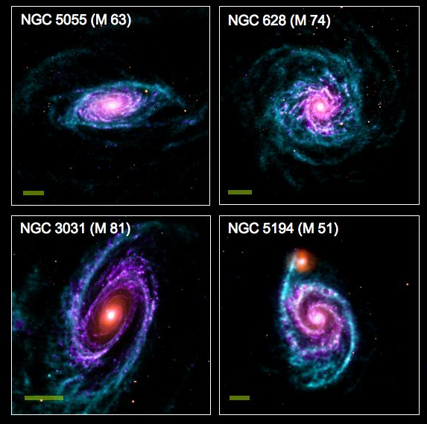
Mhongoose - Galaxy Assembly & Evolution – de Block

Slide 40
The Velocity Field of M31 and the Dark Matter
Radio observations of the neutral hydrogen line in nearby galaxies showed that the speed of rotation of the gas is constant far beyond the optical image. The optical image suggests that the galaxy must be embedded in a huge dark matter halo.

Slide 41
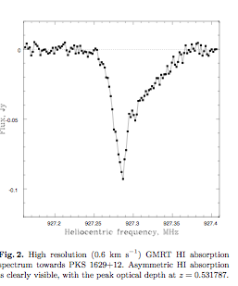
HI Absorption lines – Gupta and Srianand
HI may be detected more easily in absorption against a background continuum source
Pks 1629 + 12
Z = 0.531787
Kanekar and Chengalur
GMRT

Slide 42
2. High frequency studies nb high frequency receiver 8 – 15 GHz
MeerGAL – High-frequency survey of the Milky Way Galaxy (and Magellanic Clouds)
-Measuring Galactic structure, rotation curve. Recombination lines - investigating ionized gas component (HII regions), detecting new molecules. Molecules of life.
Mark Thompson (Hertforsdshire) and Sharmila Goedhart (RSA – MeerKAT)
MESMER (MeerKAT Search for Molecules in the Epoch of Re-ionisation) - Searching for CO at high red-shift (z>7) to investigate the role of molecular hydrogen in the early universe and also water and other molecules at high z.
Ian Heywood, Oxford University, UK

Slide 43
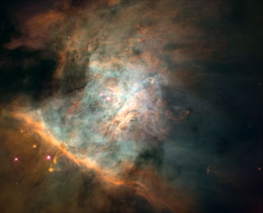
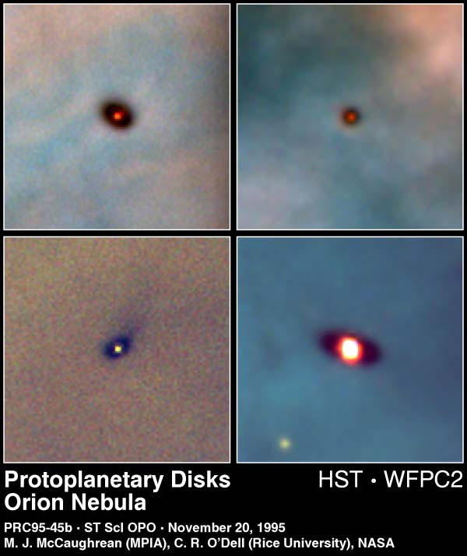
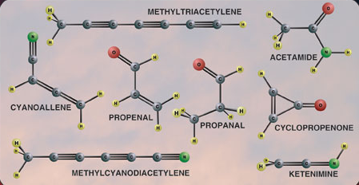
Astrobiology at Long Wavelengths
λ > 1 cm
Not affected by dust
Complex molecules have
transitions at longer wavelengths
“Waterhole” (1.4–1.7 GHz)
Leakage emissions from extrasolar planets

Slide 44
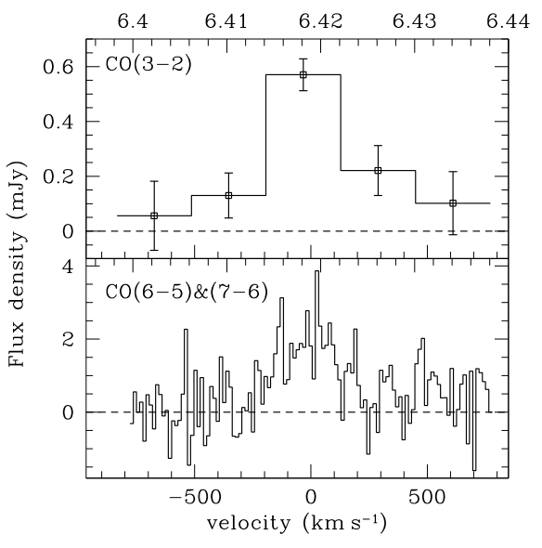
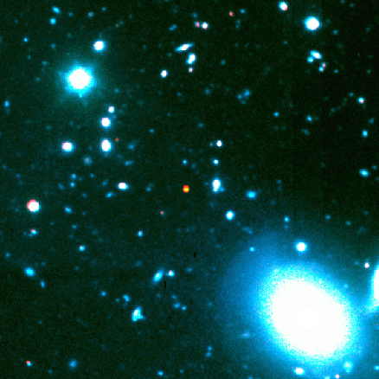
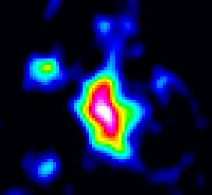
CO and dust detected at z=6.42, already close to EoR
VLA
PdBI
Fuel for Galaxy Formation
Size ~ 5.5 kpc
Radio-FIR SED follows star forming galaxy
SFR ~ 3000 M/yr
SDSS J1148+52: Gas detection
z = 6.42 (t = 0.87 Gyr)
L_{bol} = 10¹⁴ L
SMBH ~ 3 × 10⁹ M
M(H2) ~ 2 × 10¹⁰ M
Carilli et al.

Slide 45
3. Deep Continuum studies (Mightee) van der Heyden (RSA< UCT and Jarvis (Hertfordshire, UK and UWC, RSA)
Long integrations of selected regions in order to reach micro-Jansky sensitivity levels
Will integrate on the same field as Laduma
Synergy with the wider field ASKAP-EMU survey
Mightee is so sensitive that it is very likely to detect new types of radio sources – showing the way the radio galaxy population evolved

Slide 46
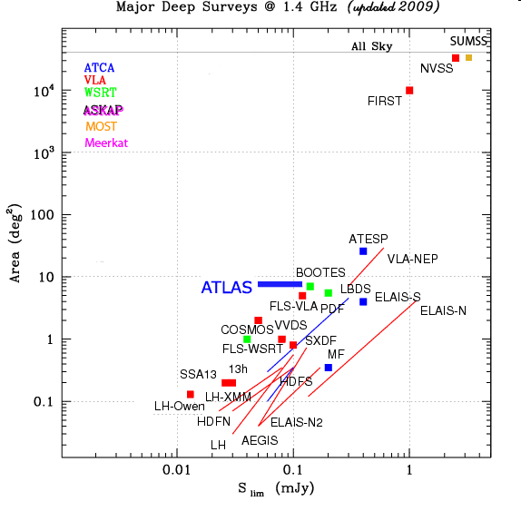
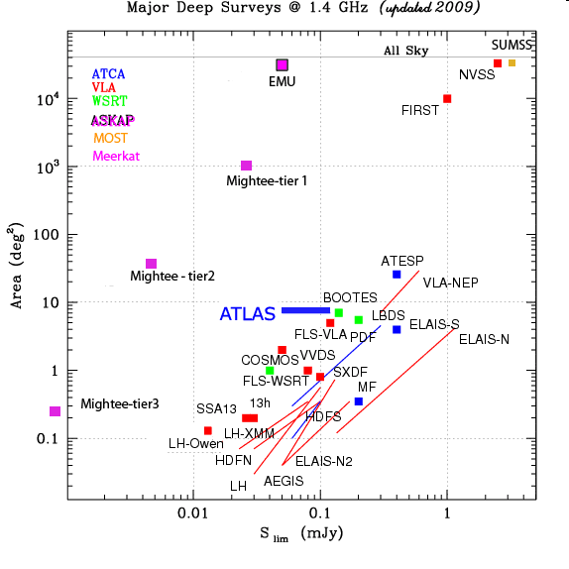
Current major 20cm surveys
SKA pathfinders
Limit of conventional radio-telescopes
Diagram courtesy of Isabella Prandoni

Slide 47
4. Pulsars and Transients
Pulsar Timing (Bailes, Australia), Gravitational wave detection – PULSARS in the Galactic Centre at high frequencies – unscattered.
Pulsar timing – gravitational waves
Pulsar timing – variations in period may indicate gravitational waves pervading the medium
Nb MEERKAT More sensitive than Parkes for Pulsar science
Trapum (Stappers (JB, UK) and Kramer (MPI, Bonn)
Pulsar Searches – looking for new types of Pulsar some switch on and off – why? how?
Transient detection, eg gamma ray bursts, new supernovae,……

Slide 48
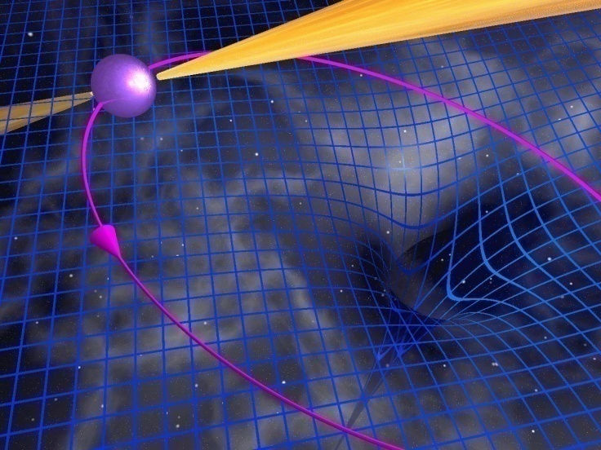
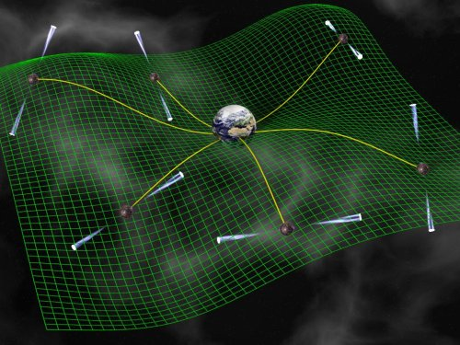
PULSARS and Tests of General Relativity and Search for Gravitational Waves
Huge pulsar surveys will discover pulsar black hole binaries, providing direct tests of gravity in the strong field limit.
Huge numbers of pulsars provide an array of very stable “clocks” which can be used to detect a background of grav waves.

Slide 49
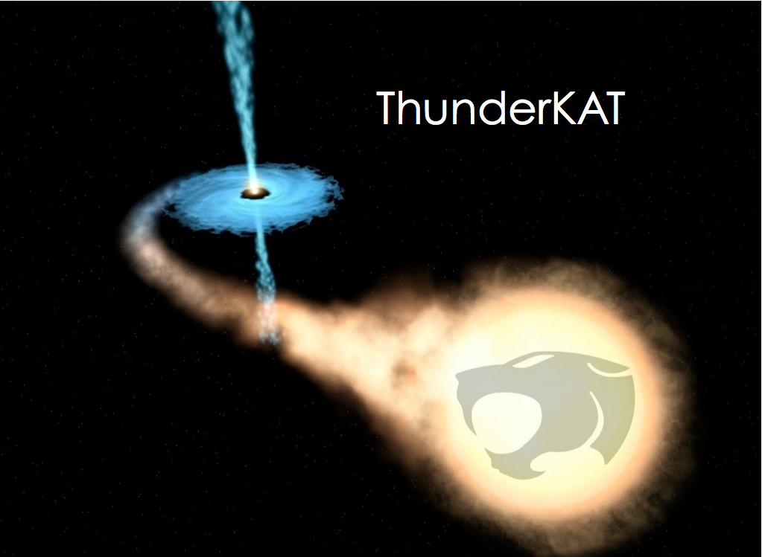
MeerKAT Transients
Woudt (UCT-SA) and Fender (Southampton, UK)

Slide 50
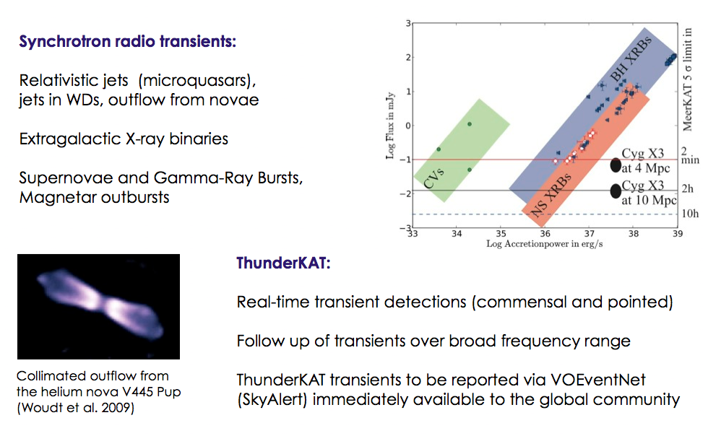
SLOW Transients

Slide 51
Slow Transients
Slow (several seconds) transients are the topic of the Thunderkat project. The team expect to detect and study high-energy gamma ray bursts, radio supernovae and other types of explosive event, in both the nearby and the more distant Universe.
All three of the timing/transient projects are data hungry and want to sample all data steams from all other projects, perhaps a head-ache for our engineers, but in doing so, they hold serious promise of very exciting results.

Slide 52
Moving forward
Networking among the pathfinder survey groups
Using existing telescopes (eg KAT-7 but also other telescopes) to obtain pilot data sets that can be used by everyone for tuning source extraction algorithms, data analysis pipelines…
A forum for sharing expertise in software – perhaps leading to more uniformity across the surveys
Public data base of simulations
Data bases of ancillary data- Optical/IR imaging, spectroscopy, X-ray data,…
Some of these collaborations already exist in eg the Pulsar community but we should become part of them, and participate in setting up others

Slide 53
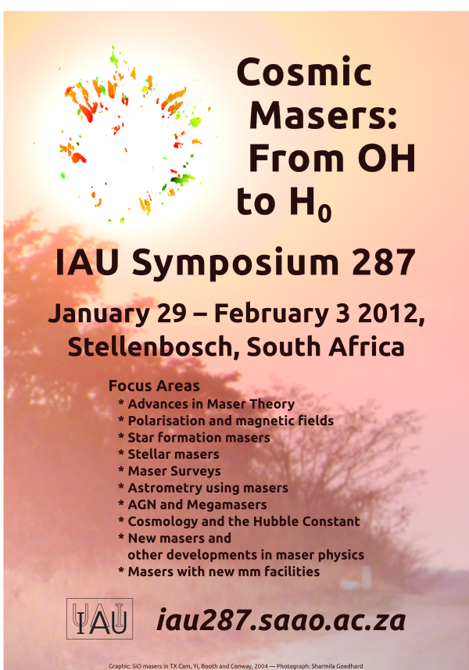
iauS287.ska.ac.za

Slide 54
