Slide 1
Structure Function of Rotation Measure toward High Galactic Latitudes
Takuya Akahori^{1,2}
¹Radio Astronomy Division, KASI
²Research Fellow for Young Scientist, Korea Research Council of Fundamental Science and Technology (KRCF)
Collaborators
@KASI, -2012.9
(KRCF fellow)
Korea SKA SWG
Magnetic Fields (Dr. Ryu, Dr. Kim)
ASKAP
Polarization Sky Survey of Universe’s Magnetism
POSSUM (Dr. Gaensler)
Takuya Akahori
Japan SKA SWG
RM Tomography (Dr. Takahashi)
@Sydney, 2012.10- (JSPS fellow)

Slide 2
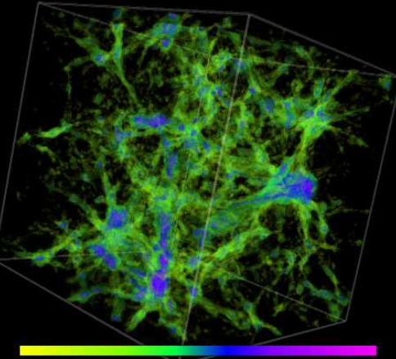
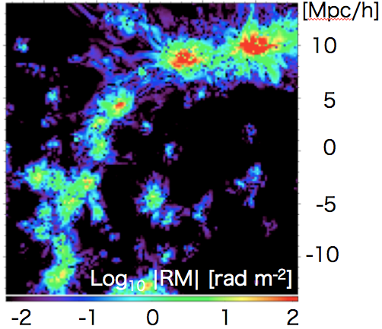
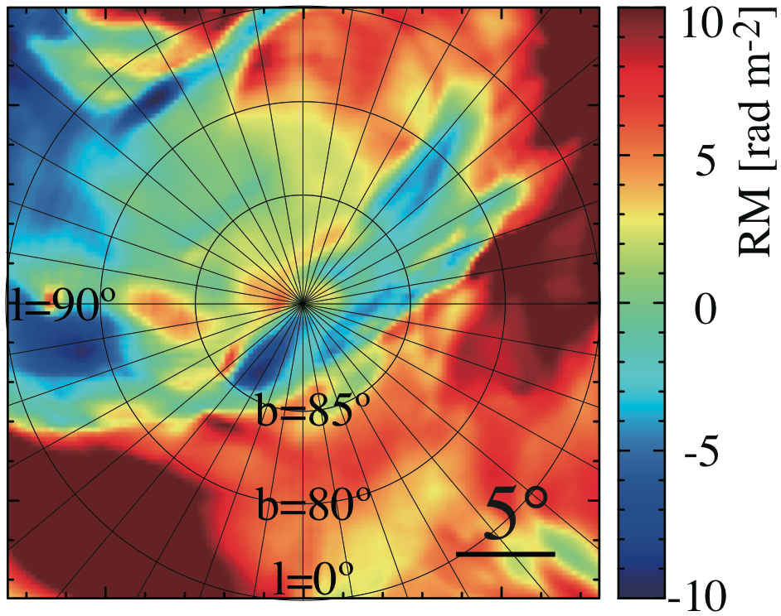
Contents
1
2
3
4
Introduction (Cosmic Magnetism)
Intergalactic Magnetic Filed (IGMF)
Galactic Magnetic Field (GMF)
SKA Activities

Slide 3
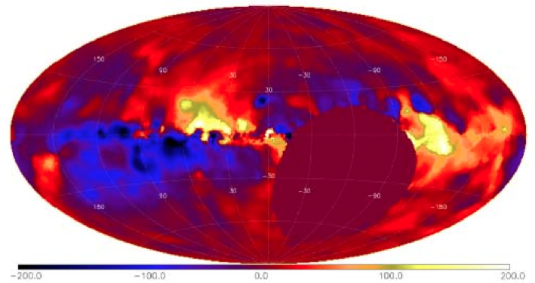
Cosmic Magnetism
Cosmic Magnetism – an unresolved problem of astrophysics –
IGMF
– Inter-Galactic Magnetic Field –
ICM → partly known
|RM| ~ 100 [rad m⁻²]
IGMF ~ 1-10 [μG]
WHIM → unknown
|RM| ~ 1? [rad m⁻²]
IGMF ~ 0.1-0.01? [μG]
Propagations of…
- UHECRs
- γ-ray halo/echo
Evolutions of…
- Galaxy clusters
- Large-scale structure
Seed Fields of...
- First objects
- Proto-galaxies
Taylor, Stil, Sunstrum (2009)

Slide 4
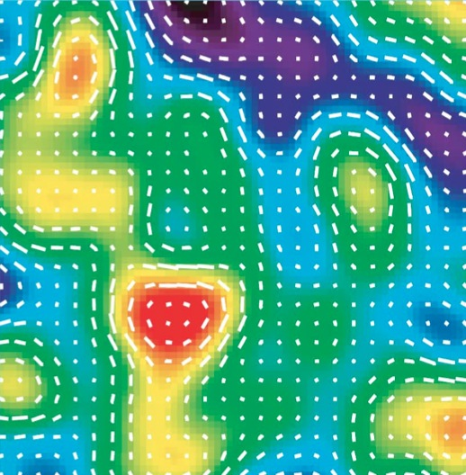
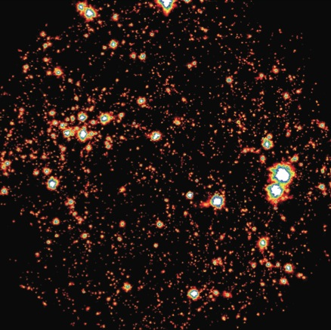
IGMF RM: Our Approach
What’s the possible origin?
Turbulence in structure formation
Dynamo amplification (Ryu+ 08; Dolag+ 08; Cho, Ryo 09; Schleicher+ 10)
Turbulence in the ICM
Kolmogorov-like power spectrum? (Vogt & Ensslin 05; Guidetti+ 08; Bonafede+ 10)
Cosmological Seed Fields
Inflation,
Phase transition, Perturbation
MHD in Structure Formation
Shock, Battery effect,
Dynamo
Leakage from Stars & Galaxies
AGN jet,
Supernova/wind, Stripping
100 h⁻¹ Mpc
We study RM due to the IGMF based on the turbulence dynamo model
10⁻⁴μG |B| 10μG
Ryu, Kang, Cho, Das (2008)

Slide 5
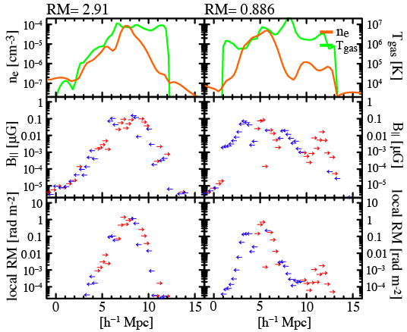
IGMF RM: Local Universe
RMS of RM through a filament ~1 [rad m⁻²]
Coherence length~ a few*100 kpc, random walk
RM map of the large-scale structure of the Universe
Line-of-sight profiles through a single filament
Akahori & Ryu (2010), ApJ, 723, 476

Slide 6
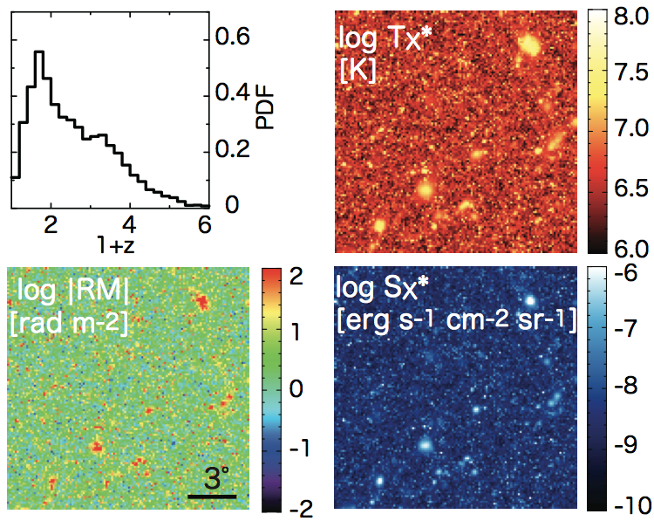
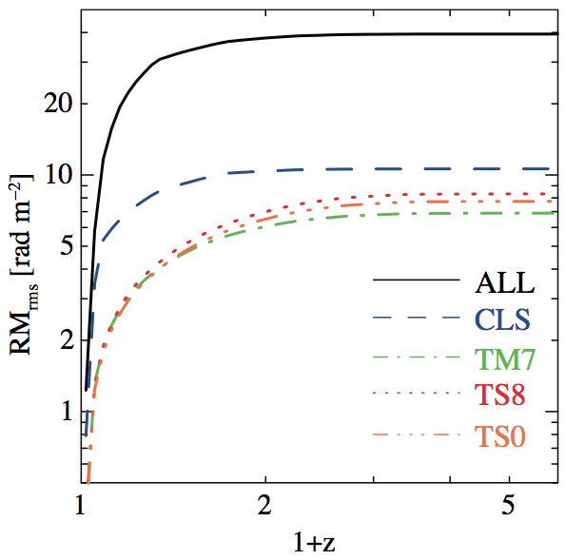
IGMF RM: Up to z=5
RMS of RM through filaments ~several-10 [rad m⁻²]
Willman et al.
(2008)
RM, Sx, Tx (z<5),
200 deg² field-of-view map
(2048² pixels, one pixel one source)
RMS of RM(<z)
(average of 2048² pixels * 200 maps)
Akahori & Ryu (2011), ApJ, 738, 134

Slide 7
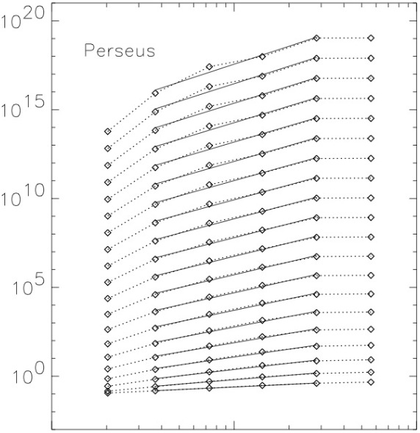
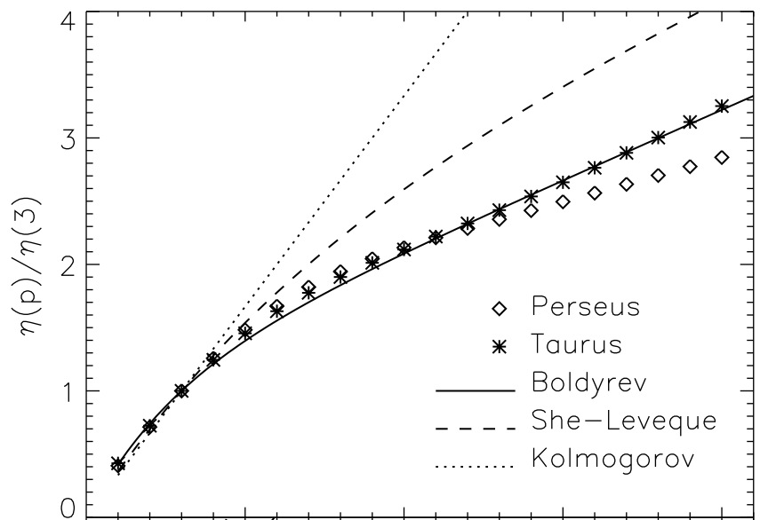
IGMF RM: Structure Function
Available for coarse-spacing data
Shape & Exponents reveal the nature of turbulence
Ex. J1-0 ¹³CO Intensity SF and SF exponents of Molecular Cloud Complexes (Padoan+ 03)
She-Leveque
Inertial range
Kolmogorov
Boldyrev
S_{n}(r)
Driving range
(Outer scale)
η_{n}
Dissipation range
(Inner scale)
0.1 1.0 10
r [pc]
n

Slide 8
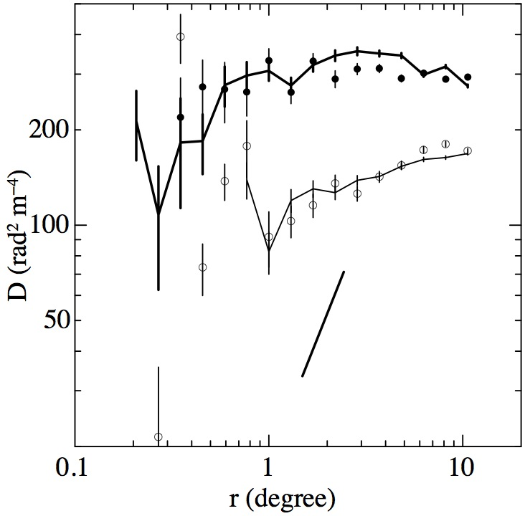
IGMF RM: Observed SFs
SFs of RM toward the Galactic Poles (Stil+ 11)
South Galactic Pole (SGP)
circles: Mao+ (10) WSRT+ACTA
lines: Taylor+ (09) NVSS
North Galactic Pole (NGP)
circles: Mao+ (10) WSRT+ACTA
lines: Taylor+ (09) NVSS
5/3
Kolmogorov
Very flat profile
100-400 [rad² m⁻⁴]
SF_{SGP} > 1.5-2 SF_{NGP}
Motivation
How much is the contribution from the IGMF?

Slide 9
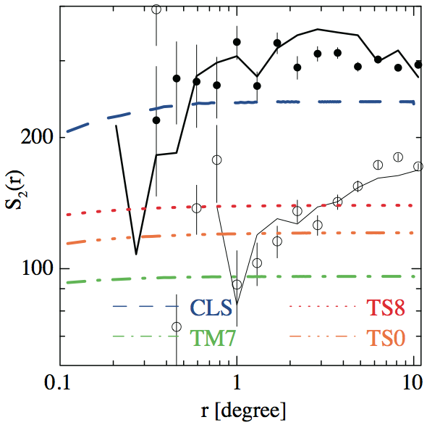
IGMF RM: Our Predicted SFs
SFs of RM toward the Galactic Poles (Stil+ 11)
South Galactic Pole (SGP)
circles: Mao+ (10) WSRT+ACTA
lines: Taylor+ (09) NVSS
North Galactic Pole (NGP)
circles: Mao+ (10) WSRT+ACTA
lines: Taylor+ (09) NVSS
Simulation Results (IGMF)
colors: Akahori, Ryu (11)
Flat @ r > 0.2º
100-200 [rad² m⁻⁴]
Motivation 2
How much is the contribution from the GMF?

Slide 10
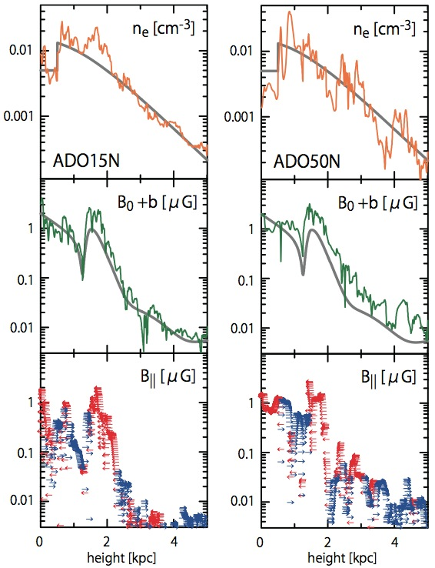
GMF RM: Our Model
GMF – Galactic Magnetic Field –
Regular component
NE2001 (Cordes, Lazio 02;03)
ASS or BSS, DP or QP, w/o Vertical (Waelkens+09; Sun, Reich 09; 10)
Random component
Stack boxes of MHD turbulence simulations (Kim+ 93; Wu+ 09)
V_{rms} = 15 - 50 [km/s]
(Tufte+ 99; Haffner+ 03, 10)
L_{drive} = 1.67 [kpc]
(Gaensler+ 08 & Wu+ 09)
Ex. of line-of-sight properties toward the NGP

Slide 11
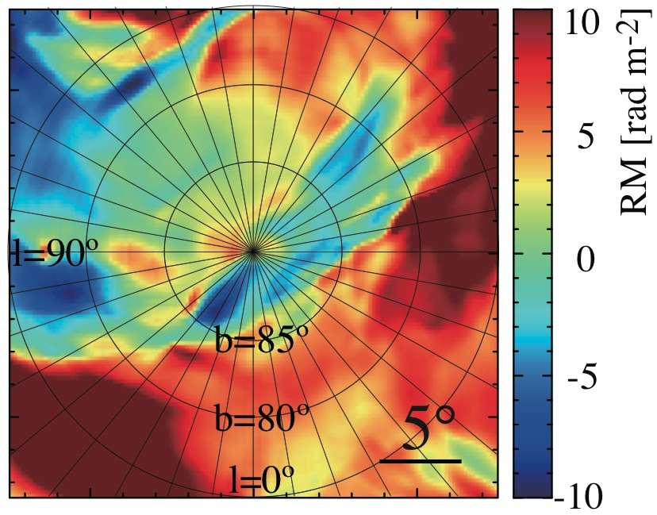
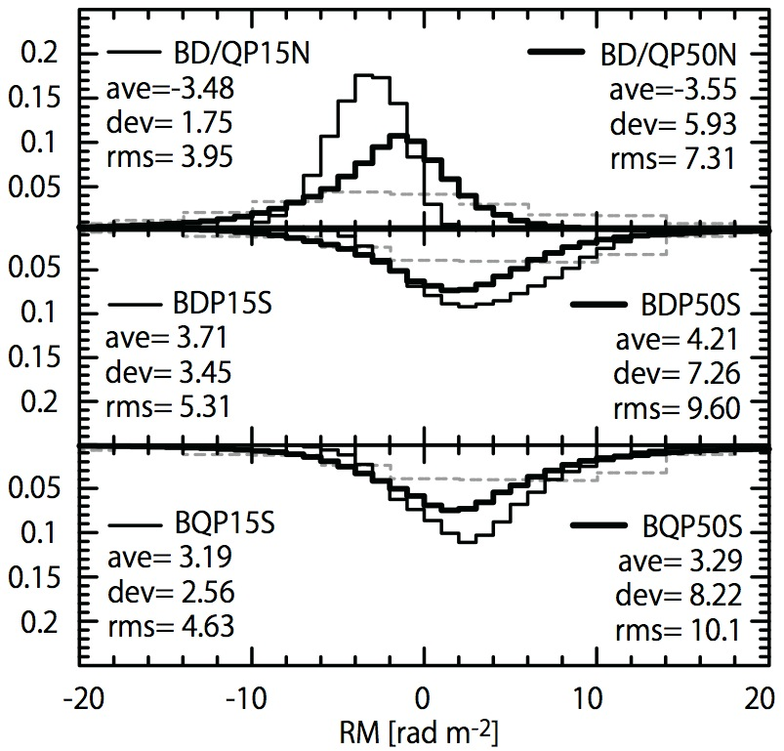
GMF RM: Map and PDF
Filament/clump structures ~ 1-severalº scales
Ave. ~ ±several [rad m⁻²], std. ~sereral [rad m⁻²]
RM map toward the NGP
PDF of RMs (Average of 200 maps)
Akahori, Ryu, Kim, Gaensler, in prep.

Slide 12
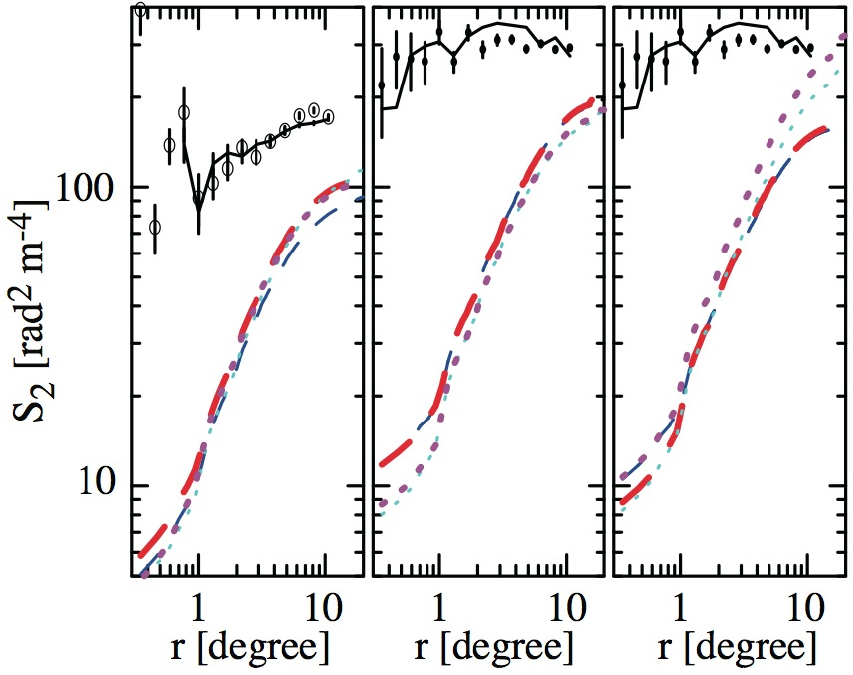
GMF RM: Structure Function
SFs of RM toward the Galactic Poles (Stil+ 11)
V_{rms} =50 km/s, L_{drive}=1.67 kpc
NGP DP SGP DP SGP QP
South Galactic Pole (SGP)
circles: Mao+ (10) WSRT+ACTA
lines: Taylor+ (09) NVSS
North Galactic Pole (NGP)
circles: Mao+ (10) WSRT+ACTA
lines: Taylor+ (09) NVSS
Simulation Results (GMF)
colors: Akahori+ in prep.
Steeper slope
100-200 [rad² m⁻⁴]
Conclusion
IGMF dominates RMs at small angular scales!

Slide 13
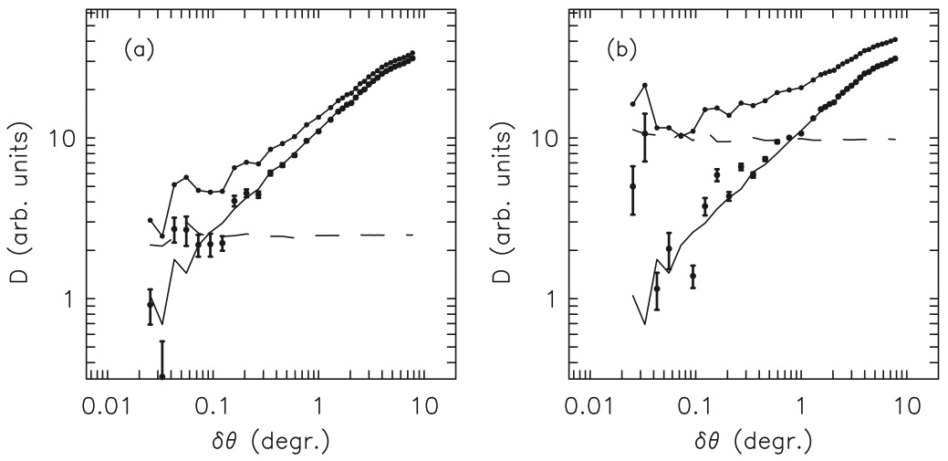
SKA Activities: Caution!
Noise effect on SFs at small angular scales (Stil+ 11)
Noise
level
Noise
level
x2
If we consider two times larger measurement error,…
We need low noise & dense RM grids data

Slide 14
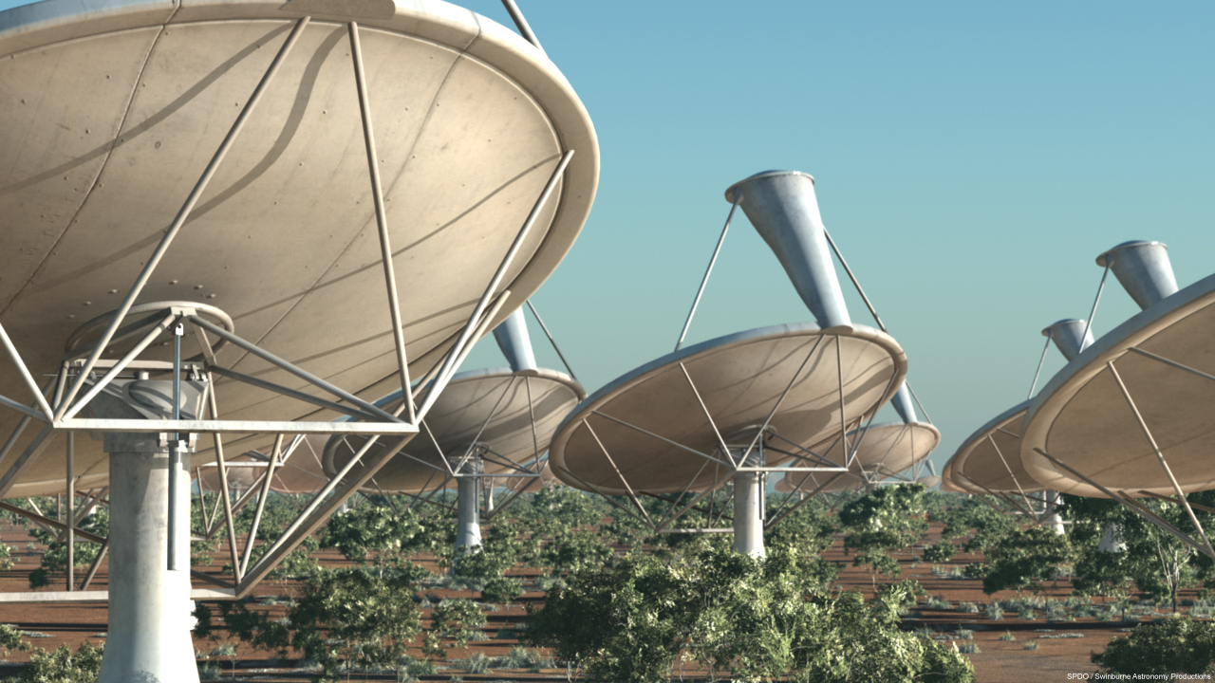
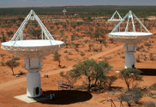
SKA Activities: ASKAP and SKA
We enter the era of observing the IGMF!
 | VLA | ASKAP | SKA
Observational uncertainty [rad m⁻²] | 10 | 1 | 0.1
Average separation of sources [degree] | 1 | 0.1 | 0.01
“Cosmic Magnetism” SKA & ASKAP
“Cosmic Magnetism” SKA-JP sub SWG
15 members: T. Akahori (PI, KASI), K. Ichiki (Nagoya), M. Inoue (ASIAA), S. Inoue (ICRR), T. Ozawa (Meisei), T. Kudo (NAOJ), K. Kumazaki (Nagoya), Y. Sofue (Meisei), Susa (Konan), K. Takahashi (Kumamoto), Y. Tsuda (Meisei), Hanayama (NAOJ), H. Nakanishi (Kagoshima), M. Machida (Kyushu), D. Yamazaki (NAOJ)
“Cosmic Magnetism” Collaboration with AUS/JPN/KOR
Polarization Sky Survey of the Universe’s Magnetism (POSSUM)

Slide 15
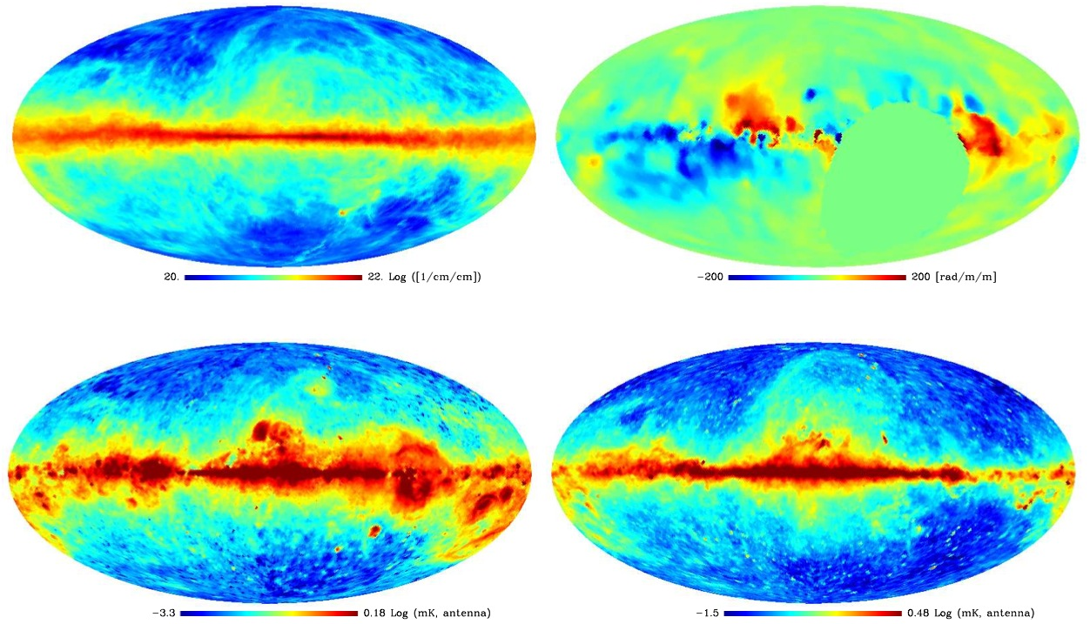
SKA Activities: Ongoing Researches
Development of Galactic Model
Correlation between “n” and “B”
n_{HI}
n_{e}, B||
I₂₁, RM
I_{syn}, I_{ff}
n_{c}, B⊥
n_{e}
Ichiki, Nakanishi, Akahori+ in prep.

Slide 16
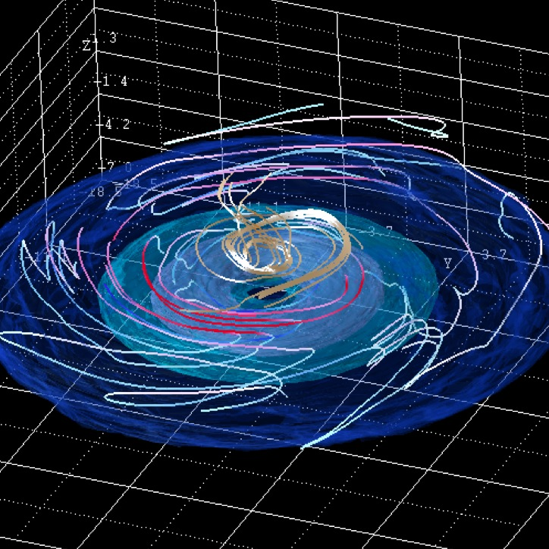
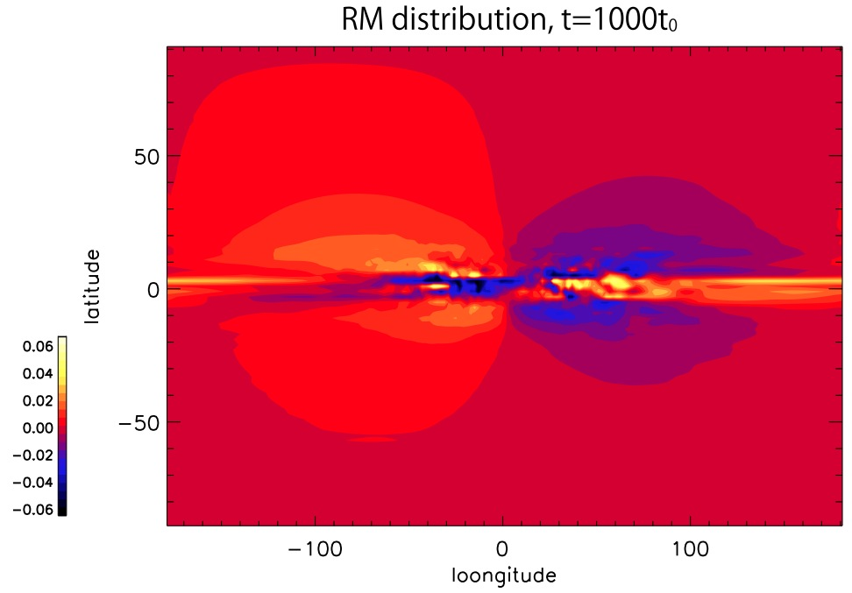
SKA Activities: Ongoing Researches
Development of Galactic Model
3D MHD simulations for global RM structure
Taylor+ (09)
Machida, Kudo, Sofue, Akahori+ in prep.

Slide 17
SKA Activities: Ongoing Researches
Development of Image Processing
Faraday RM tomography (e.g., Brentjens, de Bruyn 2005)
Polarized intensity map P(λ²)
Fourier transformation
Faraday dispersion function F(RM)
Contribution from IGMF
See Kohei’s Talk!
Kumazaki, Akahori, Takahashi, Ryu in prep.

Slide 18
SKA Activities: Possible Collaboration
Cosmic Magnetism
MHD simulations of LSS
“high resolution”
“realistic situation”
Effects of AGN activities
“jet as driving force”
“leakage of GMF”
Pulsars for 3D GMF structure
“scale height”
“latitude dependence”
Local ISM
“stratified media”
“multi-forcing”
Improvement of Tomography
“Wavelet”
“F(Φ,λ)”
Intrinsic RM
Instrumental noise

Slide 19
Summary
Cosmic Magnetism
IGMF-RM
RMS ~ 1-10 [rad m⁻²]
SF ~ 100-200 [rad² m⁻⁴], flat@r>0.2º
GMF-RM (Galactic Poles)
RMS ~ several [rad m⁻²] (V_{rms}=50km/s)
SF ~ 100-200 [rad² m⁻⁴]@10º, slope
Future
Modeling the Galaxy
Faraday Tomography

