Slide 1
3rd Center for High Energy Astrophysics Workshop
Astrophysical implications of the (n,$γ$) Reactions
Nguyen Kim Uyen,
KyungYuk Chae, Nguyen Ngoc Duy, Soomi Cha, Minsik Kwag, Kim Duhyun
Department of Physics, Sungkyunkwan University
Gyeongju - Jan. 16th–17th, 2019

Slide 2
Outline
Overview
Astrophysical implications of the (n,$γ$) reactions
Experimental approaches for the (n,$γ$) reactions
Summary and Outlook

Slide 3
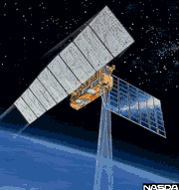
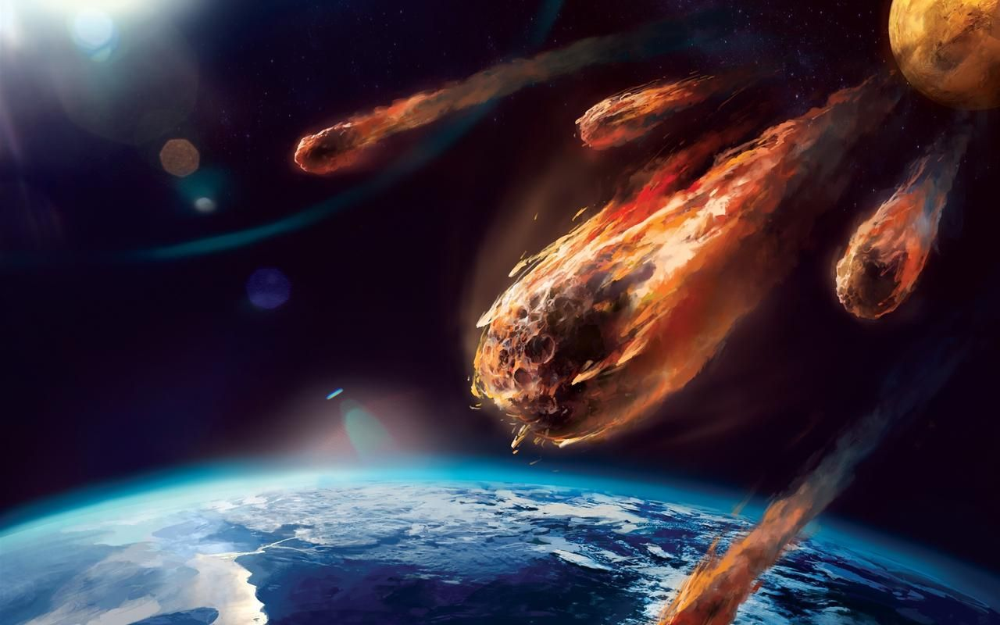
I. Overview
To understand the universe...
Meteorites
Cosmic-ray observation
Nuclear reactions

Slide 4
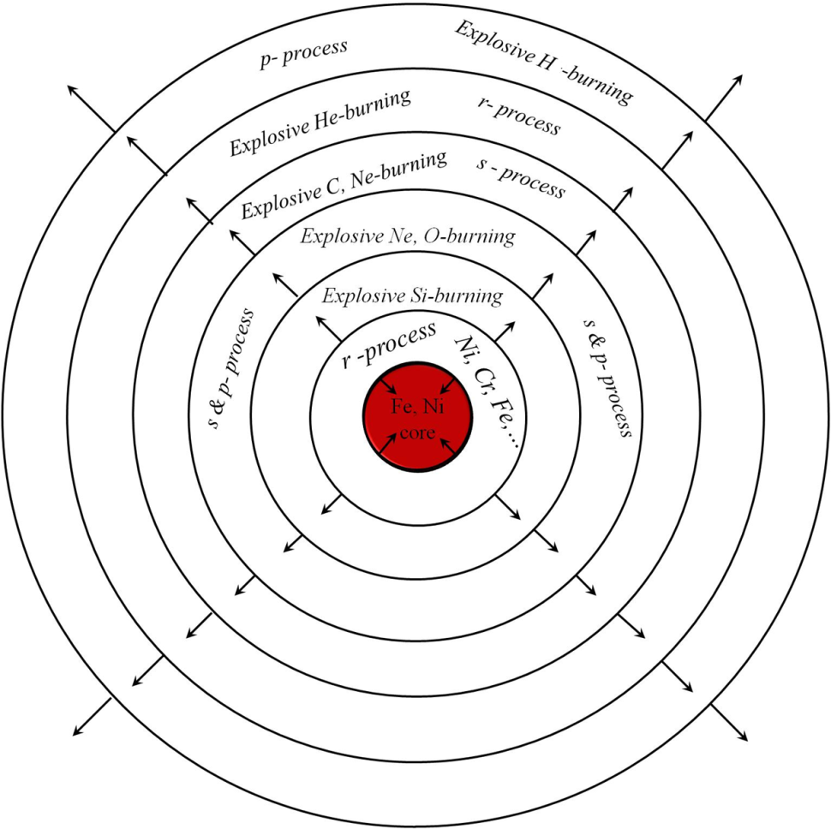
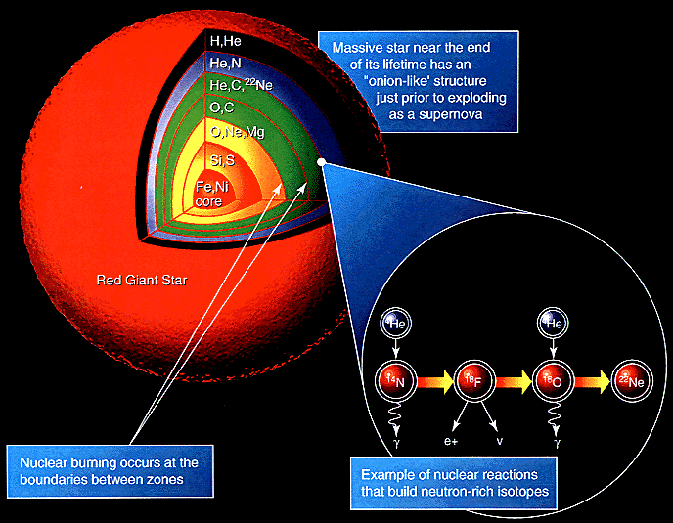
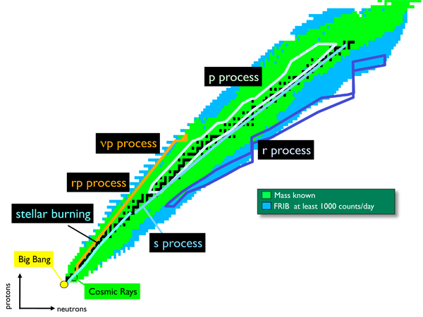
I. Overview
How is a star formed...
... Nucleosynthesis
Hydrogen burning process.
Helium burning process.
Nucleosynthesis up to Iron.
Carbon burning.
Neon burning.
Oxygen burning.
Silicon burning.
Nucleosynthesis beyond Iron.
s-process
r-process
p-process.
Other processes.
S-process
Producing half amount of heavy isotopes beyond iron, Fe.
(n,γ) and β-decay from Fe seeds along the stable nuclei.

Slide 5
II. Astrophysical implications of the (n,γ) reactions
(n,γ) reactions mainly impact on Stellar models & Abundance of isotopes
KADoNiS v0.3
T-dependent uncertainty of reaction rates
Rate uncertainty depends on the ground –state rate distribution X.
The X-factor depends on Temperature
- Reaction rates depends on temperature/energy
⁸³Kr(n,γ)⁸⁴Kr reaction for AGB stars in 1-D stellar models

Slide 6
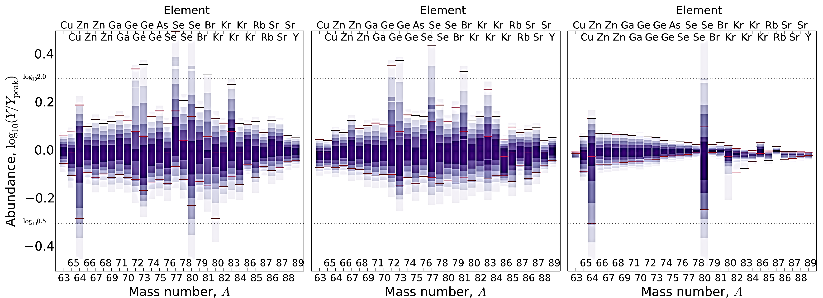
II. Astrophysical implications of the (n,γ) reactions
(n,γ) reaction rates mainly impact on Stellar models & Abundance of isotopes
Abundance of isotopes
One-zone weak s-process
Both (n,γ) and β-decay rates are varied.
Only (n,γ) rates are varied.
Only β-decay rates are varied.

Slide 7
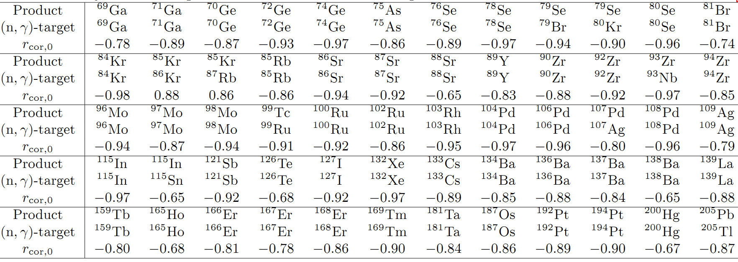
II. Astrophysical implications of the (n,γ) reactions
Important reactions
Key reactions for 1D stellar model for s-process
Weak-
Main-
N. Nishimura et al., arXiv:1802.05836v1 [astro-ph.SR] 16 Feb 2018

Slide 8
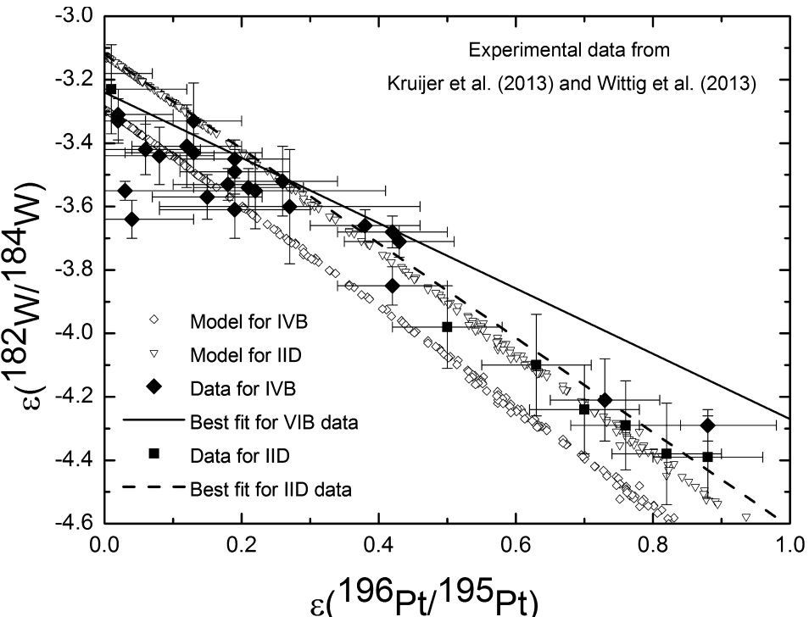
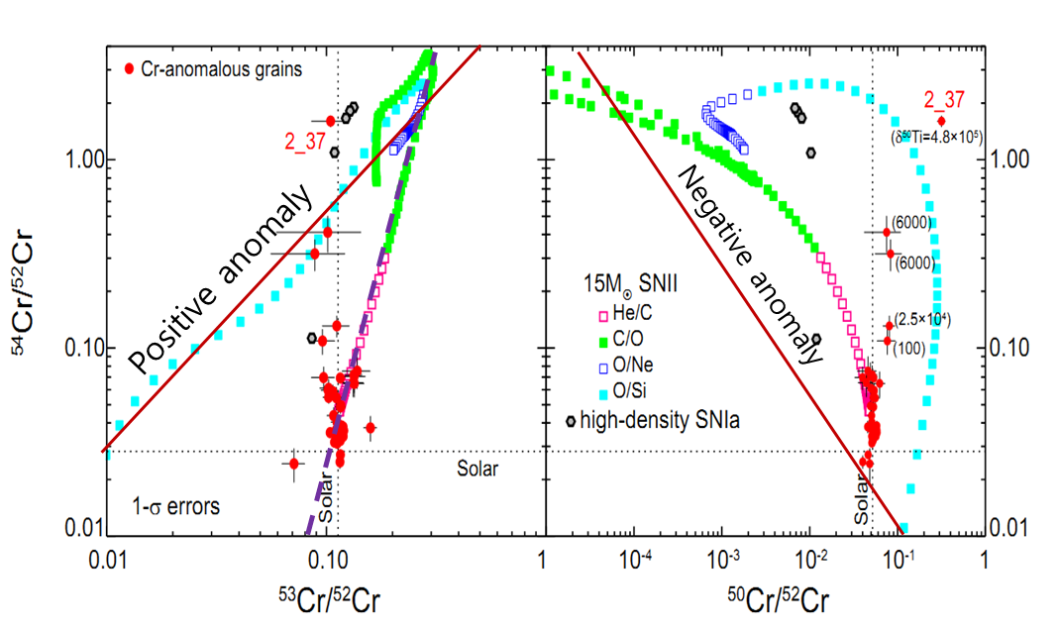
II. Astrophysical implications of the (n,γ) reactions
Reactions impact on abundance
Examples
⁵¹V(n, γ)⁵²V and ⁵²V(n,γ) ⁵³V → chrome anomaly
¹⁸¹Ta(n, γ)¹⁸²Ta
[¹⁸²W/¹⁸⁴W] = f([¹⁹⁶Pt/¹⁹⁵Pt])
with slope a = [-1.59 ~ -1.39]
Lee D. C., Halliday A. N. et al. (2002). Earth and Planetary Science Letters 198:167–175.
Kleine T., Palme H., Mezger K., and Halliday A. N. (2005). Science 310:1671–1674.
Masarik J. (1997). Earth and Planetary Science Letters 152:181–185

Slide 9
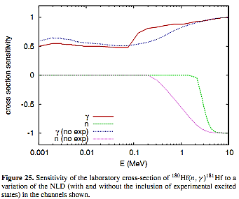
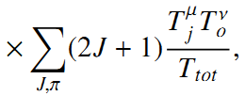
III. Experimental approaches for the (n,γ) reactions
(n,γ) reactions mainly impact on Stellar models & Abundance of heavy isotopes
Direct measurement of the cross section
More accurate reaction rates
(n,γ) reaction cross section
Hauser-Feshbach Statistical model
Improve accurate reaction rates
The more accurate Level Density,
the more precise reaction rates
[Rauscher ApJ. Supp. Ser. 201:26 (2012)]
Level density can be obtained via (n,γ) reactions

Slide 10
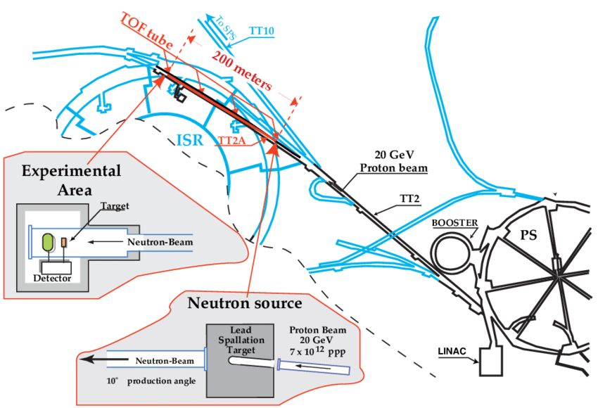
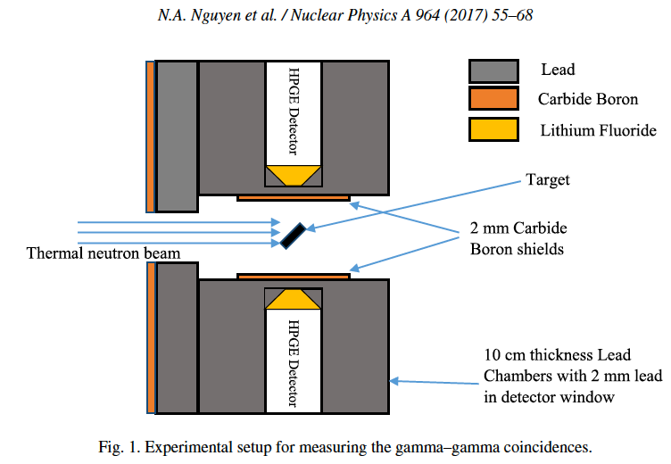
III. Experimental approaches for the (n,γ) reactions
Neutron energy for s-, r-process:
5 – 500 keV (T = 0.1 – 3 GK)
Direct measurement of the cross section
Time-of_Flight facilities: n-CERN, J-PARC, LANSCE/Los Alamos...
Determine stellar spectrum
High accuracy of reaction rates
Accurate Nuclear Level Density
Accelerator & Nuclear reactors facilities: Dalat facility, Oslo Cyclotron Laboratory, etc...
Improve accuracy of level density for Hauser-Feshbach calculation.
Measure average cross section and improve accuracy of reaction rates.

Slide 11
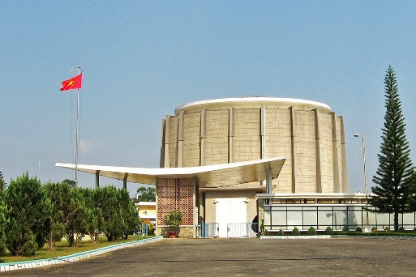
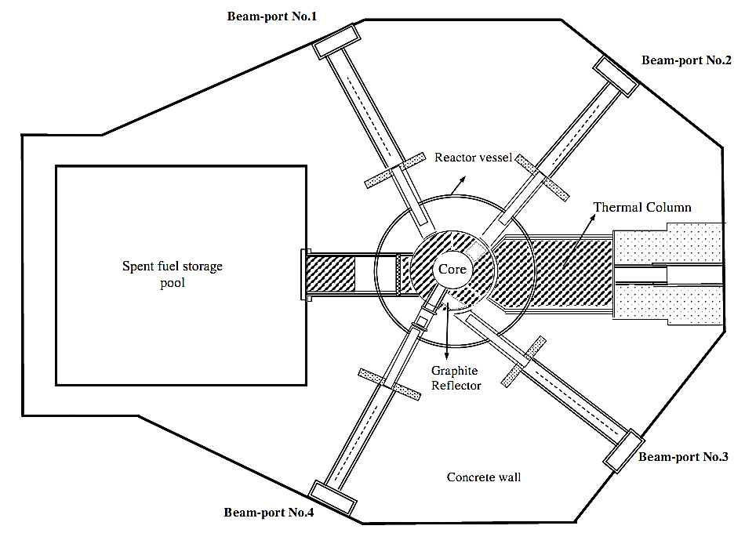
III. Experimental approaches for the (n,γ) reactions
NLD by thermal neutron capture data @ Dalat Reactor
Type: Pool type
Power: 500 kW
Coolant and moderator: Light water
Core cooling mechanism: Natural convection
Reflector: Beryllium and Graphite
Fuel type: VVR-M2, U-Al alloy, 36% enrichment
UO₂+Al, 19.75% enrichment
Control rods: 7 (2 safety rods, 4shim rods, 1 regulating rod)
Control rod material: B4C
Φ_{n} = 1.4 × 10⁶ (n.cm⁻².s⁻¹)

Slide 12
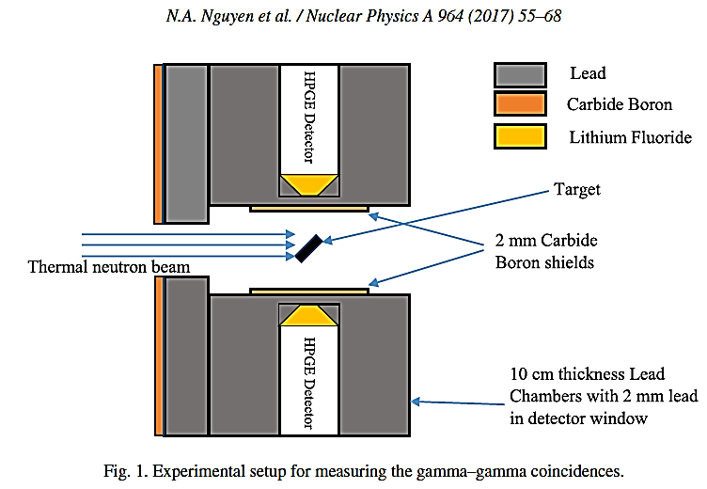
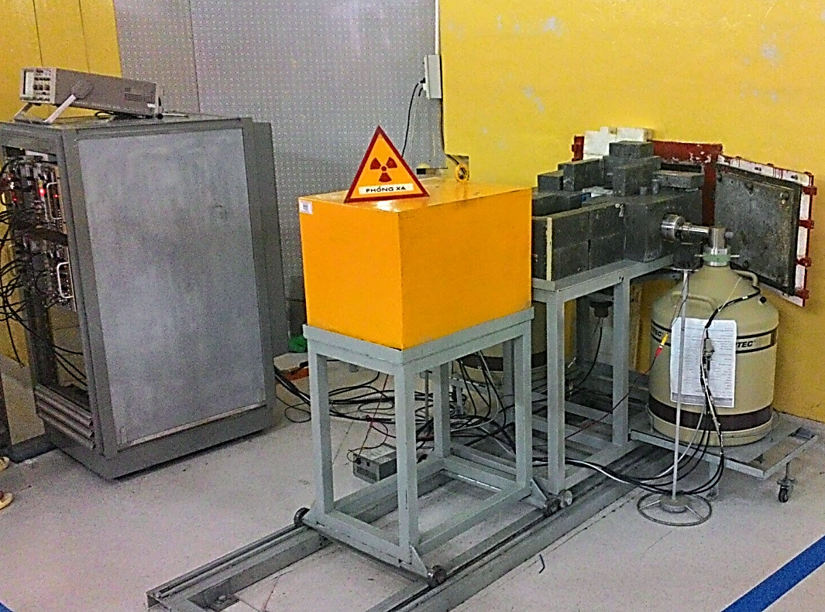
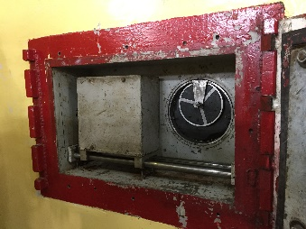
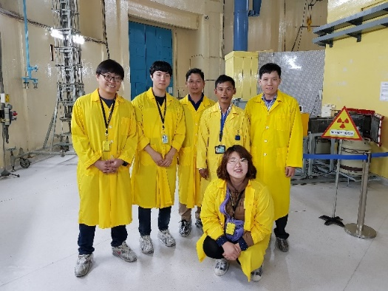
III. Experimental approaches for the (n,γ) reactions
Measurement of the ¹⁶³Dy(n,γ)¹⁶⁴Dy reactions @ Dalat Reactor
Φ_{n} = 1.4 × 10⁶ (n.cm⁻².s⁻¹)

Slide 13
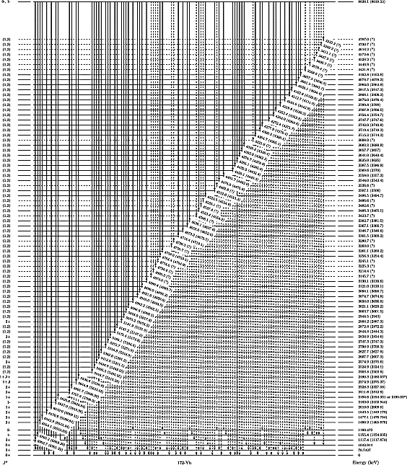
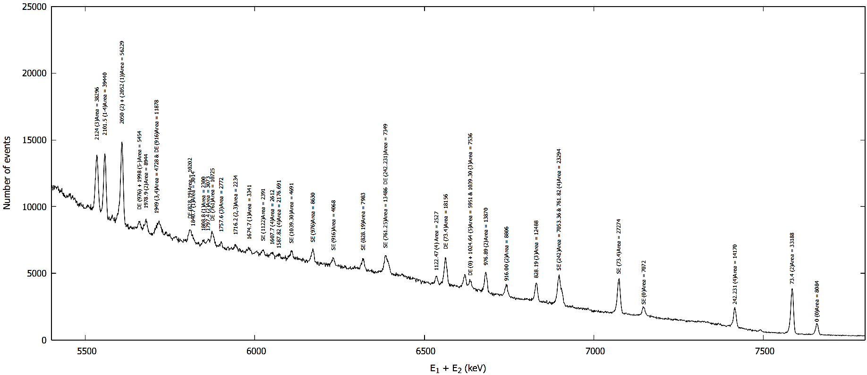
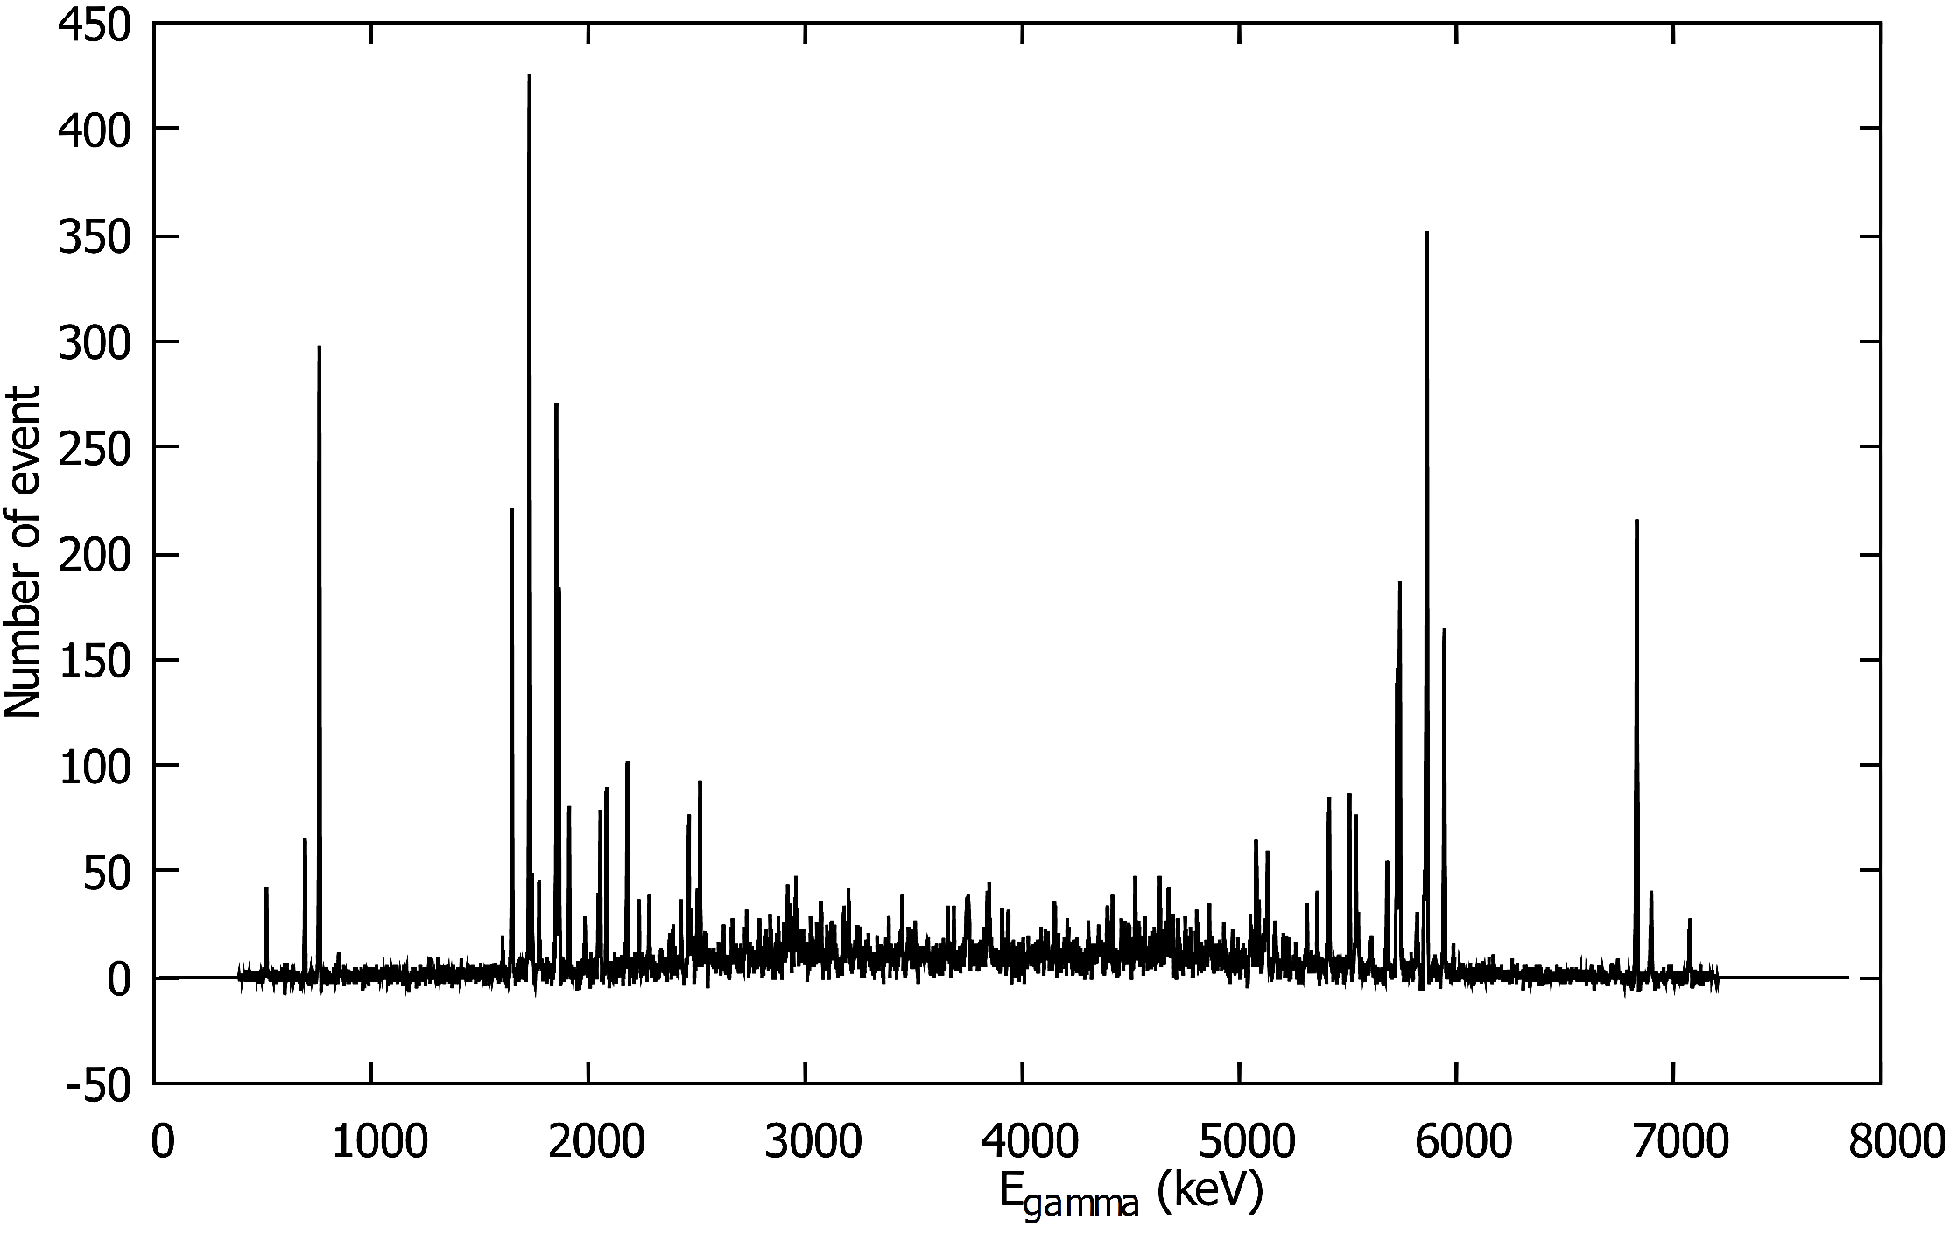
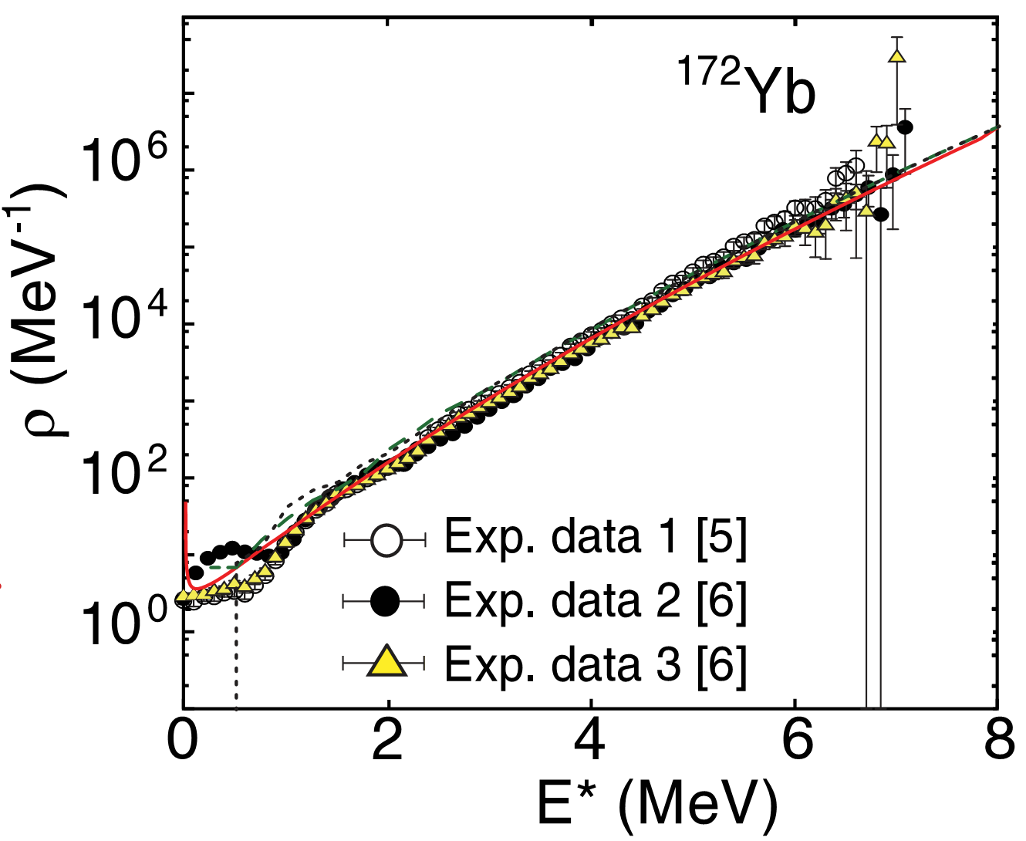
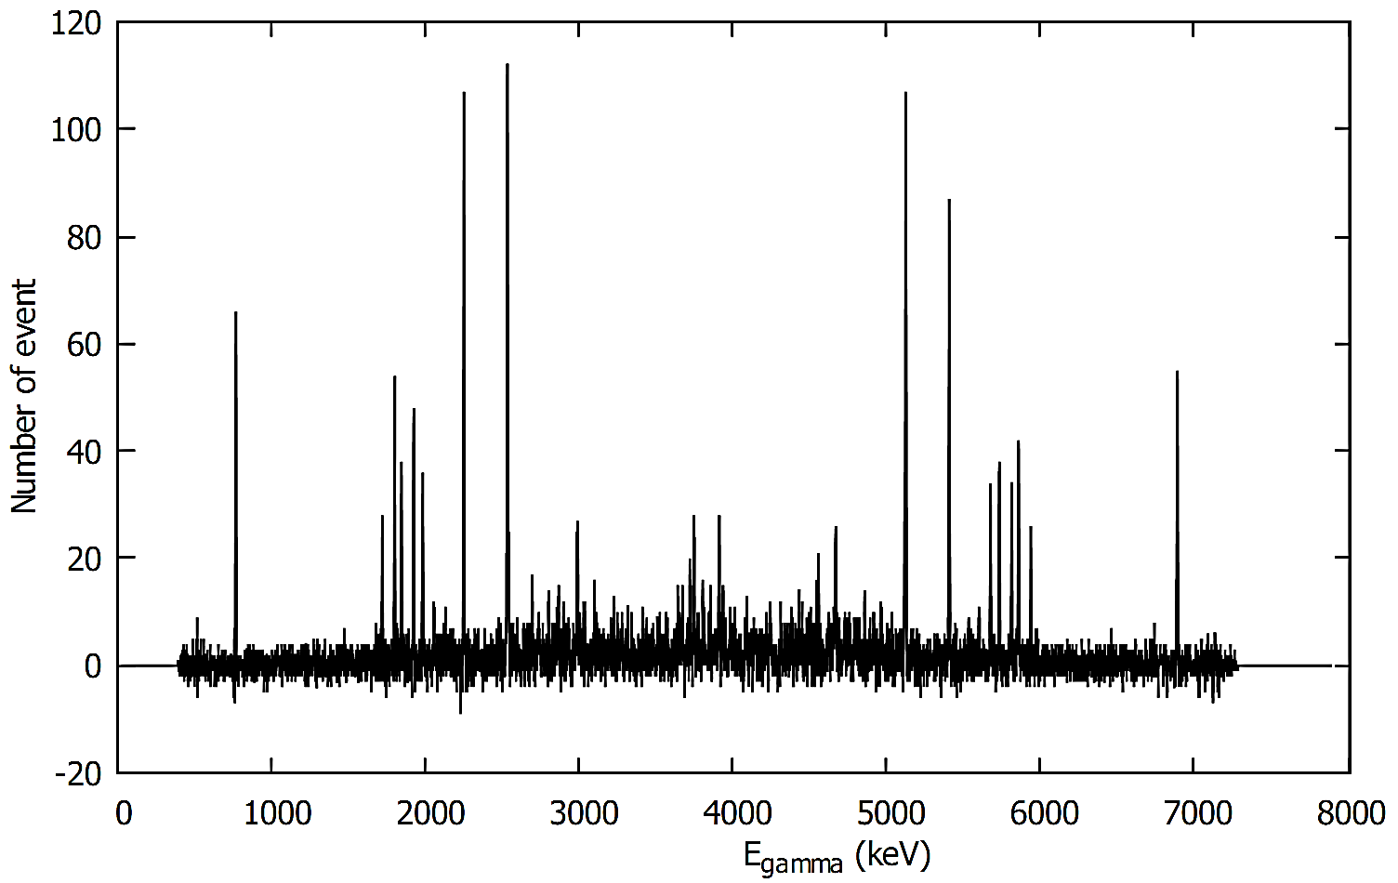
III. Experimental approaches for the (n,γ) reactions
Measurement of the ¹⁶³Dy(n,γ)¹⁶⁴Dy reactions @ Dalat Reactor
Preliminary results

Slide 14
IV. Summary and outlook
Neutron capture are important for s-process.
The (n,$γ$) reactions play important roles in modeling the stellar evolution and in the explanation of the final isotope abundance.
Experimental data of the (n,$γ$) reactions are highly demanded to reduce the uncertainty in calculations and improve the accuracy of the stellar reaction rates.
Neutron beams from both nuclear reactors and TOF facilities are necessary for the (n,$γ$) reactions related to astrophysics.
The average cross sections of (n,$γ$) reactions are being measured at Dalat Nuclear Reactor.
The nuclear level density or cross sections of the key (n,$γ$) reactions will be measured in near future.

Slide 15
Thank you for your attention!

Slide 16
Back up

Slide 17
