Slide 1
Simple interstellar cloud model for reproducing correlations between the chemical species
Jeongkwan Yoon (UNIST CAL)
3rd CHEA Workshop
Jan 16th, Gyeongju
Notes:
Thank you, professor. Hello, and good afternoon. My name is Jeongkwan Yoon, a graduate student of Computational Astrophysics Lab. In this session, I’ll talk about <Simple interstellar cloud model for reproducing correlations between the chemical species.>

Slide 2
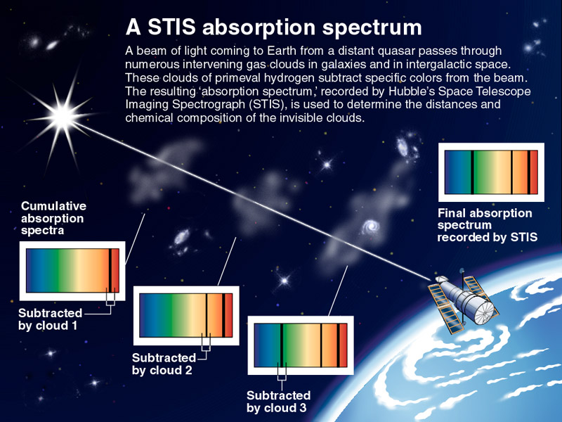
Backgrounds: Interstellar molecules
Notes:
Interstellar medium contains molecules. We can detect and estimate the number of each molecular species in certain directions as column density. These interstellar molecules are important because some species are predicted to be a meaningful factor for the star formation. Despite this importance, there is no clear idea for the origin of these interstellar molecules.

Slide 3
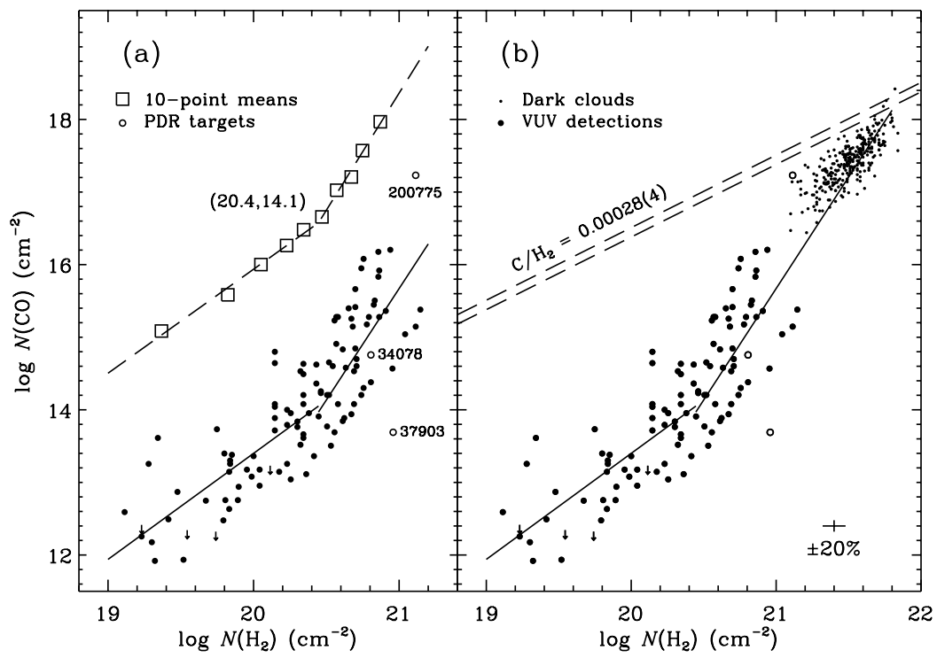
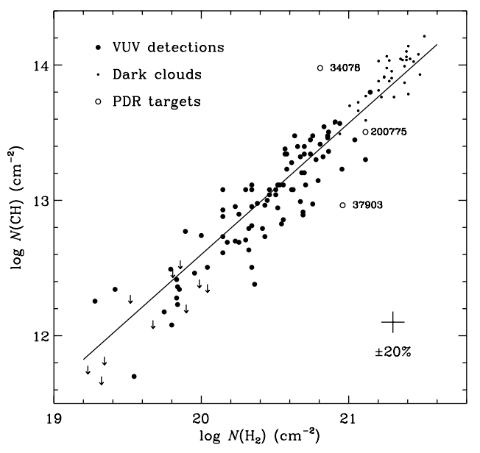
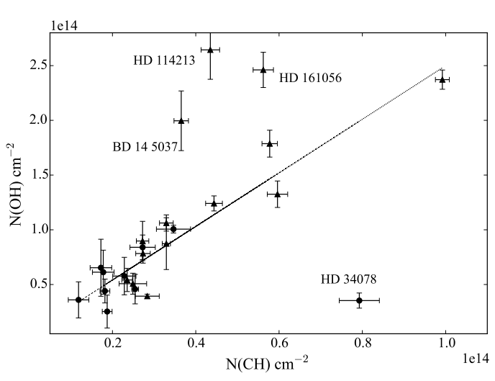
Backgrounds: correlations between molecules
(a)
(b)
(d)
(c)
(a,b) CO-H₂ correlation: $\log\left(N\left(CO\right)\right)=−24.4+1.89\log\left(N\left(H_{2}\right)\right)$ ^{[1]}
(c) CH-H₂ correlation: $\log\left(N\left(CH\right)\right)=−6.80+0.97\log\left(N\left(H_{2}\right)\right)$ ^{[1]}
(d) OH-CH correlation: $N\left(OH\right)=2.41N\left(CH\right)+8.55×{10}^{12}$ ^{[2]}
[1] Sheffer et al., ApJ, 2008
[2] Mookerjea, MNRAS, 2016
Notes:
Astronomers have found that some molecules have correlations with each other. These are examples of those correlations, some can be linear, others are exponential. In these figures, they are some examples of the correlations; CO-H2, CH-H2, and OH-CH correlation.

Slide 4
Backgrounds: reference cloud model “Model A”^{[2]}
Initial chemical states
Species | Abun.(/n(H))
H | 0.7
H₂ | 0.15
He | 0.14
C⁺ | 7.30e-5
N | 2.14e-5
O | 1.76e-4
e⁻ | 7.30e-5
Abundances in equilibrium state (partial)
Species | Abun.(/n(H*)) | Species | Abun.(/n(H*))
H | 0.986 | O | 1.76e-4
H₂ | 6.71e-3 | O₂ | 9.33e-14
H⁺ | 6.67e-4 | O⁺ | 6.54e-11
C | 2.24e-5 | CH | 6.85e-12
C₂ | 2.62e-14 | OH | 1.65e-11
C⁺ | 5.06e-5 | CO | 1.64e-11
Parameters for Ref. model
Parameter | Value
Density† | 500 /㎤
CRIR | 1.0e-14 /s
Extinction | 2.0 mag.
UV flux | 5.0 Draine‡
Temperature | 30 K
[2] Mookerjea, MNRAS, 2016
† We use n(H*), number of hydrogen nuclei in unit cube as a density
‡ “Standard” UV flux distribution of B.T. Draine, ApJS, 1978
Notes:
Then, it is possible to make an interstellar cloud model which supports a single correlation. Especially for linear correlation, there is a cloud model that satisfies the correlation at its equilibrium state. In this case, the “Model A” satisfies OH-CH correlation, column density of OH is equal to 2.41 times column density of CH. However, this model has a limitation that it supports only a single, OH-CH correlation and other correlations are not.

Slide 5
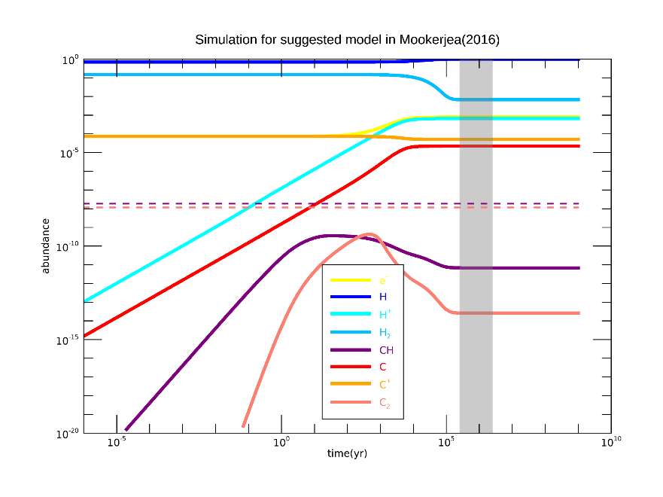
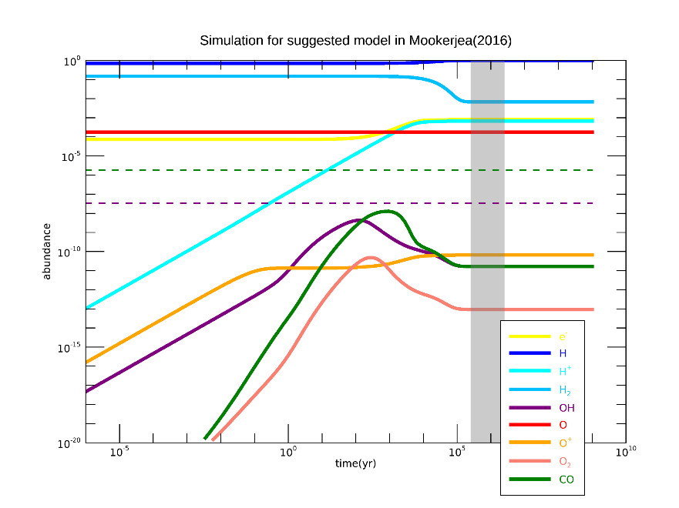
Backgrounds: Comparison to column densities
Notes:
There is another limitation for the existed model. When we try to explain column densities using this cloud model, it is impossible because it produces molecular species too low to fit current observation data. At the left figure, I marked the gap between observational data (dashed line) and the simulated reference model (solid line). From this comparison, We know that the existed cloud model is quite imperfect.

Slide 6
Motivation
Since there is no idea where interstellar molecules came from, there have been many attempts to reveal their origin.
Looking for a correlation between two specific species may give a hint to reveal the origin of ISM molecules.
When there is a cloud model that explains correlations between molecules and column densities, we may know an ancient state of ISM.
Notes:
This is the motivation for our work. when we succeed to make a cloud model that explains multiple correlations between molecules and column densities, we may know the ancient state of the interstellar medium.

Slide 7
Methods
Reform Model A for produce more molecular matter
Assumption: Single, homogeneous, static gas cloud
Use Astrochem^{[3]} as a simulator
Test cases
Various densities
Various temperature
[3] S. Maret& E. Bergin, ASCL, 2015
Notes:
We have tried to find the better cloud model from reforming the reference cloud model. Since we aimed to increase the abundance of molecular species, we have to accelerate the formation reactions of molecules, so we tried to increase density or temperature separately.

Slide 8
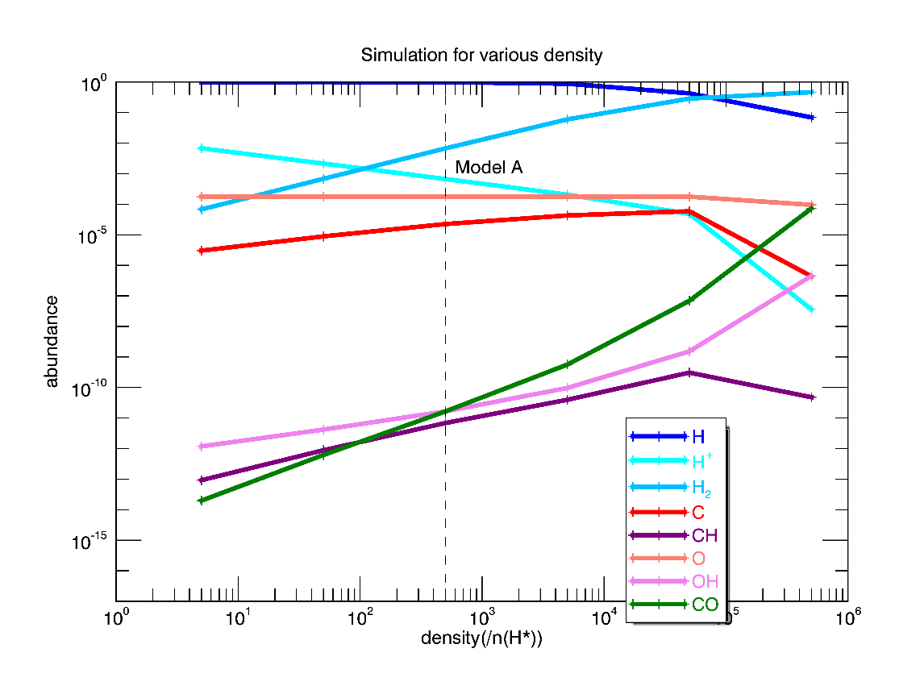
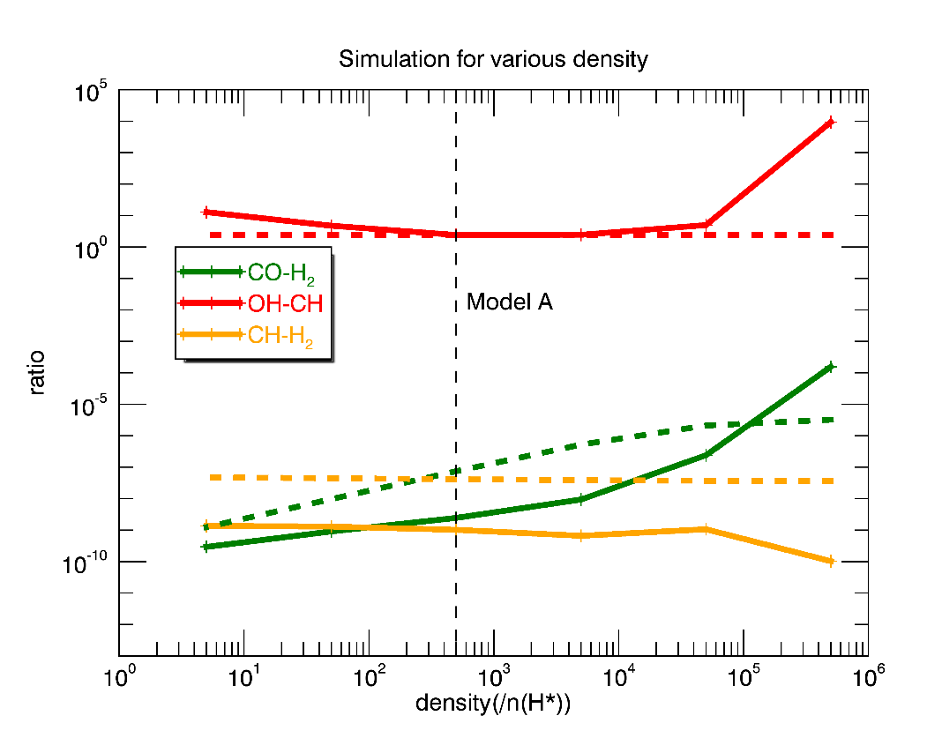
Results
1. Model A in various densities
Notes:
The first simulation set is trials with modified densities. There is no acceptable model to agree with two or more correlations simultaneously. Moreover, the amount of CH is still less than observed data, so CH-H2 correlation is still violated.

Slide 9
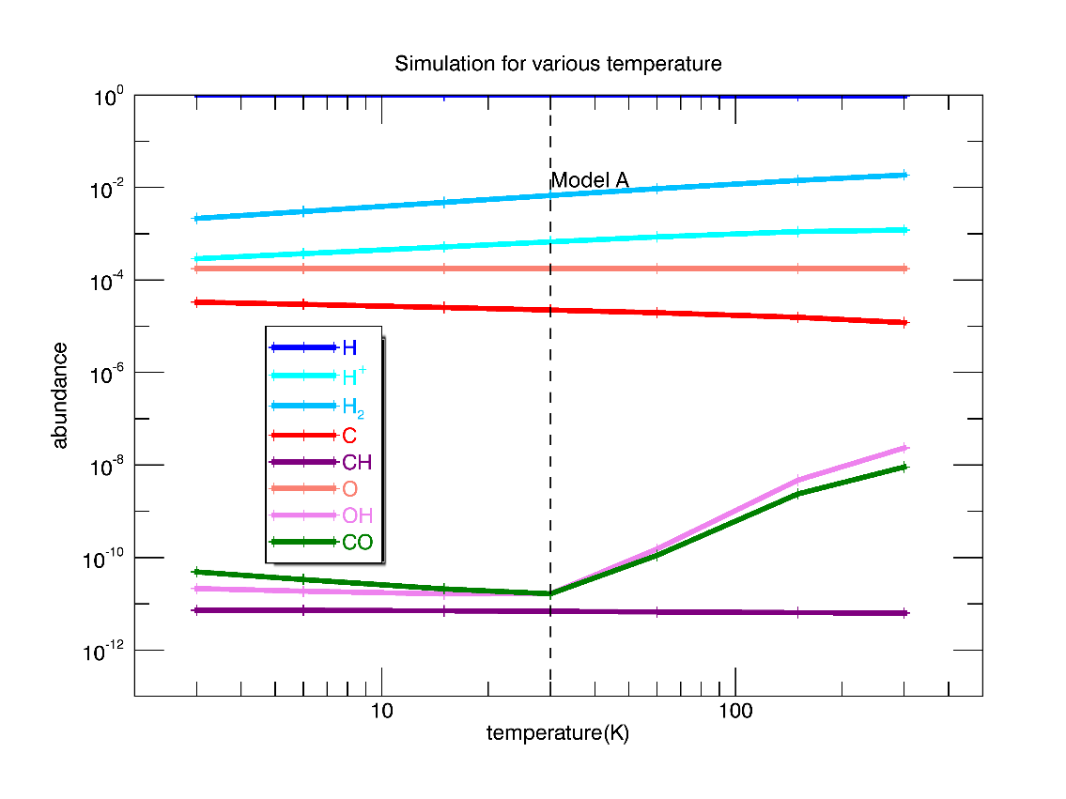
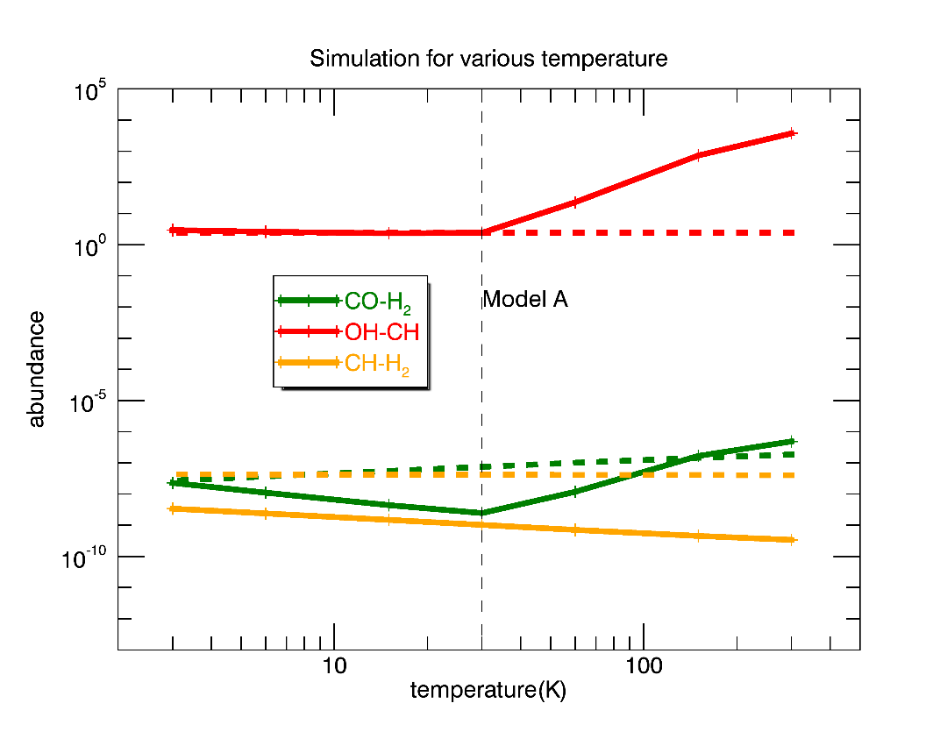
Results
2. Model A in various temperatures
T=3K
CO/H₂: 2.28 (2.69)
OH/CH: 2.93 (2.41)
Notes:
But in the second simulation set, with various temperatures, there is one cloud model which is the closest to the cloud that satisfies two correlations at the same state. When we adjust the temperature of the reference model from 30K into 3K, the ratio between CO and H2, OH and CH is quite close to the known correlation.

Slide 10
Future plans
Adjust other parameters to fit observational data
Other physical/environmental parameters also affect the chemical reactions in the model cloud.
Need to decrease the rates of dissociation reactions.
Add or change the initial chemical state
The suggested reference model does not contain all the elements found in the ISM so far.
Need to Start with the actually possible chemical state.
Notes:
Now, these are our future plans. First, we will try to adjust other parameters to fit known correlations and column densities.
Second, it is necessary to change the initial chemical state. In order to increase the molecular species, the amount of initial metallic elements is also key factor. Since initial abundances of carbon and oxygen in the reference model were smaller than the solar abundance, it is a reasonable trial to run a simulation with more amount of heavy elements.

Slide 11
Conclusion
Some ISM molecules have correlations and they give a clue for understanding the origin of ISM molecules.
There is a static interstellar cloud model which explains the correlation between certain two molecules. (e.g. OH & CH)
We have tried to reform a suggested interstellar cloud model to build a better cloud model which satisfies more correlations and column densities.
Notes:
Now, let's conclude this presentation.
Some interstellar molecules have correlations, and there is a static cloud model which explains the single correlation. We have tried to reform this kind of interstellar cloud model to build a cloud model which satisfies more correlations and column densities.
Thank you for attention.

